Slide 2
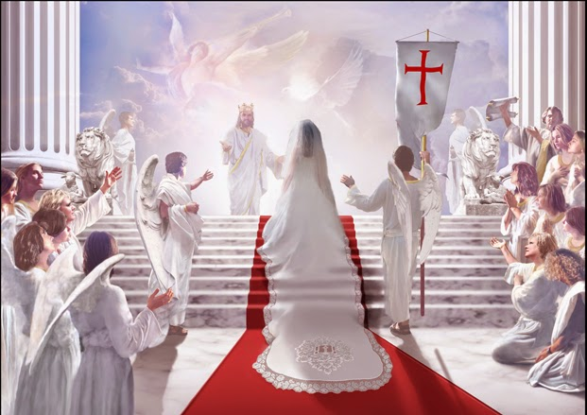
1 Corinthians 5:1-13
Honor the Church as Holy

Slide 3
I. Honor the church as holy by removing the unrepentant (verses 1-2)
“And if he refuses to listen even to the church, let him be to you as a Gentile and a tax collector.” Matthew 18:17
1 It is actually reported that there is sexual immorality among you, and of a kind that is not tolerated even among pagans, for a man has his father’s wife. 2 And you are arrogant! Ought you not rather to mourn? Let him who has done this be removed from among you.

Slide 4
I. Honor the church as holy by removing the unrepentant (verses 1-2)
1 It is actually reported that there is sexual immorality among you, and of a kind that is not tolerated even among pagans, for a man has his father’s wife. 2 And you are arrogant! Ought you not rather to mourn? Let him who has done this be removed from among you.
They should have mourned that this man’s unrepentant sexual immorality made the church Christ died for “so that he might present the church to himself in splendor, without spot or wrinkle or any such thing, that she might be holy and without blemish” (Ephesians 5:27) become defiled instead.

Slide 5
II. Honor the church as holy by preserving its redemptive aim (verses 3-8)
If the church truly is the body of Christ, and if “God did not send his Son into the world to condemn the world, but in order that the world might be saved through him,” (John 3:17), then the church - the body of Christ - must always share His redemptive aim.

Slide 6
II. Honor the church as holy by preserving its redemptive aim (verses 3-8)
…towards the unrepentant (3-5)
3 For though absent in body, I am present in spirit; and as if present, I have already pronounced judgment on the one who did such a thing. 4 When you are assembled in the name of the Lord Jesus and my spirit is present, with the power of our Lord Jesus, 5 you are to deliver this man to Satan for the destruction of the flesh, so that his spirit may be saved in the day of the Lord.

Slide 7
II. Honor the church as holy by preserving its redemptive aim (verses 3-8)
…towards the unrepentant (3-5)
3 For though absent in body, I am present in spirit; and as if present, I have already pronounced judgment on the one who did such a thing. 4 When you are assembled in the name of the Lord Jesus and my spirit is present, with the power of our Lord Jesus, 5 you are to deliver this man to Satan for the destruction of the flesh, so that his spirit may be saved in the day of the Lord.
“And the Lord said to Satan, ‘Behold, he is in your hand; only spare his life.’” Job 2:6

Slide 8
II. Honor the church as holy by preserving its redemptive aim (verses 3-8)
…towards the unrepentant (3-5)
3 For though absent in body, I am present in spirit; and as if present, I have already pronounced judgment on the one who did such a thing. 4 When you are assembled in the name of the Lord Jesus and my spirit is present, with the power of our Lord Jesus, 5 you are to deliver this man to Satan for the destruction of the flesh, so that his spirit may be saved in the day of the Lord.
“Hymenaeus and Alexander, whom I have handed over to Satan that they may learn not to blaspheme.” 1 Timothy 1:20

Slide 9
II. Honor the church as holy by preserving its redemptive aim (verses 3-8)
…towards the unrepentant (3-5)
“Paul wants Satan to have free play over this man until he wallows so much in his sinful nature, with its undesirable and degrading effects, that like the prodigal son he will remember the joy and peace he had once experienced as a baptized and confessing Christian in the fellowship of believers; then perhaps he will seek to return to Christ and his church through genuine repentance.” Expositors Bible Commentary

Slide 10
II. Honor the church as holy by preserving its redemptive aim (verses 3-8)
…towards the whole body (6-8)
6 Your boasting is not good. Do you not know that a little leaven leavens the whole lump? 7 Cleanse out the old leaven that you may be a new lump, as you really are unleavened. For Christ, our Passover lamb, has been sacrificed. 8 Let us therefore celebrate the festival, not with the old leaven, the leaven of malice and evil, but with the unleavened bread of sincerity and truth.

Slide 11
II. Honor the church as holy by preserving its redemptive aim (verses 3-8)
…towards the whole body (6-8)
6 Your boasting is not good. Do you not know that a little leaven leavens the whole lump? 7 Cleanse out the old leaven that you may be a new lump, as you really are unleavened. For Christ, our Passover lamb, has been sacrificed. 8 Let us therefore celebrate the festival, not with the old leaven, the leaven of malice and evil, but with the unleavened bread of sincerity and truth.

Slide 12
II. Honor the church as holy by preserving its redemptive aim (verses 3-8)
…towards the whole body (6-8)
6 Your boasting is not good. Do you not know that a little leaven leavens the whole lump? 7 Cleanse out the old leaven that you may be a new lump, as you really are unleavened. For Christ, our Passover lamb, has been sacrificed. 8 Let us therefore celebrate the festival, not with the old leaven, the leaven of malice and evil, but with the unleavened bread of sincerity and truth.

Slide 13
Christ died to make us become a radiant bride “in splendor, without spot or wrinkle or any such thing, that she might be holy and without blemish” (Ephesians 5:27).

Slide 14
III. Honor the church as holy by honoring its mission (verses 9-13)
9 I wrote to you in my letter not to associate with sexually immoral people— 10 not at all meaning the sexually immoral of this world, or the greedy and swindlers, or idolaters, since then you would need to go out of the world.

Slide 15
III. Honor the church as holy by honoring its mission (verses 9-13)
11 But now I am writing to you not to associate with anyone who bears the name of brother if he is guilty of sexual immorality or greed, or is an idolater, reviler, drunkard, or swindler—not even to eat with such a one. 12 For what have I to do with judging outsiders? Is it not those inside the church whom you are to judge? 13 God judges those outside. “Purge the evil person from among you.”

Slide 16
III. Honor the church as holy by honoring its mission (verses 9-13)
11 But now I am writing to you not to associate with anyone who bears the name of brother if he is guilty of sexual immorality or greed, or is an idolater, reviler, drunkard, or swindler—not even to eat with such a one. 12 For what have I to do with judging outsiders? Is it not those inside the church whom you are to judge? 13 God judges those outside. “Purge the evil person from among you.”

Slide 17
III. Honor the church as holy by honoring its mission (verses 9-13)
11 But now I am writing to you not to associate with anyone who bears the name of brother if he is guilty of sexual immorality or greed, or is an idolater, reviler, drunkard, or swindler—not even to eat with such a one. 12 For what have I to do with judging outsiders? Is it not those inside the church whom you are to judge? 13 God judges those outside. “Purge the evil person from among you.”

