Slide 1
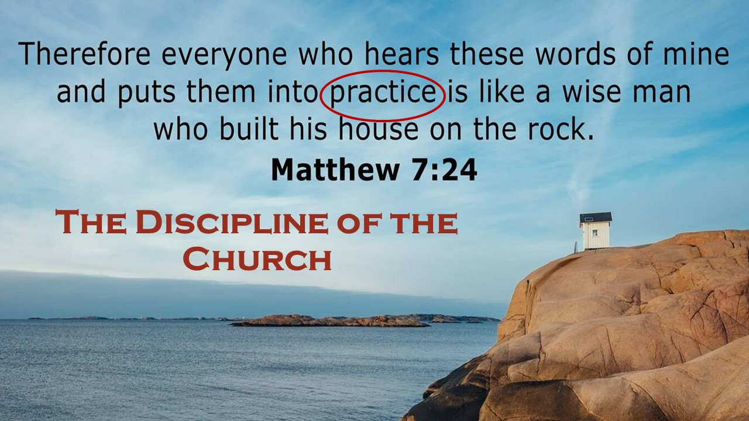

Slide 2
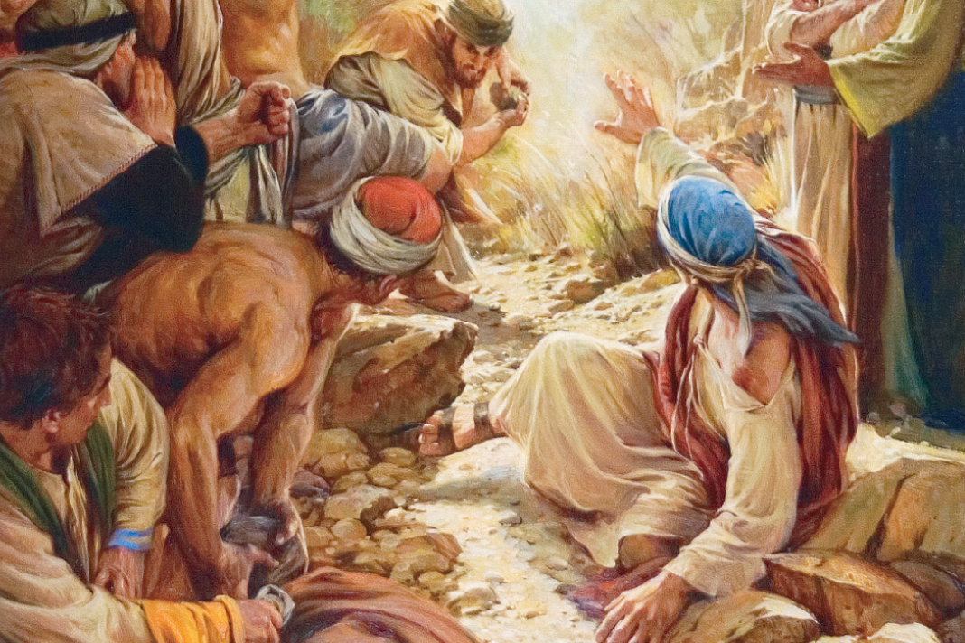
Suffer Faithfully
1 Peter 5:1-11

Slide 3
Suffer Faithfully
1 Peter 5:1-11
“Beloved, do not be surprised at the fiery trial when it comes upon you to test you, as though something strange were happening to you. But rejoice insofar as you share Christ’s sufferings, that you may also rejoice and be glad when his glory is revealed.” 1 Peter 4:12-13
“Therefore let those who suffer according to God’s will entrust their souls to a faithful Creator while doing good.” 1 Peter 4:19

Slide 4
I. Church leaders suffer faithfully by serving with good motives (Verses 1-4)
1 So I exhort the elders among you, as a fellow elder and a witness of the sufferings of Christ, as well as a partaker in the glory that is going to be revealed: 2 shepherd the flock of God that is among you, exercising oversight, not under compulsion, but willingly, as God would have you; not for shameful gain, but eagerly; 3 not domineering over those in your charge, but being examples to the flock.

Slide 5
I. Church leaders suffer faithfully by serving with good motives (Verses 1-4)
1 So I exhort the elders among you, as a fellow elder and a witness of the sufferings of Christ, as well as a partaker in the glory that is going to be revealed: 2 shepherd the flock of God that is among you, exercising oversight, not under compulsion, but willingly, as God would have you; not for shameful gain, but eagerly; 3 not domineering over those in your charge, but being examples to the flock.

Slide 6
I. Church leaders suffer faithfully by serving with good motives (Verses 1-4)
4 And when the chief Shepherd appears, you will receive the unfading crown of glory.
“this light momentary affliction is preparing for us an eternal weight of glory beyond all comparison…” 2 Corinthians 4:17

Slide 7
II. The whole flock suffers faithfully by walking humbly… (Verses 5-7)
…with one another (5)
5 Likewise, you who are younger, be subject to the elders. Clothe yourselves, all of you, with humility toward one another, for “God opposes the proud but gives grace to the humble.”

Slide 8
II. The whole flock suffers faithfully by walking humbly… (Verses 5-7)
…with one another (5)
5 Likewise, you who are younger, be subject to the elders. Clothe yourselves, all of you, with humility toward one another, for “God opposes the proud but gives grace to the humble.”
“One is justified in calling humility the ‘law of the community.’” Daryl Charles in his commentary on verse 5

Slide 9
II. The whole flock suffers faithfully by walking humbly… (Verses 5-7)
…with one another (5)
5 Likewise, you who are younger, be subject to the elders. Clothe yourselves, all of you, with humility toward one another, for “God opposes the proud but gives grace to the humble.”
“One is justified in calling humility the ‘law of the community.’” Daryl Charles in his commentary on verse 5

Slide 10
II. The whole flock suffers faithfully by walking humbly… (Verses 5-7)
…before God (5b-7)
5 …“God opposes the proud but gives grace to the humble.”
6 Humble yourselves, therefore, under the mighty hand of God so that at the proper time he may exalt you, 7 casting all your anxieties on him, because he cares for you.

Slide 11
II. The whole flock suffers faithfully by walking humbly… (Verses 5-7)
…before God (5b-7)
5 …“God opposes the proud but gives grace to the humble.”
6 Humble yourselves, therefore, under the mighty hand of God so that at the proper time he may exalt you, 7 casting all your anxieties on him, because he cares for you.

Slide 12
II. The whole flock suffers faithfully by walking humbly… (Verses 5-7)
…before God (5b-7)
5 …“God opposes the proud but gives grace to the humble.”
6 Humble yourselves, therefore, under the mighty hand of God so that at the proper time he may exalt you, 7 casting all your anxieties on him, because he cares for you.

Slide 13
III. The whole flock suffers faithfully by embracing sufferings’ eternal purpose (Verses 8-11)
Embracing sufferings’ eternal purpose entails resisting the devil’s aims to devour our faith in this purpose (8-9)
8 Be sober-minded; be watchful. Your adversary the devil prowls around like a roaring lion, seeking someone to devour. 9 Resist him, firm in your faith, knowing that the same kinds of suffering are being experienced by your brotherhood throughout the world.

Slide 14
III. The whole flock suffers faithfully by embracing sufferings’ eternal purpose (Verses 8-11)
Embracing sufferings’ eternal purpose entails resisting the devil’s aims to devour our faith in this purpose (8-9)
8 Be sober-minded; be watchful. Your adversary the devil prowls around like a roaring lion, seeking someone to devour. 9 Resist him, firm in your faith, knowing that the same kinds of suffering are being experienced by your brotherhood throughout the world.
“Does Job fear God for no reason?” Job 1:9
“But stretch out your hand and touch all that he has, and he will curse you to your face.” Job 1:11

Slide 15
III. The whole flock suffers faithfully by embracing sufferings’ eternal purpose (Verses 8-11)
Embracing sufferings’ eternal purpose entails resisting the devil’s aims to devour our faith in this purpose (8-9)
9 Resist him, firm in your faith, knowing that the same kinds of suffering are being experienced* by your brotherhood throughout the world.
9 But resist him, firm in your faith, knowing that the same experiences of suffering are being accomplished by your brethren who are in the world.
* “to cause something to happen as fulfillment of an objective or purpose.”

Slide 16
III. The whole flock suffers faithfully by embracing sufferings’ eternal purpose (Verses 8-11)
Embracing sufferings’ eternal purpose entails entrusting our souls to a faithful Creator (10-11, 4:19)
10 And after you have suffered a little while, the God of all grace, who has called you to his eternal glory in Christ, will himself restore, confirm, strengthen, and establish you. 11 To him be the dominion forever and ever. Amen.

Slide 17
III. The whole flock suffers faithfully by embracing sufferings’ eternal purpose (Verses 8-11)
Embracing sufferings’ eternal purpose entails entrusting our souls to a faithful Creator (10-11, 4:19)
10 And after you have suffered a little while, the God of all grace, who has called you to his eternal glory in Christ, will himself restore, confirm, strengthen, and establish you. 11 To him be the dominion forever and ever. Amen.

Slide 18
IV. Suffer like Jesus; Suffer Faithfully
WWJD?
“…if when you do good and suffer for it you endure, this is a gracious thing in the sight of God. For to this you have been called, because Christ also suffered for you, leaving you an example, so that you might follow in his steps. He committed no sin, neither was deceit found in his mouth. When he was reviled, he did not revile in return; when he suffered, he did not threaten, but continued entrusting himself to him who judges justly.” 1 Peter 2:20-23

Slide 19
IV. Suffer like Jesus; Suffer Faithfully
“…if when you do good and suffer for it you endure, this is a gracious thing in the sight of God. For to this you have been called, because Christ also suffered for you, leaving you an example, so that you might follow in his steps. He committed no sin, neither was deceit found in his mouth. When he was reviled, he did not revile in return; when he suffered, he did not threaten, but continued entrusting himself to him who judges justly.” 1 Peter 2:20-23

Slide 20
IV. Suffer like Jesus; Suffer Faithfully
“…if when you do good and suffer for it you endure, this is a gracious thing in the sight of God. For to this you have been called, because Christ also suffered for you, leaving you an example, so that you might follow in his steps. He committed no sin, neither was deceit found in his mouth. When he was reviled, he did not revile in return; when he suffered, he did not threaten, but continued entrusting himself to him who judges justly.” 1 Peter 2:20-23
To follow Jesus’ example in suffering faithfully is to embrace “an eternal weight of glory beyond all comparison.” 2 Corinthians 4:17

