Slide 1
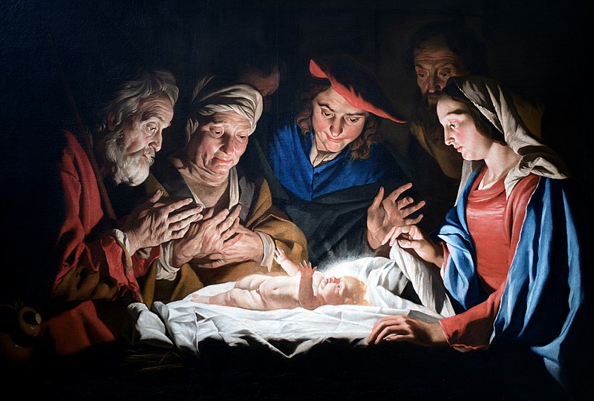
The Child of Promise

Slide 2
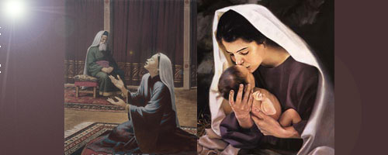
A Child of Promise, A Woman of Grace
1 Samuel 1:9-20

Slide 3
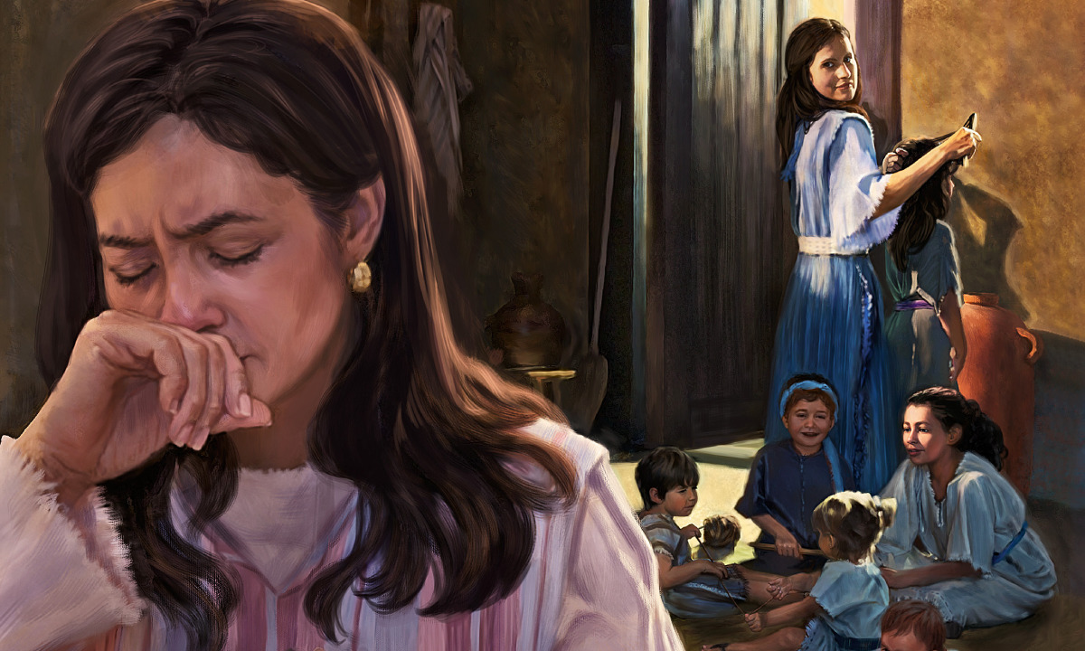
“…the Lord had closed her womb. And her rival used to provoke her grievously to irritate her, because the Lord had closed her womb. So, it went on year by year. As often as she went up to the house of the Lord, she used to provoke her.” 1 Samuel 1:5-7

Slide 4
A Child of Promise, A Woman of Grace
1 Samuel 1:9-20

Slide 5
I. Hannah prayed to the Lord to open her womb (verses 9-11)
9 After they had eaten and drunk in Shiloh, Hannah rose. Now Eli the priest was sitting on the seat beside the doorpost of the temple of the Lord. 10 She was deeply distressed and prayed to the Lord and wept bitterly. 11 And she vowed a vow and said, “O Lord of hosts, if you will indeed look on the affliction of your servant and remember me and not forget your servant, but will give to your servant a son, then I will give him to the Lord all the days of his life, and no razor shall touch his head.”

Slide 6
I. Hannah prayed to the Lord to open her womb (verses 9-11)
9 After they had eaten and drunk in Shiloh, Hannah rose. Now Eli the priest was sitting on the seat beside the doorpost of the temple of the Lord. 10 She was deeply distressed and prayed to the Lord and wept bitterly. 11 And she vowed a vow and said, “O Lord of hosts, if you will indeed look on the affliction of your servant and remember me and not forget your servant, but will give to your servant a son, then I will give him to the Lord all the days of his life, and no razor shall touch his head.”

Slide 7
I. Hannah prayed to the Lord to open her womb (verses 9-11)
9 After they had eaten and drunk in Shiloh, Hannah rose. Now Eli the priest was sitting on the seat beside the doorpost of the temple of the Lord. 10 She was deeply distressed and prayed to the Lord and wept bitterly. 11 And she vowed a vow and said, “O Lord of hosts, if you will indeed look on the affliction of your servant and remember me and not forget your servant, but will give to your servant a son, then I will give him to the Lord all the days of his life, and no razor shall touch his head.”

Slide 8
II. Hannah poured out her soul to the Lord to bring peace to her troubled spirit (Verses 12-18)
12 As she continued praying before the Lord, Eli observed her mouth. 13 Hannah was speaking in her heart; only her lips moved, and her voice was not heard. Therefore Eli took her to be a drunken woman. 14 And Eli said to her, “How long will you go on being drunk? Put your wine away from you.”

Slide 9
II. Hannah poured out her soul to the Lord to bring peace to her troubled spirit (Verses 12-18)
“He was a man who watched lips instead of perceiving hearts, who judged profound spirituality to be profligate indulgence in spirits,﻿﻿ who heard nothing when the Lord spoke (1 Sam 3:4, 6), and who criticized his sons for abusing the sacrificial system yet grew fat from their take (2:22–24; 4:18). Fittingly, in the end his powerful career was surpassed by those who were ‘nothing’—a socially powerless rural woman and a child.” Robert Bergen, New American Commentary

Slide 10
II. Hannah poured out her soul to the Lord to bring peace to her troubled spirit (Verses 12-18)
12 As she continued praying before the Lord, Eli observed her mouth. 13 Hannah was speaking in her heart; only her lips moved, and her voice was not heard. Therefore Eli took her to be a drunken woman. 14 And Eli said to her, “How long will you go on being drunk? Put your wine away from you.”

Slide 11
II. Hannah poured out her soul to the Lord to bring peace to her troubled spirit (Verses 12-18)
15 But Hannah answered, “No, my lord, I am a woman troubled in spirit. I have drunk neither wine nor strong drink, but I have been pouring out my soul before the Lord. 16 Do not regard your servant as a worthless woman, for all along I have been speaking out of my great anxiety and vexation.”

Slide 12
II. Hannah poured out her soul to the Lord to bring peace to her troubled spirit (Verses 12-18)
17 Then Eli answered, “Go in peace, and the God of Israel grant your petition that you have made to him.” 18 And she said, “Let your servant find favor in your eyes.” Then the woman went her way and ate, and her face was no longer sad.

Slide 13
III. The Lord remembered Hannah through the son she asked for (Verses 19-20)
19 They rose early in the morning and worshiped before the Lord; then they went back to their house at Ramah. And Elkanah knew Hannah his wife, and the Lord remembered her. 20 And in due time Hannah conceived and bore a son, and she called his name Samuel, for she said, “I have asked for him from the Lord.”
Samuel is spelled שְׁמוּאֵ֔ל
“to ask” is spelled שָׁאַל

Slide 14
IV. God would use Samuel to set in motion the coming of the King of kings! (1 Samuel 16:1-13, 2 Samuel 7:8-16 & Luke 1:26-33)
“The barren has borne seven, but she who has many children is forlorn.” 1 Samuel 2:5

Slide 15
IV. God would use Samuel to set in motion the coming of the King of kings! (1 Samuel 16:1-13, 2 Samuel 7:8-16 & Luke 1:26-33)
Samuel would anoint David as king over Israel (1 Samuel 16:1-13)
1 Samuel 16
“When they came, he looked on Eliab and thought, ‘Surely the Lord’s anointed is before him.’ But the Lord said to Samuel, ‘Do not look on his appearance or on the height of his stature, because I have rejected him. For the Lord sees not as man sees: man looks on the outward appearance, but the Lord looks on the heart.’” Verses 6-7
And the Lord said, “Arise, anoint him, for this is he.” Then Samuel took the horn of oil and anointed him in the midst of his brothers. And the Spirit of the Lord rushed upon David from that day forward. Verses 12-13

Slide 16
IV. God would use Samuel to set in motion the coming of the King of kings! (1 Samuel 16:1-13, 2 Samuel 7:8-16 & Luke 1:26-33)
David’s throne and kingdom would be established forever (2 Samuel 7:8-16)
2 Samuel 7
“And your house and your kingdom shall be made sure forever before me. Your throne shall be established forever.” verse 16

Slide 17
IV. God would use Samuel to set in motion the coming of the King of kings! (1 Samuel 16:1-13, 2 Samuel 7:8-16 & Luke 1:26-33)
The Lord would give Jesus David’s throne and kingdom to reign forever (Luke 1:26-33)
Luke 1
“And behold, you will conceive in your womb and bear a son, and you shall call his name Jesus. He will be great and will be called the Son of the Most High. And the Lord God will give to him the throne of his father David, and he will reign over the house of Jacob forever, and of his kingdom there will be no end.” Luke 1:31-33

