Slide 1
Renewed day-by-day
A Sermon Series from 2nd Corinthians

Slide 2
2 Corinthians 11:1-15
The gospel according to antichrist – part 1

Slide 3
I. The spirit of antichrist will distort the gospel by distorting the truth about Jesus (verses 1-4)
In 1 John 4:3, John writes that “every spirit that does not confess Jesus is not from God. This is the spirit of the antichrist…” The spirit of antichrist is the Satanic counterpart of the Holy Spirit which seeks to influence people to follow “the prince of the power of the air, the spirit that is now at work in the sons of disobedience” as Paul writes in Ephesians 2:2.

Slide 4
I. The spirit of antichrist will distort the gospel by distorting the truth about Jesus (verses 1-4)
1 I wish you would bear with me in a little foolishness. Do bear with me!
16 I repeat, let no one think me foolish. But even if you do, accept me as a fool, so that I too may boast a little.

Slide 5
I. The spirit of antichrist will distort the gospel by distorting the truth about Jesus (verses 1-4)
2 For I feel a divine jealousy for you, since I betrothed you to one husband, to present you as a pure virgin to Christ. 3 But I am afraid that as the serpent deceived Eve by his cunning, your thoughts will be led astray from a sincere and pure devotion to Christ.

Slide 6
I. The spirit of antichrist will distort the gospel by distorting the truth about Jesus (verses 1-4)
2 For I feel a divine jealousy for you, since I betrothed you to one husband, to present you as a pure virgin to Christ. 3 But I am afraid that as the serpent deceived Eve by his cunning, your thoughts will be led astray from a sincere and pure devotion to Christ.

Slide 7
I. The spirit of antichrist will distort the gospel by distorting the truth about Jesus (verses 1-4)
4 For if someone comes and proclaims another Jesus than the one we proclaimed, or if you receive a different spirit from the one you received, or if you accept a different gospel from the one you accepted, you put up with it readily enough.
4 …you bear this beautifully! NASB
1 I wish you would bear with me in a little foolishness. Do bear with me!

Slide 8
I. The spirit of antichrist will distort the gospel by distorting the truth about Jesus (verses 1-4)
4 For if someone comes and proclaims another Jesus than the one we proclaimed, or if you receive a different spirit from the one you received, or if you accept a different gospel from the one you accepted, you put up with it readily enough.
“He was oppressed, and he was afflicted, yet he opened not his mouth; like a lamb that is led to the slaughter, and like a sheep that before its shearers is silent, so he opened not his mouth” Isaiah 53:7

Slide 9
II. The spirit of antichrist will distort the gospel by exalting pride above humility (verses 5-9)
5 Indeed, I consider that I am not in the least inferior to these super-apostles. 6 Even if I am unskilled in speaking, I am not so in knowledge; indeed, in every way we have made this plain to you in all things.

Slide 10
II. The spirit of antichrist will distort the gospel by exalting pride above humility (verses 5-9)
5 Indeed, I consider that I am not in the least inferior to these super-apostles. 6 Even if I am unskilled in speaking, I am not so in knowledge; indeed, in every way we have made this plain to you in all things.

Slide 11
II. The spirit of antichrist will distort the gospel by exalting pride above humility (verses 5-9)
7 Or did I commit a sin in humbling myself so that you might be exalted, because I preached God’s gospel to you free of charge? 8 I robbed other churches by accepting support from them in order to serve you. 9 And when I was with you and was in need, I did not burden anyone, for the brothers who came from Macedonia supplied my need. So I refrained and will refrain from burdening you in any way.

Slide 12
II. The spirit of antichrist will distort the gospel by exalting pride above humility (verses 5-9)
“Their basic problem is that they have allowed the values of their culture to shape their understanding of the faith and community practice, and they lack the knowledge of God that exposes those values as foolish.” Dave Garland

Slide 13
II. The spirit of antichrist will distort the gospel by exalting pride above humility (verses 5-9)
7 Or did I commit a sin in humbling myself so that you might be exalted, because I preached God’s gospel to you free of charge?
“If we have sown spiritual things among you, is it too much if we reap material things from you? If others share this rightful claim on you, do not we even more? Nevertheless, we have not made use of this right, but we endure anything rather than put an obstacle in the way of the gospel of Christ.” 1 Corinthians 9:11-12

Slide 14
III. The spirit of antichrist will distort the gospel through appealing counterfeits (verses 10-15)
10 As the truth of Christ is in me, this boasting of mine will not be silenced in the regions of Achaia. 11 And why? Because I do not love you? God knows I do! 12 And what I am doing I will continue to do, in order to undermine the claim of those who would like to claim that in their boasted mission they work on the same terms as we do.

Slide 15
III. The spirit of antichrist will distort the gospel through appealing counterfeits (verses 10-15)
10 As the truth of Christ is in me, this boasting of mine will not be silenced in the regions of Achaia. 11 And why? Because I do not love you? God knows I do! 12 And what I am doing I will continue to do, in order to undermine the claim of those who would like to claim that in their boasted mission they work on the same terms as we do.
“I have become all things to all people, that by all means I might save some. I do it all for the sake of the gospel, that I may share with them in its blessings.” 1 Corinthians 9:22-23

Slide 16
III. The spirit of antichrist will distort the gospel through appealing counterfeits (verses 10-15)
13 For such men are false apostles, deceitful workmen, disguising themselves as apostles of Christ. 14 And no wonder, for even Satan disguises himself as an angel of light. 15 So it is no surprise if his servants, also, disguise themselves as servants of righteousness. Their end will correspond to their deeds.

Slide 17
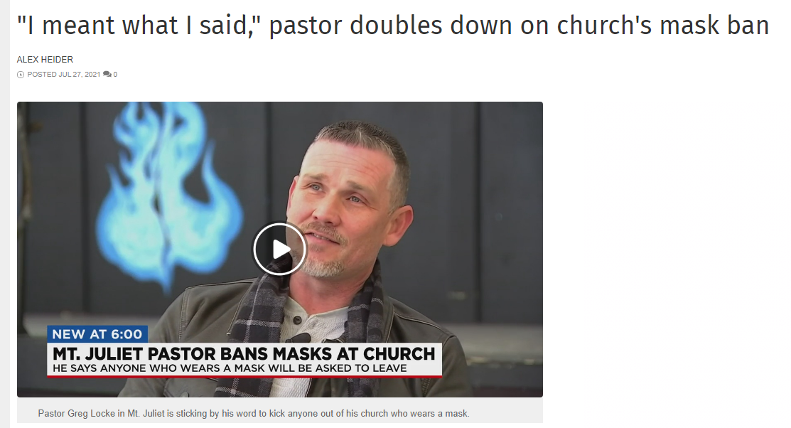
IV. The take aways for us
Keep Jesus at the center of the gospel
“We will escort you to the door”

Slide 18
IV. The take aways for us
Remember that the mark of the antichrist is an arrogant, boastful spirit
“I looked then because of the sound of the great words that the horn was speaking, (Daniel 7:11) the horn that had eyes and a mouth that spoke great things” (Daniel 7:20).
“He shall speak words against the Most High.” Daniel 7:25
The gospel we believe will be revealed by the examples of the people we endorse, celebrate, and emulate.

Slide 19
IV. The take aways for us
Respect the powerful appeal of Satanic counterfeits
“For false christs and false prophets will arise and perform great signs and wonders, so as to lead astray, if possible, even the elect. See, I have told you beforehand.” Matthew 24:24-25
Just as people whose work entails detecting counterfeits by being thoroughly familiar with the real thing, we need to spend our lives, as Paul indicates we should in verse 3, to a sincere and pure devotion to Christ; to a sincere and pure devotion to the real thing.

