Slide 1
Renewed day-by-day
A Sermon Series from 2nd Corinthians

Slide 2
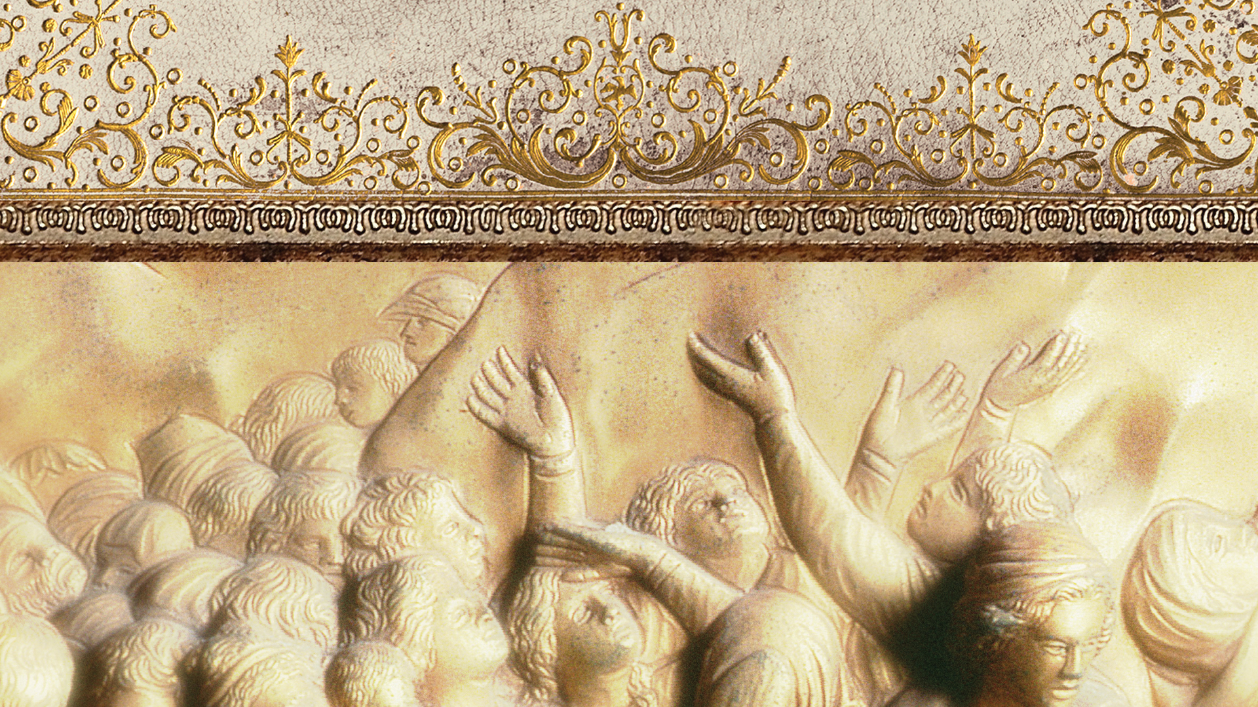
“I rejoice, because I have complete confidence in you!” 2 Corinthians 7:16
“…let us consider how to stir up one another to love and good works.” Hebrews 10:24

Slide 3
Give yourself 2 Corinthians 8:1-15

Slide 4
I. The Macedonians gave themselves to the Lord and received His amazing grace (verses 1-5)
“Now concerning the collection for the saints: as I directed the churches of Galatia, so you also are to do. On the first day of every week, each of you is to put something aside and store it up, as he may prosper, so that there will be no collecting when I come. And when I arrive, I will send those whom you accredit by letter to carry your gift to Jerusalem.” 1 Corinthians 16:1-3

Slide 5
I. The Macedonians gave themselves to the Lord and received His amazing grace (verses 1-5)
1 We want you to know, brothers, about the grace of God that has been given among the churches of Macedonia, 2 for in a severe test of affliction, their abundance of joy and their extreme poverty have overflowed in a wealth of generosity on their part. 3 For they gave according to their means, as I can testify, and beyond their means, of their own accord, 4 begging us earnestly for the favor of taking part in the relief of the saints— 5 and this, not as we expected, but they gave themselves first to the Lord and then by the will of God to us.

Slide 6
I. The Macedonians gave themselves to the Lord and received His amazing grace (verses 1-5)
1 We want you to know, brothers, about the grace of God that has been given among the churches of Macedonia, 2 or in a severe test of affliction, their abundance of joy and their extreme poverty have overflowed in a wealth of generosity on their part. 3 For they gave according to their means, as I can testify, and beyond their means, of their own accord, 4 begging us earnestly for the favor of taking part in the relief of the saints— 5 and this, not as we expected, but they gave themselves first to the Lord and then by the will of God to us.

Slide 7
II. The Lord Jesus Christ gave Himself for us so that we “might become rich” (verses 6-9)
6 Accordingly, we urged Titus that as he had started, so he should complete among you this act of grace. 7 But as you excel in everything—in faith, in speech, in knowledge, in all earnestness, and in our love for you—see that you excel in this act of grace also. 8 I say this not as a command, but to prove by the earnestness of others that your love also is genuine. 9 For you know the grace of our Lord Jesus Christ, that though he was rich, yet for your sake he became poor, so that you by his poverty might become rich.

Slide 8
II. The Lord Jesus Christ gave Himself for us so that we “might become rich” (verses 6-9)
6 Accordingly, we urged Titus that as he had started, so he should complete among you this act of grace. 7 But as you excel in everything—in faith, in speech, in knowledge, in all earnestness, and in our love for you—see that you excel in this act of grace also. 8 I say this not as a command, but to prove by the earnestness of others that your love also is genuine. 9 For you know the grace of our Lord Jesus Christ, that though he was rich, yet for your sake he became poor, so that you by his poverty might become rich.

Slide 9
II. The Lord Jesus Christ gave Himself for us so that we “might become rich” (verses 6-9)
6 Accordingly, we urged Titus that as he had started, so he should complete among you this act of grace. 7 But as you excel in everything—in faith, in speech, in knowledge, in all earnestness, and in our love for you—see that you excel in this act of grace also. 8 I say this not as a command, but to prove by the earnestness of others that your love also is genuine. 9 For you know the grace of our Lord Jesus Christ, that though he was rich, yet for your sake he became poor, so that you by his poverty might become rich.

Slide 10
II. The Lord Jesus Christ gave Himself for us so that we “might become rich” (verses 6-9)
9 For you know the grace of our Lord Jesus Christ, that though he was rich, yet for your sake he became poor, so that you by his poverty might become rich.
“though he was in the form of God, did not count equality with God a thing to be grasped, but emptied himself, by taking the form of a servant, being born in the likeness of men.” Philippians 2:6-7

Slide 11
III. To give yourself, you must finish well (verses 10-12)
10 And in this matter I give my judgment: this benefits you, who a year ago started not only to do this work but also to desire to do it. 11 So now finish doing it as well, so that your readiness in desiring it may be matched by your completing it out of what you have. 12 For if the readiness is there, it is acceptable according to what a person has, not according to what he does not have.

Slide 12
III. To give yourself, you must finish well (verses 10-12)
10 And in this matter I give my judgment: this benefits you, who a year ago started not only to do this work but also to desire to do it. 11 So now finish doing it as well, so that your readiness in desiring it may be matched by your completing it out of what you have. 12 For if the readiness is there, it is acceptable according to what a person has, not according to what he does not have.

Slide 13
IV. To give yourself is to give and have enough (verses 13-15)
“You will be enriched in every way to be generous in every way.” 2 Corinthians 9:11
Our means to give come from out of His account and not our own.

Slide 14
IV. To give yourself is to give and have enough (verses 13-15)
13 For I do not mean that others should be eased and you burdened, but that as a matter of fairness 14 your abundance at the present time should supply their need, so that their abundance may supply your need, that there may be fairness.*
* a state of matters being held in proper balance

Slide 15
IV. To give yourself is to give and have enough (verses 13-15)
13 For I do not mean that others should be eased and you burdened, but that as a matter of fairness 14 your abundance at the present time should supply their need, so that their abundance may supply your need, that there may be fairness.*
“Each one must give as he has decided in his heart, not reluctantly or under compulsion, for God loves a cheerful giver.” 2 Corinthians 9:7
* a state of matters being held in proper balance

Slide 16
IV. To give yourself is to give and have enough (verses 13-15)
15 As it is written, “Whoever gathered much had nothing left over, and whoever gathered little had no lack.”
“the Lord said to Moses, ‘Behold, I am about to rain bread from heaven for you, and the people shall go out and gather a day’s portion every day, that I may test them, whether they will walk in my law or not.’” Exodus 16:4
2 …in a severe test of affliction, their abundance of joy and their extreme poverty have overflowed in a wealth of generosity on their part.

Slide 17
Give yourself

