Slide 1
Renewed day-by-day
A Sermon Series from 2nd Corinthians

Slide 3
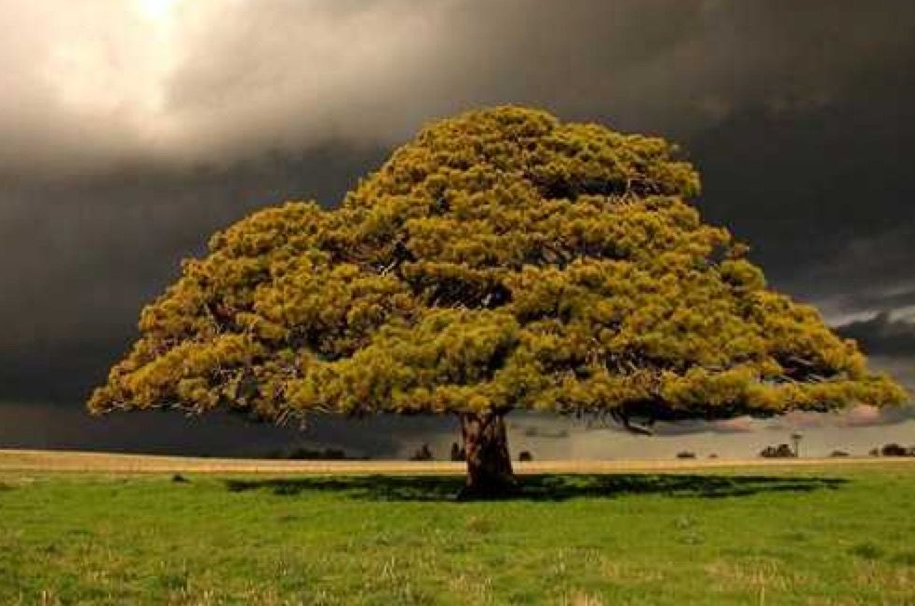
Receive the grace of god! 2 Corinthians 6:1-10
“I am the vine; you are the branches. Whoever abides in me and I in him, he it is that bears much fruit, for apart from me you can do nothing.” John 15:5

Slide 4
Receive the grace of god! 2 Corinthians 6:1-10
“He receives grace into a vacuum … who does not work with it, who does not give it his heart, and who, through sloth, makes that grace ineffectual, by not doing all that he can to express it in good works.” Anselm of Canterbury

Slide 5
I. God’s grace is always available to help us in Every way (verses 1-2)
1 Working together* with him, then, we appeal to you not to receive the grace of God in vain.
“We receive God’s grace by working together with Him and we’re deeply concerned because we think you’re not working together with Him, which will lead to a fruitless life in Christ.” Pastor’s paraphrase of verse 1
* “to engage in cooperative endeavor”

Slide 6
I. God’s grace is always available to help us in every way (verses 1-2)
1 Working together* with him, then, we appeal to you not to receive the grace of God in vain.
“…we are God’s fellow workers.” 1 Corinthians 3:9
* “to engage in cooperative endeavor”

Slide 7
I. God’s grace is always available to help us in every way (verses 1-2)
1 Working together with him, then, we appeal to you not to receive the grace of God in vain. 2 For he says, “In a favorable time I listened to you, and in a day of salvation I have helped you.” Behold, now is the favorable time; behold, now is the day of salvation.
“Therefore, my beloved, as you have always obeyed, so now, not only as in my presence but much more in my absence, work out your own salvation with fear and trembling, for it is God who works in you, both to will and to work for his good pleasure.” Philippians 2:12-13

Slide 8
II. Receive the grace of God! (Verses 3-10)
Do nothing to discredit the gospel or your witness (3)
3 We put no obstacle in anyone’s way, so that no fault may be found with our ministry…
“For I decided to know nothing among you except Jesus Christ and him crucified.” 1 Corinthians 2:2

Slide 9
II. Receive the grace of God! (Verses 3-10)
Serve God faithfully through times of suffering (4-5)
4 but as servants of God we commend ourselves in every way: by great endurance, in afflictions, hardships, calamities, 5 beatings, imprisonments, riots, labors, sleepless nights, hunger…

Slide 10
II. Receive the grace of God! (Verses 3-10)
Serve God faithfully through times of suffering (4-5)
4 but as servants of God we commend ourselves in every way: by great endurance, in afflictions, hardships, calamities, 5 beatings, imprisonments, riots, labors, sleepless nights, hunger…

Slide 11
II. Receive the grace of God! (Verses 3-10)
Serve God faithfully through times of suffering (4-5)
4 but as servants of God we commend ourselves in every way: by great endurance, in afflictions, hardships, calamities, 5 beatings, imprisonments, riots, labors, sleepless nights, hunger…

Slide 12
Serve God faithfully through times of suffering – 2 Corinthians 11:23-27
23 Are they servants of Christ? I am a better one—I am talking like a madman—with far greater labors, far more imprisonments, with countless beatings, and often near death. 24 Five times I received at the hands of the Jews the forty lashes less one. 25 Three times I was beaten with rods. Once I was stoned. Three times I was shipwrecked; a night and a day I was adrift at sea; 26 on frequent journeys, in danger from rivers, danger from robbers, danger from my own people, danger from Gentiles, danger in the city, danger in the wilderness, danger at sea, danger from false brothers; 27 in toil and hardship, through many a sleepless night, in hunger and thirst, often without food, in cold and exposure.

Slide 13
Serve God faithfully through times of suffering – 2 Corinthians 11:23-27
23 Are they servants of Christ? I am a better one—I am talking like a madman—with far greater labors, far more imprisonments, with countless beatings, and often near death. 24 Five times I received at the hands of the Jews the forty lashes less one. 25 Three times I was beaten with rods. Once I was stoned. Three times I was shipwrecked; a night and a day I was adrift at sea; 26 on frequent journeys, in danger from rivers, danger from robbers, danger from my own people, danger from Gentiles, danger in the city, danger in the wilderness, danger at sea, danger from false brothers; 27 in toil and hardship, through many a sleepless night, in hunger and thirst, often without food, in cold and exposure.

Slide 14
II. Receive the grace of God! (Verses 3-10)
Serve God in the power of His Spirit (6-7)
6 by purity, knowledge, patience, kindness, the Holy Spirit, genuine love; 7 by truthful speech, and the power of God; with the weapons of righteousness for the right hand and for the left…
“If we live by the Spirit, let us also keep in step with the Spirit.” Galatians 5:25

Slide 15
II. Receive the grace of God! (Verses 3-10)
Serve God in the power of His Spirit (6-7)
“If we live by the Spirit, let us also keep in step with the Spirit.” Galatians 5:25
“Now we have received not the spirit of the world, but the Spirit who is from God, that we might understand the things freely given us by God. And we impart this in words not taught by human wisdom but taught by the Spirit…” 1 Corinthians 2:12-13

Slide 16
II. Receive the grace of God! (Verses 3-10)
Serve God in the power of His Spirit (6-7)
6 by purity, knowledge, patience, kindness, the Holy Spirit, genuine love; 7 by truthful speech, and the power of God; with the weapons of righteousness for the right hand and for the left…

Slide 17
II. Receive the grace of God! (Verses 3-10)
Live in the present in light of eternity (8-10)
8 through honor and dishonor, through slander and praise. We are treated as impostors, and yet are true; 9 as unknown, and yet well known; as dying, and behold, we live; as punished, and yet not killed; 10 as sorrowful, yet always rejoicing; as poor, yet making many rich; as having nothing, yet possessing everything.
A question Paul may be asking the Corinthians here is “Is this the narrative you believe?”

Slide 18
II. Receive the grace of God! (Verses 3-10)
Live in the present in light of eternity (8-10)
8 through honor and dishonor, through slander and praise. We are treated as impostors, and yet are true; 9 as unknown, and yet well known; as dying, and behold, we live; as punished, and yet not killed; 10 as sorrowful, yet always rejoicing; as poor, yet making many rich; as having nothing, yet possessing everything.

Slide 19
II. Receive the grace of God! (Verses 3-10)
To receive the grace of God
Yoke your affections, not to an unbelieving world, but to the one who has guaranteed eternity to you
Make His kingdom agenda your undivided focus
Endure all the hardship and suffering that faithful ministry brings, knowing that in God’s household, such suffering makes us better servants
Serve Him in the power of the Holy Spirit, determining in our will to keep in step with the Spirit by all the means of grace God has made available to us

Slide 20
“…truly, I say to you, if you have faith like a grain of mustard seed, you will say to this mountain, ‘Move from here to there,’ and it will move, and nothing will be impossible for you.” Matthew 17:20

