Slide 1
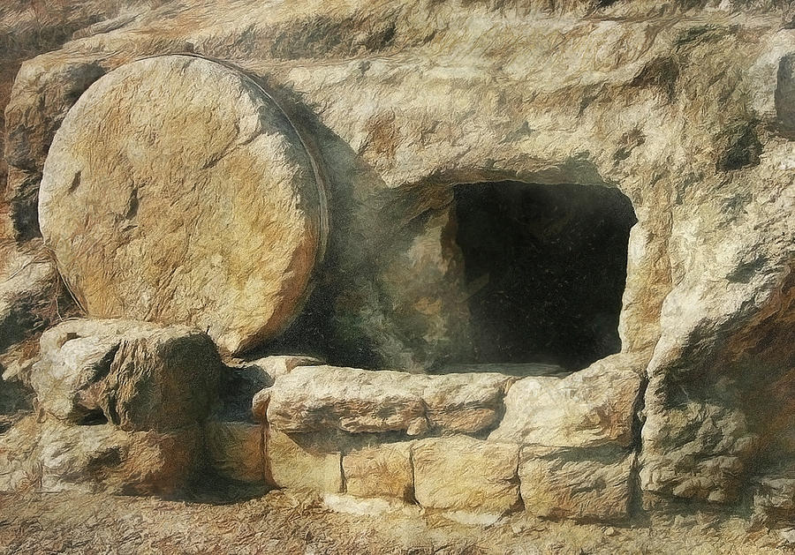
Luke’s gospel
“an orderly account” (Luke 1:3)
Luke wanted his readers to “have certainty concerning the things [they had] been taught” (Luke 1:4)
“if Christ has not been raised, then our preaching is in vain and your faith is in vain.” 1 Corinthians 15:14

Slide 2
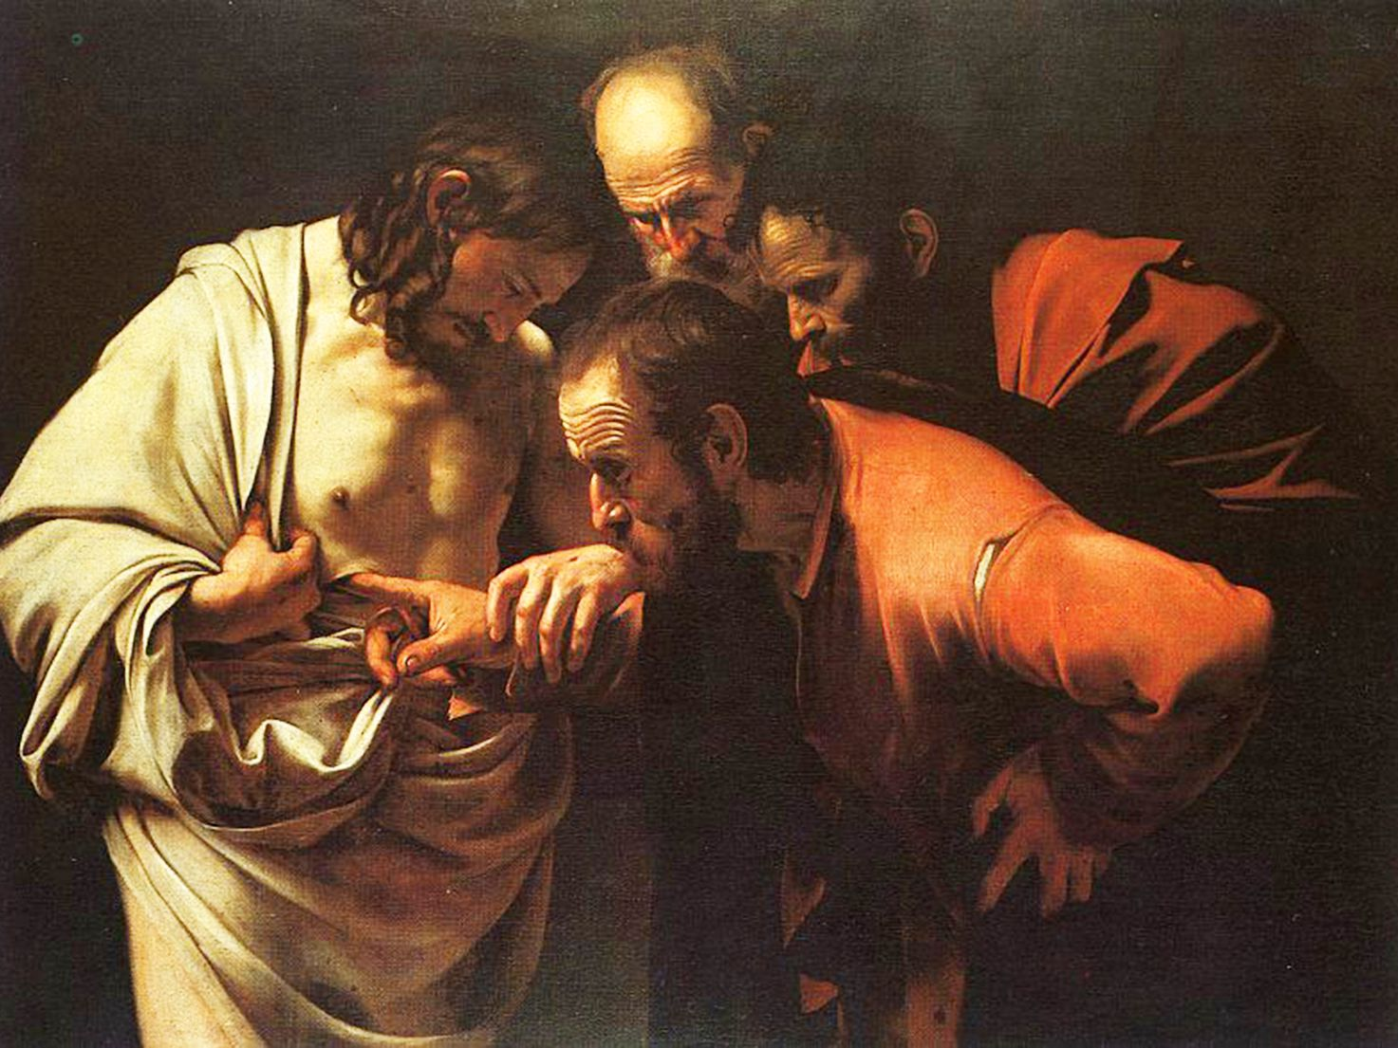
“Blessed are those who have not seen and yet have believed”
“O foolish ones, and slow of heart to believe all that the prophets have spoken!” Luke 24:25
Luke 23:50 – 24:12

Slide 3
I. Jesus was honored by the living in His death (verses 50-56)
Jesus was honored by Joseph of Arimathea (50-53)
50 Now there was a man named Joseph, from the Jewish town of Arimathea. He was a member of the council, a good and righteous man, 51 who had not consented to their decision and action; and he was looking for the kingdom of God. 52 This man went to Pilate and asked for the body of Jesus. 53 Then he took it down and wrapped it in a linen shroud and laid him in a tomb cut in stone, where no one had ever yet been laid.

Slide 4
I. Jesus was honored by the living in His death (verses 50-56)
Jesus was honored by Joseph of Arimathea (50-53)
50 Now there was a man named Joseph, from the Jewish town of Arimathea. He was a member of the council, a good and righteous man, 51 who had not consented to their decision and action; and he was looking for the kingdom of God. 52 This man went to Pilate and asked for the body of Jesus. 53 Then he took it down and wrapped it in a linen shroud and laid him in a tomb cut in stone, where no one had ever yet been laid.

Slide 5
I. Jesus was honored by the living in His death (verses 50-56)
Jesus was honored by the women who supported His ministry (54-56)
54 It was the day of Preparation, and the Sabbath was beginning. 55 The women who had come with him from Galilee followed and saw the tomb and how his body was laid. 56 Then they returned and prepared spices and ointments. On the Sabbath they rested according to the commandment.

Slide 6
I. Jesus was honored by the living in His death (verses 50-56)
Jesus was honored by the women who supported His ministry (54-56)
54 It was the day of Preparation, and the Sabbath was beginning. 55 The women who had come with him from Galilee followed and saw the tomb and how his body was laid. 56 Then they returned and prepared spices and ointments. On the Sabbath they rested according to the commandment.

Slide 7
I. Jesus was honored by the living in His death (verses 50-56)
Jesus was honored by the women who supported His ministry (54-56)
54 It was the day of Preparation, and the Sabbath was beginning. 55 The women who had come with him from Galilee followed and saw the tomb and how his body was laid. 56 Then they returned and prepared spices and ointments. On the Sabbath they rested according to the commandment.

Slide 8
I. Jesus was honored by the living in His death (verses 50-56)
Jesus was honored by the women who supported His ministry (54-56)
54 It was the day of Preparation, and the Sabbath was beginning. 55 The women who had come with him from Galilee followed and saw the tomb and how his body was laid. 56 Then they returned and prepared spices and ointments. On the Sabbath they rested according to the commandment.

Slide 9
II. Jesus honored the living with faith in His resurrection (verses 1-12)
This was true for the women who supported His ministry (1-8)
1 But on the first day of the week, at early dawn, they went to the tomb, taking the spices they had prepared. 2 And they found the stone rolled away from the tomb, 3 but when they went in they did not find the body of the Lord Jesus. 4 While they were perplexed about this, behold, two men stood by them in dazzling apparel. 5 And as they were frightened and bowed their faces to the ground, the men said to them, “Why do you seek the living among the dead?

Slide 10
II. Jesus honored the living with faith in His resurrection (verses 1-12)
This was true for the women who supported His ministry (1-8)
1 But on the first day of the week, at early dawn, they went to the tomb, taking the spices they had prepared. 2 And they found the stone rolled away from the tomb, 3 but when they went in they did not find the body of the Lord Jesus. 4 While they were perplexed about this, behold, two men stood by them in dazzling apparel. 5 And as they were frightened and bowed their faces to the ground, the men said to them, “Why do you seek the living among the dead?

Slide 11
II. Jesus honored the living with faith in His resurrection (verses 1-12)
This was true for the women who supported His ministry (1-8)
1 But on the first day of the week, at early dawn, they went to the tomb, taking the spices they had prepared. 2 And they found the stone rolled away from the tomb, 3 but when they went in they did not find the body of the Lord Jesus. 4 While they were perplexed about this, behold, two men stood by them in dazzling apparel. 5 And as they were frightened and bowed their faces to the ground, the men said to them, “Why do you seek the living among the dead?

Slide 12
II. Jesus honored the living with faith in His resurrection (verses 1-12)
This was true for the women who supported His ministry (1-8)
5 …“Why do you seek the living among the dead? 6 He is not here, but has risen. Remember how he told you, while he was still in Galilee, 7 that the Son of Man must be delivered into the hands of sinful men and be crucified and on the third day rise.”
8 And they remembered his words

Slide 13
II. Jesus honored the living with faith in His resurrection (verses 1-12)
This was true for the rest of His disciples (9-12 ff.)
9 and returning from the tomb they told all these things to the eleven and to all the rest. 10 Now it was Mary Magdalene and Joanna and Mary the mother of James and the other women with them who told these things to the apostles, 11 but these words seemed to them an idle tale, and they did not believe them. 12 But Peter rose and ran to the tomb; stooping and looking in, he saw the linen cloths by themselves; and he went home marveling at what had happened.

Slide 14
II. Jesus honored the living with faith in His resurrection (verses 1-12)
This was true for the rest of His disciples (9-12 ff.)
9 and returning from the tomb they told all these things to the eleven and to all the rest. 10 Now it was Mary Magdalene and Joanna and Mary the mother of James and the other women with them who told these things to the apostles, 11 but these words seemed to them an idle tale, and they did not believe them. 12 But Peter rose and ran to the tomb; stooping and looking in, he saw the linen cloths by themselves; and he went home marveling at what had happened.

Slide 15
II. Jesus honored the living with faith in His resurrection (verses 1-12)
This was true for the rest of His disciples (9-12 ff.)
Cleopas and his friend on the way to Emmaus
“But their eyes were kept from recognizing him.” Luke 24:16
“Are you the only visitor to Jerusalem who does not know the things that have happened there in these days?” Luke 24:18
“What things?” Jesus’ response to Cleopas in Luke 24:19

Slide 16
II. Jesus honored the living with faith in His resurrection (verses 1-12)
This was true for the rest of His disciples (9-12 ff.)
Cleopas and his friend on the way to Emmaus
“O foolish ones, and slow of heart to believe all that the prophets have spoken! Was it not necessary that the Christ should suffer these things and enter into his glory?” Luke 24:25-26
“And beginning with Moses and all the Prophets, he interpreted to them in all the Scriptures the things concerning himself.” Luke 24:27

Slide 17
II. Jesus honored the living with faith in His resurrection (verses 1-12)
This was true for the rest of His disciples (9-12 ff.)
Cleopas and his friend on the way to Emmaus
“He took the bread and blessed and broke it and gave it to them. And their eyes were opened, and they recognized him. And he vanished from their sight. They said to each other, “Did not our hearts burn within us while he talked to us on the road, while he opened to us the Scriptures?” Luke 24:30-32

Slide 18
II. Jesus honored the living with faith in His resurrection (verses 1-12)
This was true for the rest of His disciples (9-12 ff.)
His Disciples back in Jerusalem
“But they were startled and frightened and thought they saw a spirit.” Luke 24:37
“Then he said to them, ‘These are my words that I spoke to you while I was still with you, that everything written about me in the Law of Moses and the Prophets and the Psalms must be fulfilled.’ Then he opened their minds to understand the Scriptures.” Luke 24:44-45

Slide 19
III. “Blessed are those who have not seen and yet have believed.” (John 20:24-29)
24 Now Thomas, one of the twelve, called the Twin, was not with them when Jesus came. 25 So the other disciples told him, “We have seen the Lord.” But he said to them, “Unless I see in his hands the mark of the nails, and place my finger into the mark of the nails, and place my hand into his side, I will never believe.”

Slide 20
III. “Blessed are those who have not seen and yet have believed.” (John 20:29)
26 Eight days later, his disciples were inside again, and Thomas was with them. Although the doors were locked, Jesus came and stood among them and said, “Peace be with you.” 27 Then he said to Thomas, “Put your finger here, and see my hands; and put out your hand, and place it in my side. Do not disbelieve, but believe.” 28 Thomas answered him, “My Lord and my God!” 29 Jesus said to him, “Have you believed because you have seen me? Blessed are those who have not seen and yet have believed.”

Slide 21
III. “Blessed are those who have not seen and yet have believed.” (John 20:29)
26 Eight days later, his disciples were inside again, and Thomas was with them. Although the doors were locked, Jesus came and stood among them and said, “Peace be with you.” 27 Then he said to Thomas, “Put your finger here, and see my hands; and put out your hand, and place it in my side. Do not disbelieve, but believe.” 28 Thomas answered him, “My Lord and my God!” 29 Jesus said to him, “Have you believed because you have seen me? Blessed are those who have not seen and yet have believed.”

Slide 22
If Jesus doesn’t act on our behalf, what awaits us after death is an eternity under God’s terrible wrath. But Jesus suffered on our behalf so that this doesn’t have to be our destiny, and Jesus rose from the grave to an eternal human life so that we who believe that He died to save us from a terrifying eternity can know that He rose to save us for God’s unimaginably wonderful eternal destiny: “that in the coming ages he might show the immeasurable riches of his grace in kindness toward us in Christ Jesus” (Ephesians 2:7).

