Slide 1
The Renewed Mind
“For he who sanctifies and those who are sanctified all have one source. That is why he is not ashamed to call them brothers, saying, ‘I will tell of your name to my brothers; in the midst of the congregation, I will sing your praise.’” Hebrews 2:11-12
A sermon series from Romans 12-16

Slide 2
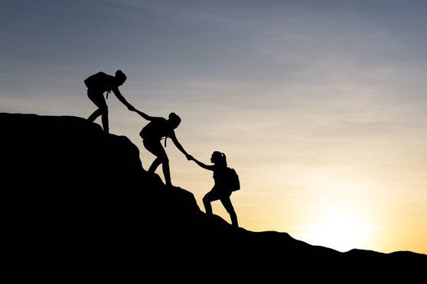
Share the blessings of the gospel
Romans 15:1-7

Slide 3
I. Unity comes when the body grows together in truth (verses 1-4)
The first step to unity is for the strong to embrace the walk of the weak (1)
1 We who are strong have an obligation to bear with the failings of the weak, and not to please ourselves.
“…if your brother is grieved by what you eat, you are no longer walking in love.” Romans 14:15
Strong = “able, capable” / Weak = “powerless, unable”

Slide 4
I. Unity comes when the body grows together in truth (verses 1-4)
The first step to unity is for the strong to embrace the walk of the weak (1)
1 We who are strong have an obligation to bear with the failings of the weak, and not to please ourselves.
“Bear one another’s burdens, and so fulfill the law of Christ.” Galatians 6:2
“To the weak I became weak, that I might win the weak. I have become all things to all people, that by all means I might save some.” 1 Corinthians 9:22

Slide 5
And I will be my brother's keeper.
Not the one who judges him.
I won't despise him for his weakness.
I won't regard him for his strength.
I won't take away his freedom.
I will help him learn to stand.
And I will, I will be my brother's keeper.
Rich Mullins, Brother’s Keeper

Slide 6
I. Unity comes when the body grows together in truth (verses 1-4)
When the strong become weak, the weak are built up (2-3)
2 Let each of us please his neighbor for his good, to build him up. 3 For Christ did not please himself, but as it is written, “The reproaches of those who reproached you fell on me.”

Slide 7
I. Unity comes when the body grows together in truth (verses 1-4)
When the strong become weak, the weak are built up (2-3)
2 Let each of us please his neighbor for his good, to build him up. 3 For Christ did not please himself, but as it is written, “The reproaches of those who reproached you fell on me.”

Slide 8
I. Unity comes when the body grows together in truth (verses 1-4)
“Have this mind among yourselves, which is yours in Christ Jesus, who, though he was in the form of God, did not count equality with God a thing to be grasped, but emptied himself, by taking the form of a servant, being born in the likeness of men. And being found in human form, he humbled himself by becoming obedient to the point of death, even death on a cross.” Philippians 2:5-8
“To the weak I became weak, that I might win the weak. I have become all things to all people, that by all means I might save some.” 1 Corinthians 9:22

Slide 9
I. Unity comes when the body grows together in truth (verses 1-4)
When the weak are built up, the body grows together in truth (4)
4 For whatever was written in former days was written for our instruction, that through endurance and through the encouragement of the Scriptures we might have hope.
“If the strong believers, therefore, wish to maintain their hope, they must work to put into effect the unity of the people of God, within which they experience their own salvation.” Doug Moo

Slide 10
II. When the body grows together in truth, the blessings of the gospel are shared (verses 5-6)
5 May the God of endurance and encouragement grant you to live in such harmony with one another, in accord with Christ Jesus, 6 that together you may with one voice glorify the God and Father of our Lord Jesus Christ.

Slide 11
II. When the body grows together in truth, the blessings of the gospel are shared (verses 5-6)
5 May the God of endurance and encouragement grant you to live in such harmony with one another, in accord with Christ Jesus, 6 that together you may with one voice glorify the God and Father of our Lord Jesus Christ.
“with one mind in one mouth, glorify the God and Father of our Lord Jesus Christ.” Greek Text literal

Slide 12
III. Share the blessings of the gospel! (verse 7)
“welcome… the one who is weak in faith.” Romans 14:1
“God has welcomed him [the strong].” Romans 14:3
7 Therefore welcome one another as Christ has welcomed you, for the glory of God.
“I have no greater joy than to hear that my children are walking in the truth.” 3 John 4

Slide 13
III. Share the blessings of the gospel! (verse 7)
7 Therefore welcome one another as Christ has welcomed you, for the glory of God.
“To the weak I became weak, that I might win the weak. I have become all things to all people, that by all means I might save some.” 1 Corinthians 9:22
“I do it all for the sake of the gospel, that I may share with them in its blessings.” 1 Corinthians 9:23

