Slide 1
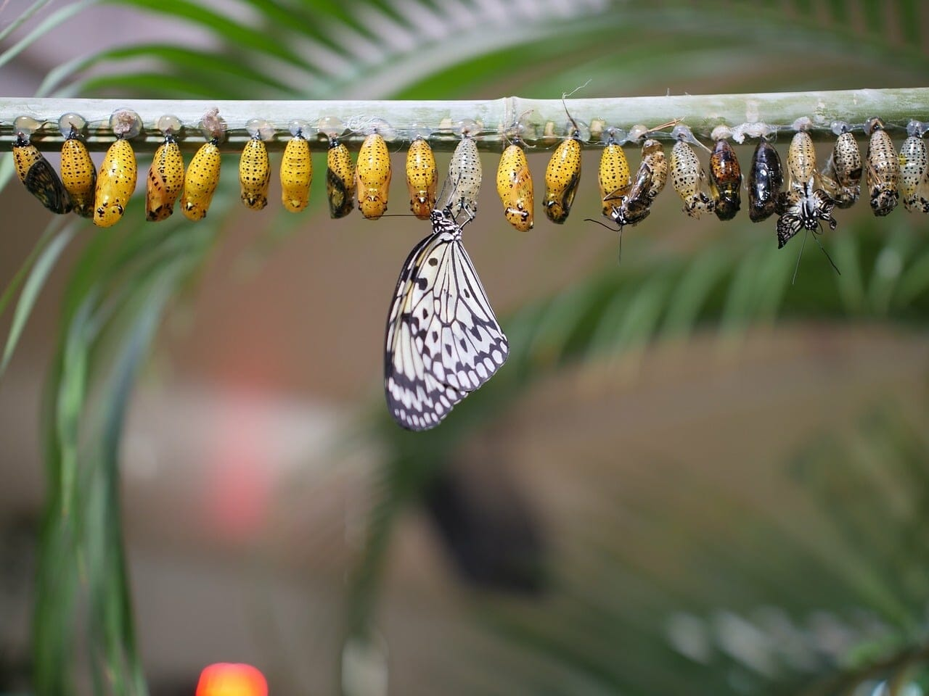
The Renewed Mind
A sermon series from Romans 12-16

Slide 2
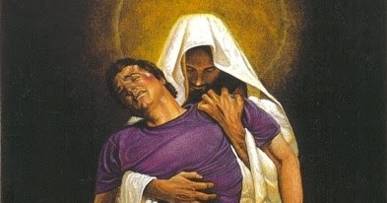
The declaration of dependence
Romans 14:4-9

Slide 3
I. We can stand because the Lord is able to make us stand (verse 4)
4 Who are you to pass judgment on the servant of another? It is before his own master that he stands or falls. And he will be upheld, for the Lord is able to make him stand.

Slide 4
I. We can stand because the Lord is able to make us stand (verse 4)
4 Who are you to pass judgment on the servant of another? It is before his own master that he stands or falls. And he will be upheld, for the Lord is able to make him stand.

Slide 5
I. We can stand because the Lord is able to make us stand (verse 4)
4 Who are you to pass judgment on the servant of another? It is before his own master that he stands or falls. And he will be upheld, for the Lord is able to make him stand.

Slide 6
II. Therefore, honoring the Lord should be our sole motivation in all we do (verses 5-6)
5 One person esteems one day as better than another, while another esteems all days alike. Each one should be fully convinced in his own mind.
“The faith that you have, keep between yourself and God. Blessed is the one who has no reason to pass judgment on himself for what he approves.” Romans 14:22

Slide 7
II. Therefore, honoring the Lord should be our sole motivation in all we do (verses 5-6)
6 The one who observes the day, observes it in honor of the Lord. The one who eats, eats in honor of the Lord, since he gives thanks to God, while the one who abstains, abstains in honor of the Lord and gives thanks to God.

Slide 8
II. Therefore, honoring the Lord should be our sole motivation in all we do (verses 5-6)
6 The one who observes the day, observes it in honor of the Lord. The one who eats, eats in honor of the Lord, since he gives thanks to God, while the one who abstains, abstains in honor of the Lord and gives thanks to God.
“The chief end of man is to glorify God and to enjoy Him forever.” The Westminster Shorter Catechism

Slide 9
III. Depend upon the Lord in all things for all of eternity(verses 7-9)
7 For none of us lives to himself, and none of us dies to himself. 8 For if we live, we live to the Lord, and if we die, we die to the Lord. So then, whether we live or whether we die, we are the Lord’s.
“For to me to live is Christ, and to die is gain. If I am to live in the flesh, that means fruitful labor for me.” Philippians 1:21-22

Slide 10
III. Depend upon the Lord in all things for all of eternity(verses 7-9)
7 For none of us lives to himself, and none of us dies to himself. 8 For if we live, we live to the Lord, and if we die, we die to the Lord. So then, whether we live or whether we die, we are the Lord’s.
“For I am sure that neither death nor life, nor angels nor rulers, nor things present nor things to come, nor powers, nor height nor depth, nor anything else in all creation, will be able to separate us from the love of God in Christ Jesus our Lord.” Romans 8:38-39

Slide 11
III. Depend upon the Lord in all things for all of eternity(verses 7-9)
9 For to this end Christ died and lived again, that he might be Lord both of the dead and of the living.

Slide 12
III. Depend upon the Lord in all things for all of eternity(verses 7-9)
Do you struggle with how Christ can faithfully lead us as He leads us to be “fully convinced” in such different ways?

Slide 13
III. Depend upon the Lord in all things for all of eternity(verses 7-9)
One thing shouldn’t change in our journey
“Jesus Christ is the same yesterday and today and forever.” Hebrews 13:8

Slide 14
Perhaps the one who is truly strong is the one who is unchanging in their utter dependence upon Christ and stands in wonder of the Lord and Savior who proves Himself true to us every day, every hour, every minute, and every second.

