Slide 1
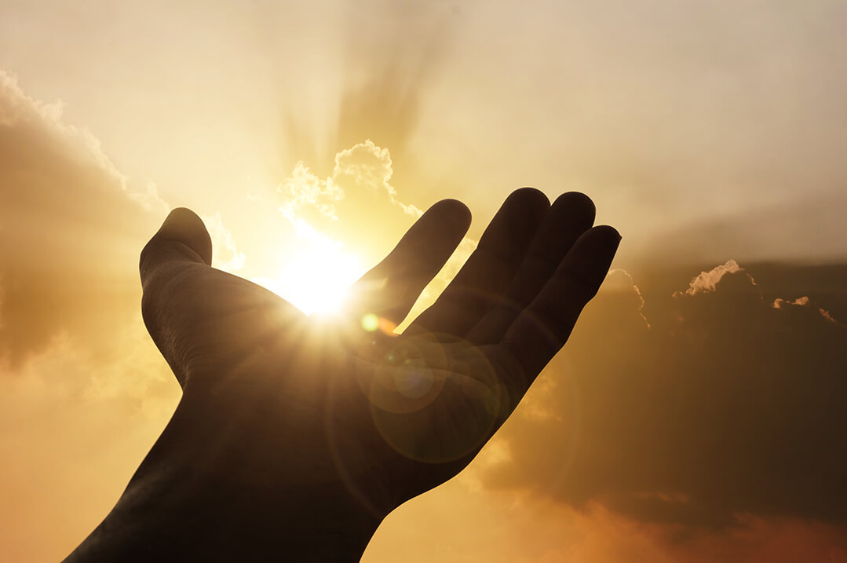
Every Spiritual Blessing The Gospel Revisited
A sermon series from Ephesians 1-3

Slide 2
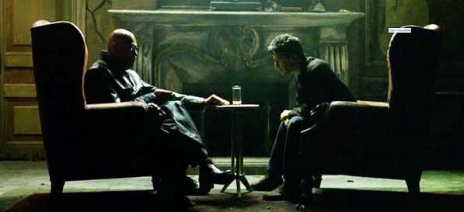
“Let me tell you why you're here. You're here because you know something…you can't explain—but you feel it. You've felt it your entire life. That there's something wrong with the world…it is the world that has been pulled over your eyes to blind you from the truth...that you are a slave, Neo. Like everyone else, you were born into bondage.”

Slide 3
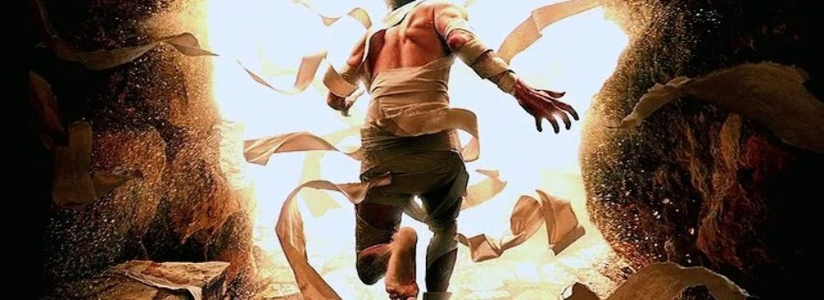
The gospel: Bringing the dead to life
Ephesians 2:1-10

Slide 4
“We know that we are from God, and the whole world lies in the power of the evil one.” 1 John 5:19

Slide 5
I. Apart from Christ, you were dead! (verses 1-3)
1 And you were dead in the trespasses and sins 2 in which you once walked, following the course of this world, following the prince of the power of the air, the spirit that is now at work in the sons of disobedience— 3 among whom we all once lived in the passions of our flesh, carrying out the desires of the body and the mind, and were by nature children of wrath, like the rest of mankind.

Slide 6
I. Apart from Christ, you were dead! (verses 1-3)
1 And you were dead in the trespasses and sins 2 in which you once walked, following the course of this world, following the prince of the power of the air, the spirit that is now at work in the sons of disobedience— 3 among whom we all once lived in the passions of our flesh, carrying out the desires of the body and the mind, and were by nature children of wrath, like the rest of mankind.
“You are of your father the devil, and your will is to do your father’s desires.” John 8:44

Slide 7
I. Apart from Christ, you were dead! (verses 1-3)
1 And you were dead in the trespasses and sins 2 in which you once walked, following the course of this world, following the prince of the power of the air, the spirit that is now at work in the sons of disobedience— 3 among whom we all once lived in the passions of our flesh, carrying out the desires of the body and the mind, and were by nature children of wrath, like the rest of mankind.
“You are of your father the devil, and your will is to do your father’s desires.” John 8:44

Slide 8
I. Apart from Christ, you were dead! (verses 1-3)
3 …we all once lived in the passions of our flesh, carrying out the desires of the body and the mind, and were by nature children of wrath, like the rest of mankind.
“And the devil who had deceived them was thrown into the lake of fire and sulfur where the beast and the false prophet were, and they will be tormented day and night forever and ever.” Revelation 20:10

Slide 9
II. In Christ, God made you alive! (verses 4-7)
4 But God, being rich in mercy, because of the great love with which he loved us, 5 even when we were dead in our trespasses, made us alive together with Christ—by grace you have been saved— 6 and raised us up with him and seated us with him in the heavenly places in Christ Jesus…

Slide 10
II. In Christ, God made you alive! (verses 4-7)
4 But God, being rich in mercy, because of the great love with which he loved us, 5 even when we were dead in our trespasses, made us alive together with Christ—by grace you have been saved— 6 and raised us up with him and seated us with him in the heavenly places in Christ Jesus…

Slide 11
II. In Christ, God made you alive! (verses 4-7)
4 But God, being rich in mercy, because of the great love with which he loved us, 5 even when we were dead in our trespasses, made us alive together with Christ—by grace you have been saved— 6 and raised us up with him and seated us with him in the heavenly places in Christ Jesus…
“Finally, be strong in the Lord and in the strength of his might. Put on the whole armor of God, that you may be able to stand against the schemes of the devil.” Ephesians 6:10-11

Slide 12
II. In Christ, God made you alive! (verses 4-7)
4 But God, being rich in mercy, because of the great love with which he loved us, 5 even when we were dead in our trespasses, made us alive together with Christ—by grace you have been saved— 6 and raised us up with him and seated us with him in the heavenly places in Christ Jesus…
“God protects him, and the evil one does not touch him.” 1 John 5:18

Slide 13
II. In Christ, God made you alive! (verses 4-7)
7 so that in the coming ages he might show the immeasurable riches of his grace in kindness toward us in Christ Jesus.

Slide 14
III. Our life in Christ is all by grace through faith! (verses 8-10)
8 For by grace you have been saved through faith. And this is not your own doing; it is the gift of God…
“…the gifts and the calling of God are irrevocable.” Romans 11:29

Slide 15
III. Our life in Christ is all by grace through faith! (verses 8-10)
8 For by grace you have been saved through faith. And this is not your own doing; it is the gift of God…

Slide 16
III. Our life in Christ is all by grace through faith! (verses 8-10)
8 For by grace you have been saved through faith. And this is not your own doing; it is the gift of God, 9 not a result of works, so that no one may boast.

Slide 17
III. Our life in Christ is all by grace through faith! (verses 8-10)
8 For by grace you have been saved through faith. And this is not your own doing; it is the gift of God, 9 not a result of works, so that no one may boast. 10 For we are his workmanship, created in Christ Jesus for good works, which God prepared beforehand, that we should walk in them.

