Slide 1
Every Spiritual Blessing The Gospel Revisited
A sermon series from Ephesians 1-3

Slide 2
“Brothers…one thing I do: forgetting what lies behind and straining forward to what lies ahead, I press on toward the goal for the prize of the upward call of God in Christ Jesus.” Philippians 3:13-14

Slide 3
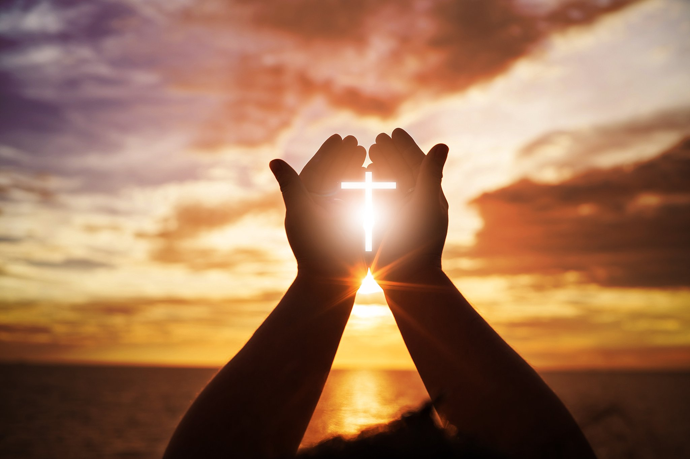
The gospel: God lavishes His grace upon us
Ephesians 1:3-14

Slide 4
I. In Christ, we have the spiritual blessings of adoption (verses 4-6)
To be “in Christ”
“even when we were dead in our trespasses, [God] made us alive together with Christ—by grace you have been saved—and raised us up with him and seated us with him in the heavenly places in Christ Jesus.” Ephesians 2:5-6
Our “life is hidden with Christ in God.” Colossians 3:3

Slide 5
I. In Christ, we have the spiritual blessings of adoption (verses 4-6)
4 even as he chose us in him before the foundation of the world, that we should be holy and blameless before him. In love 5 he predestined us for adoption to himself as sons through Jesus Christ, according to the purpose of his will, 6 to the praise of his glorious grace, with which he has blessed us in the Beloved.

Slide 6
II. In Christ, we have the spiritual blessings of redemption (verses 7-10)
Christ has fully delivered us from our bondage to sin and death (7)
7 In him we have redemption through his blood, the forgiveness of our trespasses, according to the riches of his grace,

Slide 7
We are slaves to sin in need of redemption
“Truly, truly, I say to you, everyone who practices sin is a slave to sin.” John 8:34
“The slave does not remain in the house forever; the son remains forever.” John 8:35
“…if the Son sets you free, you will be free indeed.” John 8:36

Slide 8
II. In Christ, we have the spiritual blessings of redemption (verses 7-10)
Christ has fully delivered us from our bondage to sin and death (7)
7 In him we have redemption through his blood, the forgiveness of our trespasses, according to the riches of his grace,
“He who did not spare his own Son but gave him up for us all, how will he not also with him graciously give us all things?” Romans 8:32

Slide 9
II. In Christ, we have the spiritual blessings of redemption (verses 7-10)
The Father has “lavished upon us” a full understanding of what we were redeemed for (8-10)
8 which he lavished upon us, in all wisdom and insight 9 making known to us the mystery of his will, according to his purpose, which he set forth in Christ 10 as a plan for the fullness of time, to unite all things in him, things in heaven and things on earth.

Slide 10
II. In Christ, we have the spiritual blessings of redemption (verses 7-10)
The Father has “lavished upon us” a full understanding of what we were redeemed for (8-10)
8 which he lavished upon us, in all wisdom and insight 9 making known to us the mystery of his will, according to his purpose, which he set forth in Christ 10 as a plan for the fullness of time, to unite all things in him, things in heaven and things on earth.

Slide 11
III. In Christ, we have the spiritual blessings of an inheritance (verses 11-14)
The Father has blessed us with an inheritance “to the praise of His glory” (11-12)
11 In him we have obtained an inheritance, having been predestined according to the purpose of him who works all things according to the counsel of his will.
We are “fellow heirs with Christ.” Romans 8:17

Slide 12
III. In Christ, we have the spiritual blessings of an inheritance (verses 11-14)
The Father has blessed us with an inheritance “to the praise of His glory” (11-12)
11 In him we have obtained an inheritance, having been predestined according to the purpose of him who works all things according to the counsel of his will, 12 so that we who were the first to hope in Christ might be to the praise of his glory.

Slide 13
III. In Christ, we have the spiritual blessings of an inheritance (verses 11-14)
The Father has guaranteed our inheritance with the Holy Spirit (13-14)
13 In him you also, when you heard the word of truth, the gospel of your salvation, and believed in him, were sealed with the promised Holy Spirit, 14 who is the guarantee of our inheritance until we acquire possession of it, to the praise of his glory.

Slide 14
III. In Christ, we have the spiritual blessings of an inheritance (verses 11-14)
The Father has guaranteed our inheritance with the Holy Spirit (13-14)
We will acquire possession of our inheritance because, in Christ and by the power of the Holy Spirit, as Peter teaches us, we have been “born again to a living hope through the resurrection of Jesus Christ from the dead, to an inheritance that is imperishable, undefiled, and unfading, kept in heaven for you, who by God’s power are being guarded through faith for a salvation ready to be revealed in the last time.” 1 Peter 1:3-5

Slide 15
IV. In Christ, we have every spiritual blessing (verse 3)
3 Blessed be the God and Father of our Lord Jesus Christ, who has blessed us in Christ with every spiritual blessing in the heavenly places.

Slide 16
IV. In Christ, we have every spiritual blessing (verse 3)
The blessing of assurance by the evidence of the Spirit’s presence
“Now we have received not the spirit of the world, but the Spirit who is from God, that we might understand the things freely given us by God. And we impart this in words not taught by human wisdom but taught by the Spirit, interpreting spiritual truths to those who are spiritual. The natural person does not accept the things of the Spirit of God, for they are folly to him, and he is not able to understand them because they are spiritually discerned.” 1 Corinthians 2:12-14

Slide 17
IV. In Christ, we have every spiritual blessing (verse 3)
The blessing of assurance by the evidence of the Spirit’s presence
“We are from God. Whoever knows God listens to us; whoever is not from God does not listen to us. By this we know the Spirit of truth and the spirit of error.” 1 John 4:6

Slide 18
IV. In Christ, we have every spiritual blessing (verse 3)
The blessing of assurance by the evidence of the Spirit’s presence
“But the fruit of the Spirit is love, joy, peace, patience, kindness, goodness, faithfulness, gentleness, self-control.” Galatians 5:22-23

Slide 19
IV. In Christ, we have every spiritual blessing (verse 3)
The blessing of assurance by the evidence of the Spirit’s presence
Understanding
Obedience
Life change

