Slide 1
Majoring in the Minors
A sermon series from Haggai and Malachi

Slide 2
“How dare you create a world to which there is such misery that is not our fault. It's not right, it's utterly, utterly evil. Why should I respect a capricious, mean-minded, stupid God who creates a world that is so full of injustice and pain?” Stephen Fry
It’s interesting how a person can deny the existence of God while, in the very same breath, blame God for the existence of evil as the reason for denying God’s existence!

Slide 3
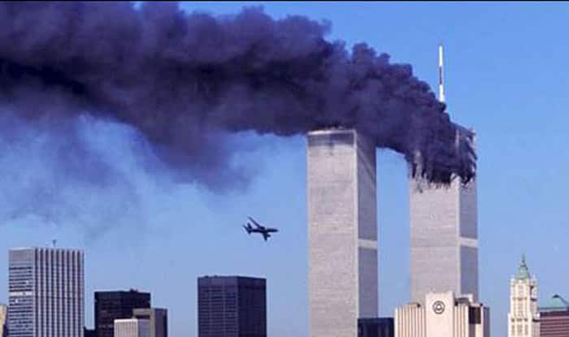
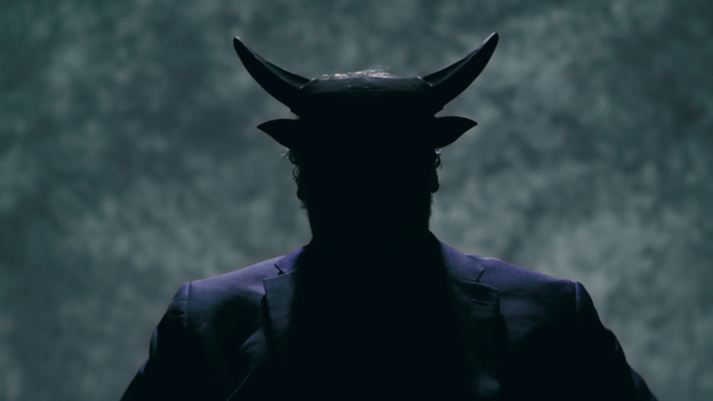
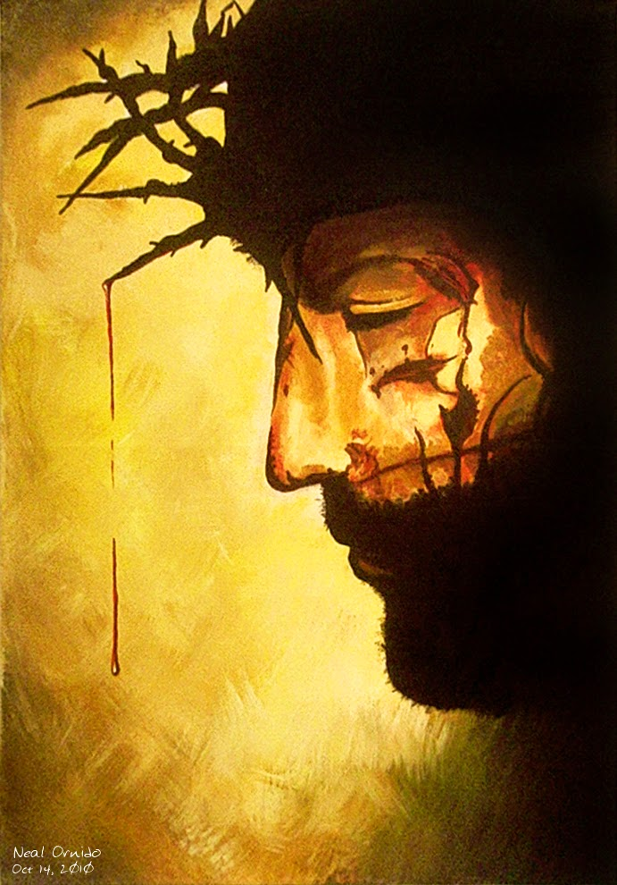
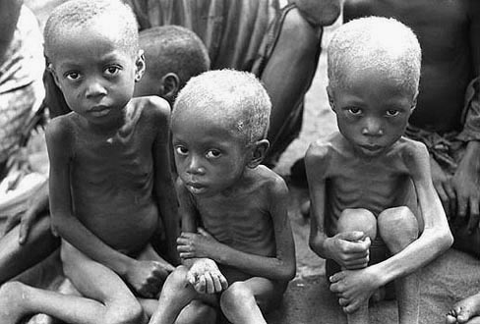
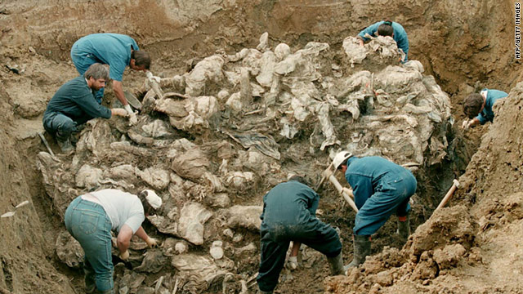
God
is not
the problem!
Malachi
2:17 – 3:15

Slide 4
I. God’s grace brings His justice to all at the perfect time and in a perfect way (2:17-3-7)
The people did not believe God was just (17)
17 You have wearied the Lord with your words. But you say, “How have we wearied him?” By saying, “Everyone who does evil is good in the sight of the Lord, and he delights in them.” Or by asking, “Where is the God of justice? ”
“…he makes his sun rise on the evil and on the good, and sends rain on the just and on the unjust.” Matthew 5:45

Slide 5
I. God’s grace brings His justice to all at the perfect time and in a perfect way (2:17-3-7)
God will prove to be just by refining His people to be righteous (1-4)
3 He will sit as a refiner and purifier of silver, and he will purify the sons of Levi and refine them like gold and silver, and they will bring offerings in righteousness to the Lord. 4 Then the offering of Judah and Jerusalem will be pleasing to the Lord as in the days of old and as in former years.”

Slide 6
I. God’s grace brings His justice to all at the perfect time and in a perfect way (2:17-3-7)
God will prove to be just by refining His people to be righteous (1-4)
God promised to be just by purifying His people through the coming of the Messiah and His eternal life saving work “that he might be just and the justifier of the one who has faith in Jesus.” Romans 3:26

Slide 7
I. God’s grace brings His justice to all at the perfect time and in a perfect way (2:17-3-7)
God will prove to be just by judging the disobedient according to His grace (5-7)
5 “Then I will draw near to you for judgment. I will be a swift witness against the sorcerers, against the adulterers, against those who swear falsely, against those who oppress the hired worker in his wages, the widow and the fatherless, against those who thrust aside the sojourner, and do not fear me, says the Lord of hosts.”

Slide 8
I. God’s grace brings His justice to all at the perfect time and in a perfect way (2:17-3-7)
God will prove to be just by judging the disobedient according to His grace (5-7)
6 “For I the Lord do not change; therefore you, O children of Jacob, are not consumed. 7 From the days of your fathers you have turned aside from my statutes and have not kept them. Return to me, and I will return to you, says the Lord of hosts. But you say, ‘How shall we return?’

Slide 9
I. God’s grace brings His justice to all at the perfect time and in a perfect way (2:17-3-7)
God will prove to be just by judging the disobedient according to His grace (5-7)
6 “For I the Lord do not change; therefore you, O children of Jacob, are not consumed. 7 From the days of your fathers you have turned aside from my statutes and have not kept them. Return to me, and I will return to you, says the Lord of hosts. But you say, ‘How shall we return?’

Slide 10
I. God’s grace brings His justice to all at the perfect time and in a perfect way (2:17-3-7)
God will prove to be just by keeping His word (8-12)
10 Bring the full tithe into the storehouse, that there may be food in my house. And thereby put me to the test, says the Lord of hosts, if I will not open the windows of heaven for you and pour down for you a blessing until there is no more need.”

Slide 11
I. God’s grace brings His justice to all at the perfect time and in a perfect way (2:17-3-7)
God will prove to be just by keeping His word (8-12)
“If God is for us, who can be against us? ” Romans 8:31
“I know the plans I have for you, declares the Lord, plans for welfare and not for evil, to give you a future and a hope.” Jeremiah 29:11

Slide 12
II. The peoples’ real spiritual problem is that He is for them and they are against Him (13-15)
13 “Your words have been hard against me, says the Lord. But you say, ‘How have we spoken against you?’ 14 You have said, ‘It is vain to serve God. What is the profit of our keeping his charge or of walking as in mourning before the Lord of hosts? 15 And now we call the arrogant blessed. Evildoers not only prosper but they put God to the test and they escape.’ ”

Slide 13
II. The peoples’ real spiritual problem is that He is for them and they are against Him (13-15)
13 “Your words have been hard against me, says the Lord. But you say, ‘How have we spoken against you?’ 14 You have said, ‘It is vain to serve God. What is the profit of our keeping his charge or of walking as in mourning before the Lord of hosts? 15 And now we call the arrogant blessed. Evildoers not only prosper but they put God to the test and they escape.’ ”

Slide 14
II. The peoples’ real spiritual problem is that He is for them and they are against Him (13-15)
13 “Your words have been hard against me, says the Lord. But you say, ‘How have we spoken against you?’ 14 You have said, ‘It is vain to serve God. What is the profit of our keeping his charge or of walking as in mourning before the Lord of hosts? 15 And now we call the arrogant blessed. Evildoers not only prosper but they put God to the test and they escape.’ ”

Slide 15
III. God is not the problem!
One thing God promises to ultimately do is enter into a final just judgment over all humanity. Referring to that judgement, Jesus teaches it will come through resurrection: “…those who have done good to the resurrection of life, and those who have done evil to the resurrection of judgment.” John 5:29
“The Lord is not slow concerning his promise, as some regard slowness, but is being patient toward you, because he does not wish for any to perish but for all to come to repentance.” 2 Peter 3:9

Slide 16
III. God is not the problem!
Remember, all of us who know Jesus Christ as Savior deserved this kind of justice before we came to Him who suffered the greatest injustice in the history of the universe so that God could be just in forgiving us and giving us new life in Christ so that we would no longer be objects of wrath.
“To walk away from one's faith because of unanswered questions about evil is to walk into a storm of unanswered questions about good.” Ravi Zacharias

