Slide 1
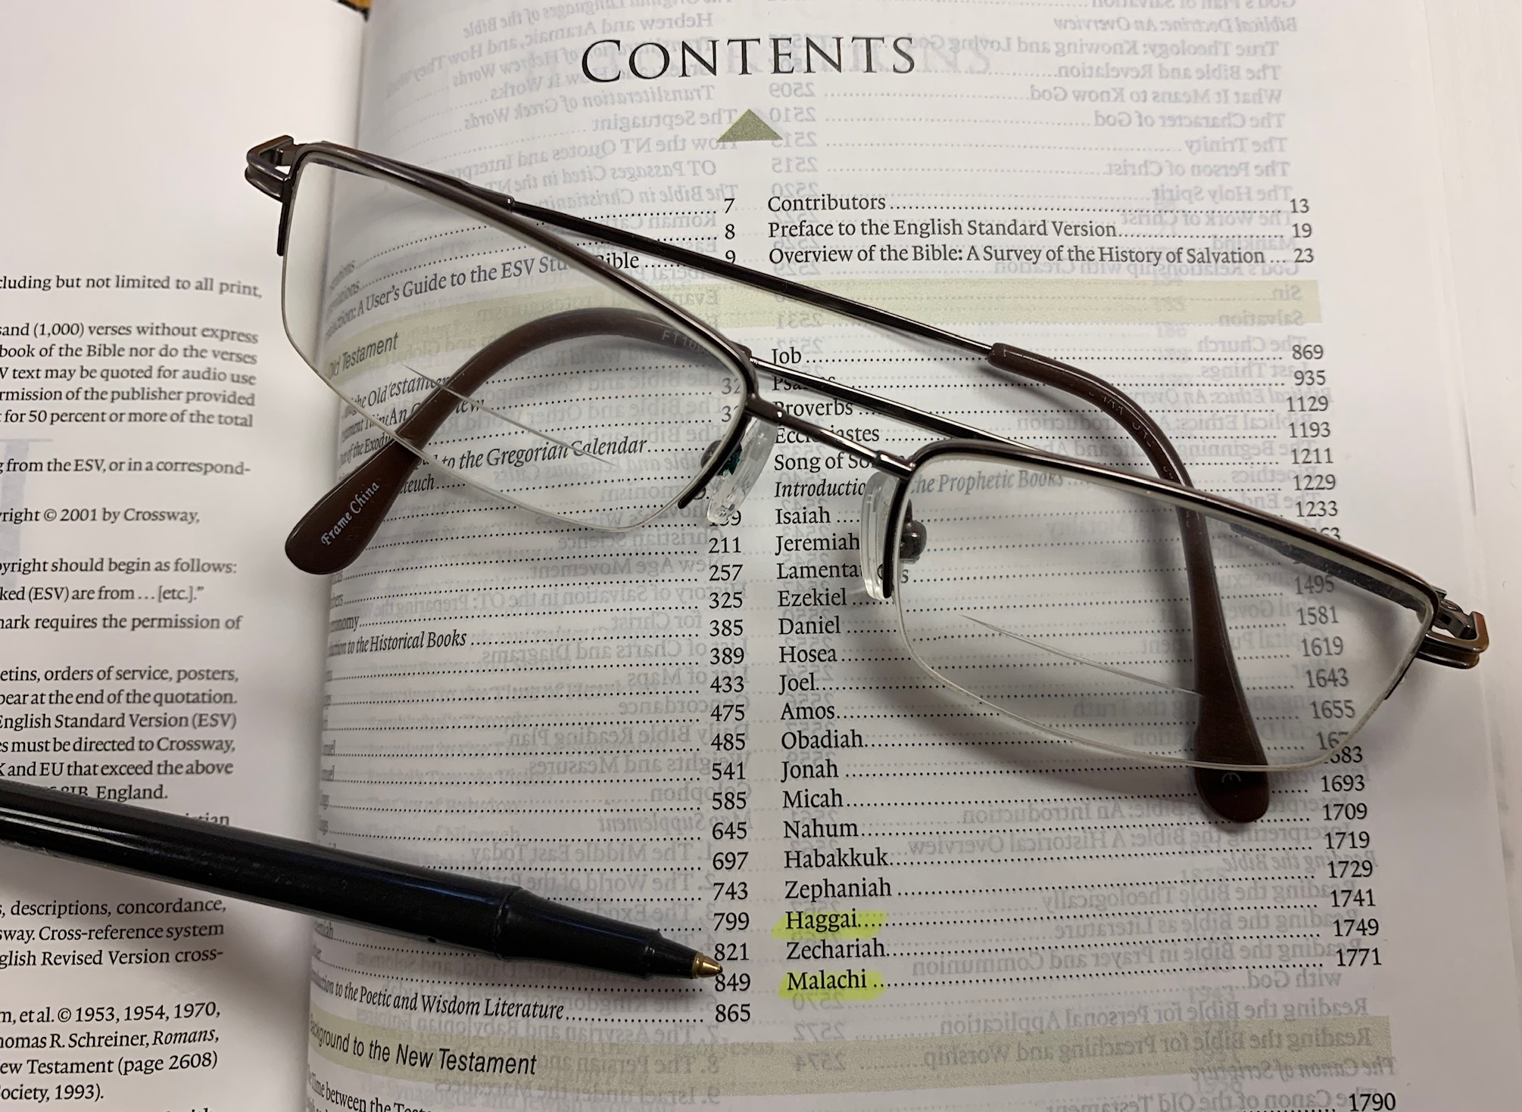
Majoring in the Minors
A sermon series from Haggai and Malachi

Slide 2
“To grow in wisdom and love is not to lose all fear of God; it is to change our fear of God. It is to pass from the servile fear of the slave, the fear of punishment, to the loving reverence of the son, fearing to offend his father, and in the end to the purely selfless fear of the lover, the fear of hurting what you love.” Gerald Vann

Slide 3
Honor His name as holy
Ἰησοῦς
ר֣וּחַ אֱלֹהִ֔ים
אֶֽהְיֶ֖ה
θεὸς
Malachi 2:1-9

Slide 4
I. God will not fail to act to ensure His name is honored above all (1-4)
1 “And now, O priests, this command is for you. 2 If you will not listen, if you will not take it to heart to give honor to my name, says the Lord of hosts, then I will send the curse upon you and I will curse your blessings. Indeed, I have already cursed them, because you do not lay it to heart.”

Slide 5
I. God will not fail to act to ensure His name is honored above all (1-4)
1 “And now, O priests, this command is for you. 2 If you will not listen, if you will not take it to heart to give honor to my name, says the Lord of hosts, then I will send the curse upon you and I will curse your blessings. Indeed, I have already cursed them, because you do not lay it to heart.”

Slide 6
I. God will not fail to act to ensure His name is honored above all (1-4)
1 “And now, O priests, this command is for you. 2 If you will not listen, if you will not take it to heart to give honor to my name, says the Lord of hosts, then I will send the curse upon you and I will curse your blessings. Indeed, I have already cursed them, because you do not lay it to heart.”

Slide 7
I. God will not fail to act to ensure His name is honored above all (1-4)
3 “Behold, I will rebuke your offspring, and spread dung on your faces, the dung of your offerings, and you shall be taken away with it.”
“I the Lord your God am a jealous God, visiting the iniquity of the fathers on the children to the third and the fourth generation of those who hate me.” Exodus 20:5

Slide 8
I. God will not fail to act to ensure His name is honored above all (1-4)
3 “Behold, I will rebuke your offspring, and spread dung on your faces, the dung of your offerings, and you shall be taken away with it.”

Slide 9
I. God will not fail to act to ensure His name is honored above all (1-4)
4 “So shall you know that I have sent this command to you, that my covenant with Levi may stand, says the Lord of hosts.”

Slide 10
II. God honors those who honor His name above all
(5-7)
5 “My covenant with him was one of life and peace, and I gave them to him. It was a covenant of fear, and he feared me. He stood in awe of my name. 6 True instruction was in his mouth, and no wrong was found on his lips. He walked with me in peace and uprightness, and he turned many from iniquity.”

Slide 11
The covenant of life and peace
“Phinehas the son of Eleazar, son of Aaron the priest, has turned back my wrath from the people of Israel, in that he was jealous with my jealousy among them, so that I did not consume the people of Israel in my jealousy. Therefore say, ‘Behold, I give to him my covenant of peace, and it shall be to him and to his descendants after him the covenant of a perpetual priesthood, because he was jealous for his God and made atonement for the people of Israel.’” Numbers 25:11-13

Slide 12
II. God honors those who honor His name above all
(5-7)
5 “My covenant with him was one of life and peace, and I gave them to him. It was a covenant of fear, and he feared me. He stood in awe of my name. 6 True instruction was in his mouth, and no wrong was found on his lips. He walked with me in peace and uprightness, and he turned many from iniquity.”

Slide 13
II. God honors those who honor His name above all
(5-7)
7 “For the lips of a priest should guard knowledge, and people should seek instruction from his mouth, for he is the messenger of the Lord of hosts.”

Slide 14
III. God will bring dishonor upon His people who fail to keep His ways (8-9)
8 “But you have turned aside from the way. You have caused many to stumble by your instruction. You have corrupted the covenant of Levi, says the Lord of hosts, 9 and so I make you despised and abased before all the people, inasmuch as you do not keep my ways but show partiality in your instruction.”

Slide 15
III. God will bring dishonor upon His people who fail to keep His ways (8-9)
Matthew 6:9
“Our Father in heaven, hallowed be your name.” ESV
“Our Father in heaven, your name be honored as holy.” CSB

Slide 16
IV. Honor His name as holy
Hold our leaders in the church to a high standard in how they live and teach
“Do your best to present yourself to God as one approved, a worker who has no need to be ashamed, rightly handling the word of truth.” 2 Timothy 2:15
“those who worship him must worship in spirit and truth” John 4:24

Slide 17
Stand in awe of His name
“Those who have God’s law in their hearts and thus have an appropriate and healthy fear of the true God, as did the early Levitical priests, have no need to fear anything else. As those who know the Lord, we must realize that we live every moment of every day in the immediate presence of a God whose limitless grace is all that protects us from being destroyed by the boundless conflagration of his righteous wrath. Only a fool could respond with anything but fear and love, which together should motivate diligent faithfulness and obedience.” Richard Taylor and Ray Clendenen

Slide 18
Honor His name as holy
Ἰησοῦς
ר֣וּחַ אֱלֹהִ֔ים
אֶֽהְיֶ֖ה
θεὸς
Malachi 2:1-9

