Slide 1
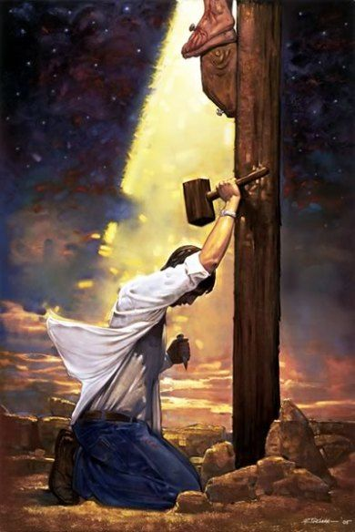
God’s power to save
A sermon series on the gospel from the book of Romans

Slide 2
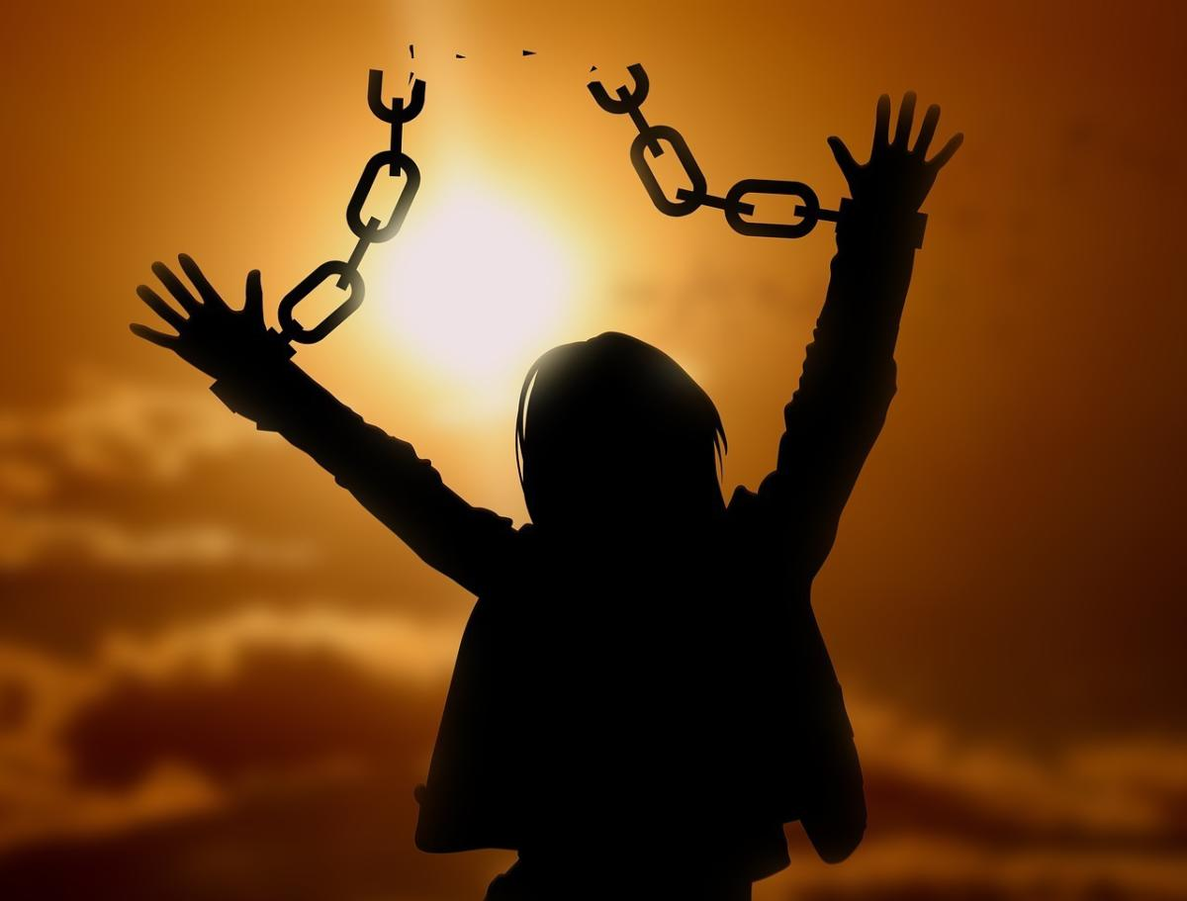
Under new ownership!
Romans 6:1-14

Slide 3
Satan
“the ruler of this world” John 12:31
Christ
“The kingdom of the world has become the kingdom of our Lord and of his Christ” Revelation 11:15

Slide 4
Christ
Holy Spirit
“all who are led by the Spirit of God are sons of God” Romans 8:14
Satan
Sin
“the spirit that is now at work in the sons of disobedience” Ephesians 2:2

Slide 5
Satan
Sin
Law
“I would not have known what it is to covet if the law had not said, ‘You shall not covet.’ But sin, seizing an opportunity through the commandment, produced in me all kinds of covetousness.” Romans 7:7-8
Christ
Holy Spirit
Grace
“For the grace of God has appeared…training us to renounce ungodliness and worldly passions, and to live self-controlled, upright, and godly lives in the present age” Titus 2:11-12

Slide 6
Satan
Sin
Law
Death
“you were dead in the trespasses and sins” Ephesians 2:1
Christ
Holy Spirit
Grace
Life
“The thief comes only to steal and kill and destroy. I came that they may have life and have it abundantly.” John 10:10

Slide 7
Satan
Sin
Law
Death
Christ
Holy Spirit
Grace
Life
“Jesus answered them, ‘Truly, truly, I say to you, everyone who practices sin is a slave to sin. The slave does not remain in the house forever; the son remains forever. So if the Son sets you free, you will be free indeed.’” John 8:34-36

Slide 8
Under new ownership!
Romans 6:1-14

Slide 9
I. In Christ, believers are forever united with His life (verses 1-5)
“…where sin increased, grace abounded all the more, so that, as sin reigned in death, grace also might reign through righteousness leading to eternal life through Jesus Christ our Lord.” Romans 5:20-21
“And why not do evil that good may come? —as some people slanderously charge us with saying.” Romans 3:8

Slide 10
I. In Christ, believers are forever united with His life (verses 1-5)
Christ did not die to unite us to an ungodly life (1-2)
1 What shall we say then? Are we to continue in sin that grace may abound? 2 By no means! How can we who died to sin still live in it?

Slide 11
I. In Christ, believers are forever united with His life (verses 1-5)
Christ did not die to unite us to an ungodly life (1-2)
Christ died and rose again to unite us to a life like His (3-5)
3 Do you not know that all of us who have been baptized into Christ Jesus were baptized into his death? 4 We were buried therefore with him by baptism into death, in order that, just as Christ was raised from the dead by the glory of the Father, we too might walk in newness of life. 5 For if we have been united with him in a death like his, we shall certainly be united with him in a resurrection like his.

Slide 12
I. In Christ, believers are forever united with His life (verses 1-5)
Christ did not die to unite us to an ungodly life (1-2)
Christ died and rose again to unite us to a life like His (3-5)
3 Do you not know that all of us who have been baptized into Christ Jesus were baptized into his death? 4 We were buried therefore with him by baptism into death, in order that, just as Christ was raised from the dead by the glory of the Father, we too might walk in newness of life. 5 For if we have been united with him in a death like his, we shall certainly be united with him in a resurrection like his.

Slide 13
I. In Christ, believers are forever united with His life (verses 1-5)
Christ did not die to unite us to an ungodly life (1-2)
Christ died and rose again to unite us to a life like His (3-5)
No resurrection; no gospel
As Paul writes in 1 Corinthians 15:17, “…if Christ has not been raised, your faith is futile and you are still in your sins.” Without Christ’s resurrection, we’re still helplessly bound under sin’s power and authority.

Slide 14
II. In Christ, believers are forever delivered from sin’s authority (verses 6-10)
Being united with Christ in His death sets us free from sin’s authority (6-7)
6 We know that our old self was crucified with him in order that the body of sin might be brought to nothing, so that we would no longer be enslaved to sin. 7 For one who has died has been set free from sin.
“…whoever hears my word and believes him who sent me has eternal life. He does not come into judgment, but has passed from death to life.” John 5:24

Slide 15
II. In Christ, believers are forever delivered from sin’s authority (verses 6-10)
Being united with Christ in His death sets us free from sin’s authority (6-7)
Being united with Christ in His resurrection sets us free to live for God (8-10)
8 Now if we have died with Christ, we believe that we will also live with him.

Slide 16
II. In Christ, believers are forever delivered from sin’s authority (verses 6-10)
Being united with Christ in His death sets us free from sin’s authority (6-7)
Being united with Christ in His resurrection sets us free to live for God (8-10)
9 We know that Christ, being raised from the dead, will never die again; death no longer has dominion over him. 10 For the death he died he died to sin, once for all, but the life he lives he lives to God.

Slide 17
II. In Christ, believers are forever delivered from sin’s authority (verses 6-10)
Being united with Christ in His death sets us free from sin’s authority (6-7)
Being united with Christ in His resurrection sets us free to live for God (8-10)
9 We know that Christ, being raised from the dead, will never die again; death no longer has dominion over him. 10 For the death he died he died to sin, once for all, but the life he lives he lives to God.

Slide 18
II. In Christ, believers are forever delivered from sin’s authority (verses 6-10)
Being united with Christ in His death sets us free from sin’s authority (6-7)
Being united with Christ in His resurrection sets us free to live for God (8-10)
9 We know that Christ, being raised from the dead, will never die again; death no longer has dominion over him. 10 For the death he died he died to sin, once for all, but the life he lives he lives to God.

Slide 19
II. In Christ, believers are forever delivered from sin’s authority (verses 6-10)
Being united with Christ in His death sets us free from sin’s authority (6-7)
Being united with Christ in His resurrection sets us free to live for God (8-10)
9 We know that Christ, being raised from the dead, will never die again; death no longer has dominion over him. 10 For the death he died he died to sin, once for all, but the life he lives he lives to God.

Slide 20
III. Live like you’re under new ownership! (verses 11-14)
You must always embrace who you are in Christ (11)
11 So you also must consider yourselves dead to sin and alive to God in Christ Jesus.
“reckon yourselves,” NKJV
2 By no means! How can we who died to sin still live in it?

Slide 21
III. Live like you’re under new ownership! (verses 11-14)
You must always embrace who you are in Christ (11)
You must always reject the overtures of your old master, “sin,” in your life (12-13a)
12 Let not sin therefore reign in your mortal body, to make you obey its passions.

Slide 22
III. Live like you’re under new ownership! (verses 11-14)
You must always embrace who you are in Christ (11)
You must always reject the overtures of your old master, “sin,” in your life (12-13a)
12 Let not sin therefore reign in your mortal body, to make you obey its passions. 13 Do not present your members to sin as instruments for unrighteousness…”
13 Do not let any part of your body become an instrument of evil to serve sin. (NLT)

Slide 23
III. Live like you’re under new ownership! (verses 11-14)
You must always embrace who you are in Christ (11)
You must always reject the overtures of your old master, “sin,” in your life (12-13a)
13 Do not let any part of your body become an instrument of evil to serve sin. (NLT)

Slide 24
III. Live like you’re under new ownership! (verses 11-14)
You must always embrace who you are in Christ (11)
You must always reject the overtures of your old master, “sin,” in your life (12-13a)
You must always seek God’s grace to live the righteous life He has called you to (13b-14)
13 …but present yourselves to God as those who have been brought from death to life, and your members to God as instruments for righteousness.
“…present your bodies as a living sacrifice, holy and acceptable to God.” Romans 12:1

Slide 25
III. Live like you’re under new ownership! (verses 11-14)
Seek His Grace
In His word
In prayer
“pray without ceasing” 1 Thessalonians 5:17

Slide 26
III. Live like you’re under new ownership! (verses 11-14)
Seek His Grace
In His word
In prayer
In corporate worship, fellowship, and study
“let us consider how to stir up one another to love and good works, not neglecting to meet together, as is the habit of some, but encouraging one another” Hebrews 10:24-25

Slide 27
III. Live like you’re under new ownership! (verses 11-14)
Seek His Grace
In His word
In prayer
In corporate worship, fellowship, and study
In service to the Lord
“For we are God’s fellow workers” 1 Corinthians 3:9
“Having gifts that differ according to the grace given to us, let us use them.” Romans 12:6

Slide 28
14 For sin will have no dominion over you, since you are not under law but under grace.

