Slide 1
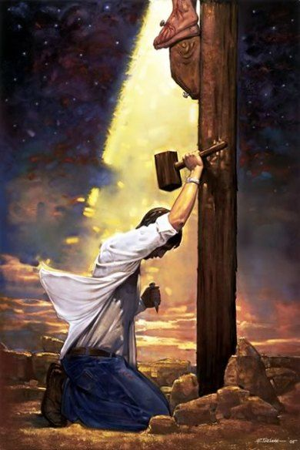
God’s power to save
A sermon series on the gospel from the book of Romans

Slide 2
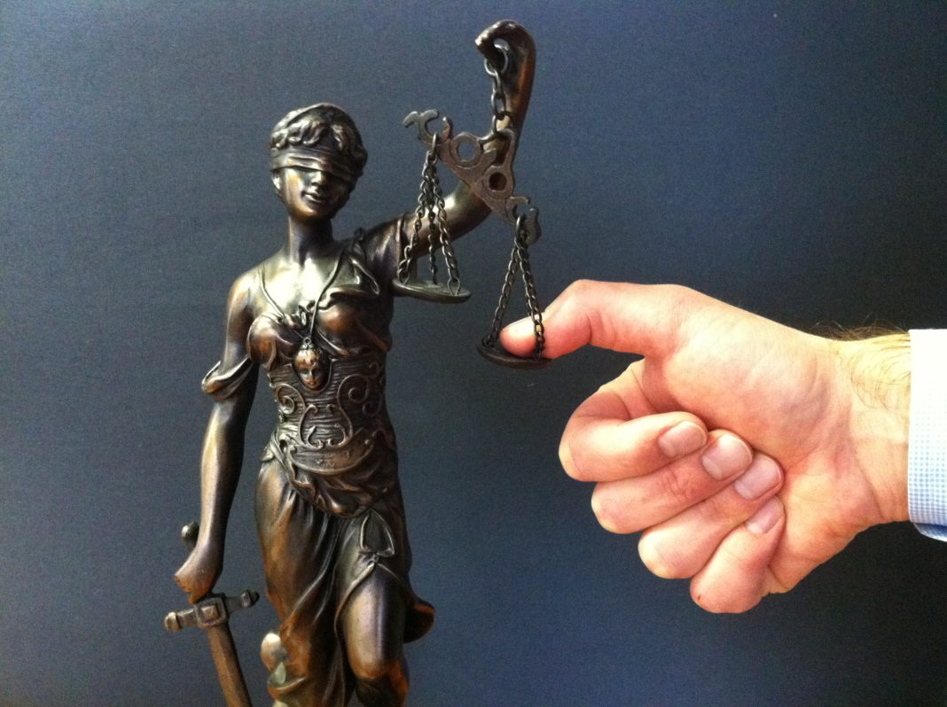
All fall short of the glory of God
Part 2 Romans 2:1-11

Slide 3
I. There is no religious exemption from God’s judgment upon sin (verses 1-5)
Speaking of people “filled with all manner of unrighteousness” (Romans 1:29), Paul writes “Though they know God’s righteous decree that those who practice such things deserve to die, they not only do them but give approval to those who practice them” (Romans 1:32).

Slide 4
I. There is no religious exemption from God’s judgment upon sin (verses 1-5)
Hypocrisy in human judgment mistakenly presumes God judges likewise (1-4)
1 Therefore you have no excuse, O man, every one of you who judges. For in passing judgment on another you condemn yourself, because you, the judge, practice the very same things. 2 We know that the judgment of God rightly falls on those who practice such things.

Slide 5
I. There is no religious exemption from God’s judgment upon sin (verses 1-5)
Hypocrisy in human judgment mistakenly presumes God judges likewise (1-4)
3 Do you suppose, O man—you who judge those who practice such things and yet do them yourself—that you will escape the judgment of God? 4 Or do you presume on the riches of his kindness and forbearance and patience, not knowing that God’s kindness is meant to lead you to repentance?”

Slide 6
The Wisdom of Solomon 1st Century B.C. Jewish Writing
After a lengthy teaching that God’s just judgement will come upon the Gentiles because of their idolatry and sin, the author writes in 15:1-2 “But you, our God, are kind and true, patient, and ruling all things in mercy. For even if we sin, we are yours.”

Slide 7
I. There is no religious exemption from God’s judgment upon sin (verses 1-5)
Hypocrisy in human judgment mistakenly presumes God judges likewise (1-4)
1 Therefore you have no excuse, O man, every one of you who judges. For in passing judgment on another you condemn yourself, because you, the judge, practice the very same things. 2 We know that the judgment of God rightly falls on those who practice such things.

Slide 8
I. There is no religious exemption from God’s judgment upon sin (verses 1-5)
Hypocrisy in human judgment mistakenly presumes God judges likewise (1-4)
Hypocrisy in human judgment brings God’s righteous wrath upon the hypocrite (5)
5 But because of your hard and impenitent heart you are storing up wrath for yourself on the day of wrath when God’s righteous judgment will be revealed.

Slide 9
I. There is no religious exemption from God’s judgment upon sin (verses 1-5)
Hypocrisy in human judgment mistakenly presumes God judges likewise (1-4)
Hypocrisy in human judgment brings God’s righteous wrath upon the hypocrite (5)
5 But because of your hard and impenitent heart you are storing up wrath for yourself on the day of wrath when God’s righteous judgment will be revealed.

Slide 10
II. God judges righteously (verses 6-11)
God judges impartially on the basis of deeds (6, 9b, 10b-11)
6 He will render to each one according to his works … 11 For God shows no partiality.
“To you, O Lord, belongs steadfast love. For you will render to a man according to his work.” Psalm 62:12

Slide 11
II. God judges righteously (verses 6-11)
God judges impartially on the basis of deeds (6, 9b, 10b-11)
6 He will render to each one according to his works … 11 For God shows no partiality.
“For the Son of Man is going to come with his angels in the glory of his Father, and then he will repay each person according to what he has done.” Matthew 16:27

Slide 12
II. God judges righteously (verses 6-11)
God judges impartially on the basis of deeds (6, 9b, 10b-11)
6 He will render to each one according to his works … 11 For God shows no partiality.
“As obedient children, do not be conformed to the passions of your former ignorance, but as he who called you is holy, you also be holy in all your conduct, since it is written, ‘You shall be holy, for I am holy.’ And if you call on him as Father who judges impartially according to each one’s deeds, conduct yourselves with fear throughout the time of your exile.” 1 Peter 1:14-17

Slide 13
II. God judges righteously (verses 6-11)
God judges impartially on the basis of deeds (6, 9b, 10b-11)
God renders eternal life to those who do good (7 & 10)
7 to those who by patience in well-doing seek for glory and honor and immortality, he will give eternal life.
10 but glory and honor and peace for everyone who does good, the Jew first and also the Greek.”

Slide 14
II. God judges righteously (verses 6-11)
God judges impartially on the basis of deeds (6, 9b, 10b-11)
God renders eternal life to those who do good (7 & 10)
God renders wrath, fury, tribulation and distress to those who do evil (8-9)
8 …for those who are self-seeking and do not obey the truth, but obey unrighteousness, there will be wrath and fury. 9 There will be tribulation and distress for every human being who does evil, the Jew first and also the Greek”

Slide 15
Concluding that God is indifferent towards the facts of our lives is a dangerous conclusion. It’s a conclusion Paul warns against in Galatians 6:7-9 when he writes “Do not be deceived: God is not mocked, for whatever one sows, that will he also reap. For the one who sows to his own flesh will from the flesh reap corruption, but the one who sows to the Spirit will from the Spirit reap eternal life. And let us not grow weary of doing good, for in due season we will reap, if we do not give up.”

Slide 16
“Paul goes out of his way to stress that the work that God so rewards is a persistent lifestyle of godliness. In contrast to these people are ‘those who are characterized by selfishness, and who disobey the truth while obeying unrighteousness, there will be wrath and fury.’ As the contrast in these verses makes clear, there are two, and only two, fates in store for every person at the time of God’s righteous judgment. Those who do not receive eternal life receive the punishment of God’s wrath. As often in Romans, Paul singles out obedience as indicative of one’s true spiritual state.” Doug Moo in his commentary on Romans 2:1-11

Slide 17
III. All fall short of the glory of God
God’s power working in us through the gospel is the sole cause for human righteousness
The gospel does what God promises us it does: save us by giving us new life in Christ in which God can find merit in us in judgment because, as Paul teaches in Titus 2:11-12, “…the grace of God has appeared, bringing salvation for all people, training us to renounce ungodliness and worldly passions, and to live self-controlled, upright, and godly lives in the present age.”

Slide 18
III. All fall short of the glory of God
God’s power working in us through the gospel is the sole cause for human righteousness
“For the mind that is set on the flesh is hostile to God, for it does not submit to God’s law; indeed, it cannot. Those who are in the flesh cannot please God. You, however, are not in the flesh but in the Spirit, if in fact the Spirit of God dwells in you. Anyone who does not have the Spirit of Christ does not belong to him. But if Christ is in you, although the body is dead because of sin, the Spirit is life because of righteousness.” Romans 8:7-10

Slide 19
III. All fall short of the glory of God
God’s power working in us through the gospel is the sole cause for human righteousness
The gospel does not promise an exemption from God’s impartial judgment of our sin
“Examine yourselves, to see whether you are in the faith. Test yourselves. Or do you not realize this about yourselves, that Jesus Christ is in you?—unless indeed you fail to meet the test!” 2 Corinthians 13:5

