Slide 1
Luke 2:13-14

Slide 2
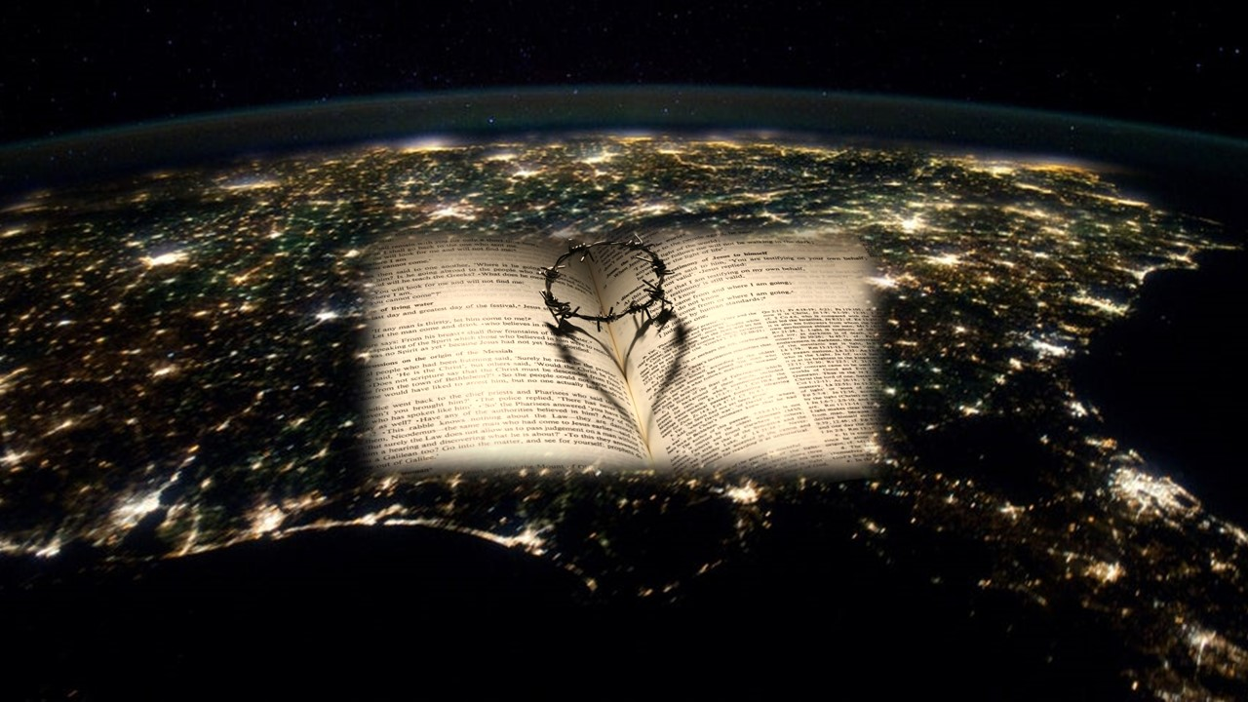
“Heaven’s glory is peace on earth!”

Slide 3
I. Christmas is a time of great joy because God is glorified in heaven
13 And suddenly there was with the angel a multitude of the heavenly host praising God and saying, 14 “Glory to God in the highest…
15 When the angels went away from them into heaven, the shepherds said to one another…
20 …the shepherds returned, glorifying and praising God for all they had heard and seen…

Slide 4
I. Christmas is a time of great joy because God is glorified in heaven
13 And suddenly there was with the angel a multitude of the heavenly host praising God and saying, 14 “Glory to God in the highest…
“Praise the Lord! Praise the Lord from the heavens; praise him in the heights! Praise him, all his angels; praise him, all his hosts! Praise him, sun and moon, praise him, all you shining stars! Praise him, you highest heavens, and you waters above the heavens!” Psalm 148:1-4

Slide 5
II. Christmas is a time of great joy because Christ gives God’s peace to His children on earth!
14 “Glory to God in the highest, and on earth peace among those with whom he is pleased!”
This peace is a gift particular to His children and its source is Jesus Christ
“For he himself is our peace…” Ephesians 2:14
“the punishment that brought us peace was on him…” Isaiah 53:5, NIV

Slide 6
II. Christmas is a time of great joy because Christ gives God’s peace to His children on earth!
14 “Glory to God in the highest, and on earth peace among those with whom he is pleased!”
This is peace He gives and that it’s not to be misunderstood as the kind of peace the world gives
“Do you think that I have come to give peace on earth? No, I tell you, but rather division. For from now on in one house there will be five divided, three against two and two against three. They will be divided, father against son and son against father, mother against daughter and daughter against mother, mother-in-law against her daughter-in-law and daughter-in-law against mother-in-law.” Luke 12:51-53

Slide 7
II. Christmas is a time of great joy because Christ gives God’s peace to His children on earth!
14 “Glory to God in the highest, and on earth peace among those with whom he is pleased!”
This is peace He gives and that it’s not to be misunderstood as the kind of peace the world gives
“Peace I leave with you; my peace I give to you. Not as the world gives do I give to you. Let not your hearts be troubled, neither let them be afraid.” John 14:27

Slide 8
II. Christmas is a time of great joy because Christ gives God’s peace to His children on earth!
14 “Glory to God in the highest, and on earth peace among those with whom he is pleased!”
It is the peace we have in the midst of troubles
“I have said these things to you, that in me you may have peace. In the world you will have tribulation. But take heart; I have overcome the world.” John 16:33

Slide 9
II. Christmas is a time of great joy because Christ gives God’s peace to His children on earth!
5 Blessings His peace brings
God’s peace brings us salvation
“As for the word that he sent to Israel, preaching good news of peace through Jesus Christ…” Acts 10:36
Paul describes the gospel as “the gospel of peace” in Ephesians 6:15

Slide 10
II. Christmas is a time of great joy because Christ gives God’s peace to His children on earth!
5 Blessings His peace brings
God’s peace brings us into His presence fully reconciled
“Therefore, since we have been justified by faith, we have peace with God through our Lord Jesus Christ. Through him we have also obtained access by faith into this grace in which we stand.” Romans 5:1-2

Slide 11
II. Christmas is a time of great joy because Christ gives God’s peace to His children on earth!
5 Blessings His peace brings
God’s peace brings us into His presence fully reconciled
“For if while we were enemies we were reconciled to God by the death of his Son, much more, now that we are reconciled, shall we be saved by his life. More than that, we also rejoice in God through our Lord Jesus Christ, through whom we have now received reconciliation.” Romans 5:10-11

Slide 12
II. Christmas is a time of great joy because Christ gives God’s peace to His children on earth!
5 Blessings His peace brings
God’s peace overtakes our inner being
“For those who live according to the flesh set their minds on the things of the flesh, but those who live according to the Spirit set their minds on the things of the Spirit. For to set the mind on the flesh is death, but to set the mind on the Spirit is life and peace.” Romans 8:5-6
“let the peace of Christ rule in your hearts.” Colossians 3:15

Slide 13
II. Christmas is a time of great joy because Christ gives God’s peace to His children on earth!
5 Blessings His peace brings
God’s peace overtakes our inner being
“do not be anxious about anything, but in everything by prayer and supplication with thanksgiving let your requests be made known to God. And the peace of God, which surpasses all understanding, will guard your hearts and your minds in Christ Jesus.” Philippians 4:6-7

Slide 14
II. Christmas is a time of great joy because Christ gives God’s peace to His children on earth!
5 Blessings His peace brings
God’s peace leads us in a right walk with Him
“Your faith has saved you; go in peace.” Luke 7:50
“Daughter, your faith has made you well; go in peace.” Luke 8:48
“because of the tender mercy of our God, whereby the sunrise shall visit us from on high to give light to those who sit in darkness and in the shadow of death, to guide our feet into the way of peace.” Luke 1:78-79

Slide 15
II. Christmas is a time of great joy because Christ gives God’s peace to His children on earth!
5 Blessings His peace brings
God’s peace leads us in a right walk with Him
“the gospel…is the power of God for salvation to everyone who believes, to the Jew first and also to the Greek.” Romans 1:16
“There will be tribulation and distress for every human being who does evil, the Jew first and also the Greek, but glory and honor and peace for everyone who does good, the Jew first and also the Greek.” Romans 2:9-10

Slide 16
II. Christmas is a time of great joy because Christ gives God’s peace to His children on earth!
5 Blessings His peace brings
God’s peace is established in His creation of the church
“For he himself is our peace, who has made the two groups one and has destroyed the barrier, the dividing wall of hostility, by setting aside in his flesh the law with its commands and regulations. His purpose was to create in himself one new humanity out of the two, thus making peace, and in one body to reconcile both of them to God through the cross, by which he put to death their hostility.” Ephesians 2:14-16 (NIV)

Slide 17
“Heaven’s glory is peace on earth!”

