Slide 1

Press on to maturity!

Slide 2
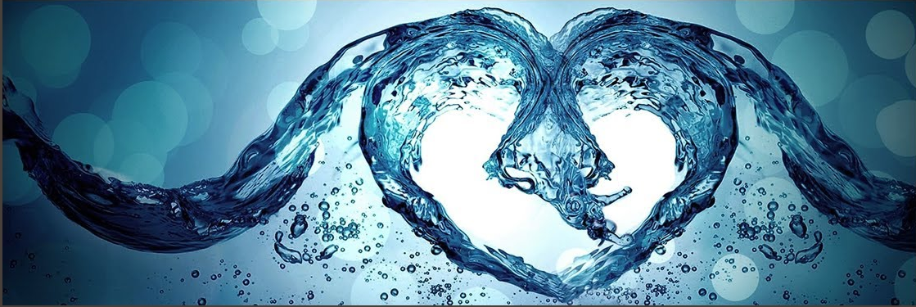
How now should we live?
Hebrews 10:19-31

Slide 3
I. In Christ, we have all we need to confidently live in a manner pleasing to God(verses 19-25)
“Faith is confidence in the person of Jesus Christ and in his power, so that even when his power does not serve my end, my confidence in him remains because of who he is.” Ravi Zacharias

Slide 4
I. In Christ, we have all we need to confidently live in a manner pleasing to God(verses 19-25)
19 Therefore, brothers, since we have confidence to enter the holy places by the blood of Jesus, 20 by the new and living way that he opened for us through the curtain, that is, through his flesh…
“I am the way, and the truth, and the life. No one comes to the Father except through me.” John 14:6

Slide 5
I. In Christ, we have all we need to confidently live in a manner pleasing to God(verses 19-25)
21 And since we have a great priest over the house of God…
We can draw near to God by faith (verse 22)
22 let us draw near with a true heart in full assurance of faith, with our hearts sprinkled clean from an evil conscience and our bodies washed with pure water.
  “full assurance:” a state of complete certainty (Greek Lexicon of the New Testament)

Slide 6
I. In Christ, we have all we need to confidently live in a manner pleasing to God(verses 19-25)
21 And since we have a great priest over the house of God…
We can draw near to God by faith (verse 22)
22 let us draw near with a true heart in full assurance of faith, with our hearts sprinkled clean from an evil conscience and our bodies washed with pure water.
“And that water is a picture of baptism, which now saves you, not by removing dirt from your body, but as a response to God from a clean conscience. It is effective because of the resurrection of Jesus Christ.” 1 Peter 3:21, NLT

Slide 7
I. In Christ, we have all we need to confidently live in a manner pleasing to God(verses 19-25)
21 And since we have a great priest over the house of God…
We can draw near to God by faith (verse 22)
We can live with certain hope in God’s promise of eternal salvation (verse 23)
23 Let us hold fast the confession of our hope without wavering, for he who promised is faithful.”

Slide 8
I. In Christ, we have all we need to confidently live in a manner pleasing to God(verses 19-25)
21 And since we have a great priest over the house of God…
We can draw near to God by faith (verse 22)
We can live with certain hope in God’s promise of eternal salvation (verse 23)
We can serve one another with love and good works (verses 24-25)
24 And let us consider how to stir up one another to love and good works.

Slide 9
24 And let us consider how to stir up one another to love and good works.
“Little children, let us not love in word or talk but in deed and in truth.” 1 John 3:18

Slide 10
24 And let us consider how to stir up one another to love and good works.
“And let us consider how to provoke one another to love and good deeds” Verse 24, NRSV
25 not neglecting to meet together, as is the habit of some, but encouraging one another, and all the more as you see the Day drawing near.
“If you love me, you will keep my commandments.” John 14:15

Slide 11
II. To choose a life of sin over a life of faith, hope and love will bring fearful judgment from the living God (verses 26-31)
A life of willful sin brings a judgment to be feared upon those in covenant relationship with God (verses 26-27 [29-30])

Slide 12
A case for taking this passage as a warning to believers
Verse 19: “Therefore, brothers…”
Verse 26: “For if we go on sinning deliberately...”
He then writes in verse 29 of the one who goes “on sinning deliberately,” that this action profanes “the blood of the covenant by which he was sanctified…”
Verse 30: “The Lord will judge his people.”

Slide 13
II. To choose a life of sin over a life of faith, hope and love will bring fearful judgment from the living God (verses 26-31)
A life of willful sin brings a judgment to be feared upon those in covenant relationship with God (verses 26-27 [29-30])
26 For if we go on sinning deliberately after receiving the knowledge of the truth, there no longer remains a sacrifice for sins, 27 but a fearful expectation of judgment, and a fury of fire that will consume the adversaries.
Greek Text: “fiery zeal”
27 fiery indignation which will devour the adversaries - NKJV

Slide 14
“the Lord disciplines the one he loves and chastises every son whom he receives.” Hebrews 12:6
“Whoever, therefore, eats the bread or drinks the cup of the Lord in an unworthy manner will be guilty concerning the body and blood of the Lord. Let a person examine himself, then, and so eat of the bread and drink of the cup. For anyone who eats and drinks without discerning the body eats and drinks judgment on himself. That is why many of you are weak and ill, and some have died. But if we judged ourselves truly, we would not be judged.” 1 Corinthians 11:27-31

Slide 15
II. To choose a life of sin over a life of faith, hope and love will bring fearful judgment from the living God (verses 26-31)
A life of willful sin brings a judgment to be feared upon those in covenant relationship with God (verses 26-27 [29-30])
This too is a lesson from the shadows (verses 28-31)
28 Anyone who has set aside the law of Moses dies without mercy on the evidence of two or three witnesses. 29 How much worse punishment, do you think, will be deserved by the one who has trampled underfoot the Son of God, and has profaned the blood of the covenant by which he was sanctified, and has outraged the Spirit of grace? 30 For we know him who said, “Vengeance is mine; I will repay.” And again, “The Lord will judge his people.” 31 It is a fearful thing to fall into the hands of the living God.

Slide 16
II. To choose a life of sin over a life of faith, hope and love will bring fearful judgment from the living God (verses 26-31)
A life of willful sin brings a judgment to be feared upon those in covenant relationship with God (verses 26-27 [29-30])
This too is a lesson from the shadows (verses 28-31)
28 Anyone who has set aside the law of Moses dies without mercy on the evidence of two or three witnesses. 29 How much worse punishment, do you think, will be deserved by the one who has trampled underfoot the Son of God, and has profaned the blood of the covenant by which he was sanctified, and has outraged the Spirit of grace? 30 For we know him who said, “Vengeance is mine; I will repay.” And again, “The Lord will judge his people.” 31 It is a fearful thing to fall into the hands of the living God.

Slide 17
II. To choose a life of sin over a life of faith, hope and love will bring fearful judgment from the living God (verses 26-31)
A life of willful sin brings a judgment to be feared upon those in covenant relationship with God (verses 26-27 [29-30])
This too is a lesson from the shadows (verses 28-31)
28 Anyone who has set aside the law of Moses dies without mercy on the evidence of two or three witnesses. 29 How much worse punishment, do you think, will be deserved by the one who has trampled underfoot the Son of God, and has profaned the blood of the covenant by which he was sanctified, and has outraged the Spirit of grace? 30 For we know him who said, “Vengeance is mine; I will repay.” And again, “The Lord will judge his people.” 31 It is a fearful thing to fall into the hands of the living God.

Slide 18
A Man after God’s own Heart in the hands of the living god - 2 Samuel 24
“The anger of the Lord was kindled against Israel, and he incited David against them, saying, ‘Go, number Israel and Judah.’” 24:1
“May the Lord your God add to the people a hundred times as many as they are, while the eyes of my lord the king still see it, but why does my lord the king delight in this thing?” (David’s Army commander Joab in 24:3)
“But the king’s word prevailed against Joab and the commanders of the army. So, Joab and the commanders. of the army went out from the presence of the king to number the people of Israel” 24:4

Slide 19
A Man after God’s own Heart in the hands of the living god - 2 Samuel 24
“But David’s heart struck him after he had numbered the people. And David said to the Lord, ‘I have sinned greatly in what I have done. But now, O Lord, please take away the iniquity of your servant, for I have done very foolishly.’” 24:10
“I am in great distress. Let us fall into the hand of the Lord, for his mercy is great; but let me not fall into the hand of man. So, the Lord sent a pestilence on Israel from the morning until the appointed time. And there died of the people from Dan to Beersheba 70,000 men.” 24:14-15

