Slide 1
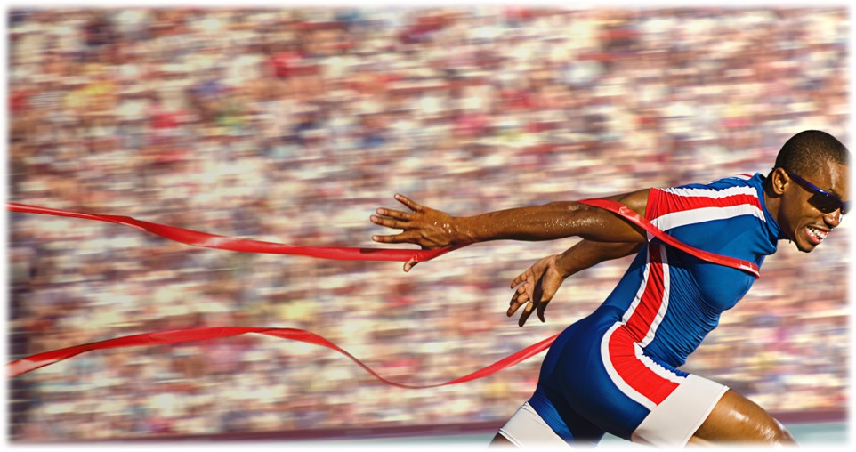
Press on to maturity!
In Hebrews 8:5, the author of Hebrews describes the ministry of the priests under the OT law saying “They serve a copy and shadow of the heavenly things.”

Slide 2
See how great He is!
Hebrews 7:1-10

Slide 3
I. Melchizedek is great because he resembles the Son of God (verses 1-3)
“The Lord has sworn and will not change his mind, You are a priest forever after the order of Melchizedek.” Psalm 110:4

Slide 4
I. Melchizedek is great because he resembles the Son of God (verses 1-3)
Abraham honored Melchizedek as his superior (verses 1-2a)
1 For this Melchizedek, king of Salem, priest of the Most High God, met Abraham returning from the slaughter of the kings and blessed him, 2 and to him Abraham apportioned a tenth part of everything.
Abraham did not honor the king of Sodom, but told him that he had sworn before the Lord “I would not take a thread or a sandal strap or anything that is yours.” Genesis 14:23

Slide 5
I. Melchizedek is great because he resembles the Son of God (verses 1-3)
Abraham honored Melchizedek as his superior (verses 1-2a)
Melchizedek resembles the character of the Son of God (verse 2b)
2 …He is first, by translation of his name, king of righteousness, and then he is also king of Salem, that is, king of peace.

Slide 6
I. Melchizedek is great because he resembles the Son of God (verses 1-3)
Abraham honored Melchizedek as his superior (verses 1-2a)
Melchizedek resembles the character of the Son of God (verse 2b)
Melchizedek also resembles the nature of the Son of God (verse 3)
3 He is without father or mother or genealogy, having neither beginning of days nor end of life, but resembling the Son of God he continues a priest forever.

Slide 7
II. Melchizedek is great because his priesthood is superior to any priesthood perpetuated through descent by mortal men (verses 4-10)
“See how great this man was to whom Abraham the patriarch gave a tenth of the spoils!” (verses 4-6)
“And see this great one!” Greek text of verse 4
“See how great he is!” New Revised Standard Version of verse 4

Slide 8
II. Melchizedek is great because his priesthood is superior to any priesthood perpetuated through descent by mortal men (verses 4-10)
“See how great this man was to whom Abraham the patriarch gave a tenth of the spoils!” (verses 4-6)
5 And those descendants of Levi who receive the priestly office have a commandment in the law to take tithes from the people, that is, from their brothers, though these also are descended from Abraham. 6 But this man who does not have his descent from them received tithes from Abraham and blessed him who had the promises.

Slide 9
II. Melchizedek is great because his priesthood is superior to any priesthood perpetuated through descent by mortal men (verses 4-10)
“See how great this man was to whom Abraham the patriarch gave a tenth of the spoils!” (verses 4-6)
Levi himself also paid tithes to Melchizedek (verses 7-10)
7 It is beyond dispute that the inferior is blessed by the superior. 8 In the one case tithes are received by mortal men, but in the other case, by one of whom it is testified that he lives. 9 One might even say that Levi himself, who receives tithes, paid tithes through Abraham, 10 for he was still in the loins of his ancestor when Melchizedek met him.

Slide 10
II. Melchizedek is great because his priesthood is superior to any priesthood perpetuated through descent by mortal men (verses 4-10)
“See how great this man was to whom Abraham the patriarch gave a tenth of the spoils!” (verses 4-6)
Levi himself also paid tithes to Melchizedek (verses 7-10)
7 It is beyond dispute that the inferior is blessed by the superior. 8 In the one case tithes are received by mortal men, but in the other case, by one of whom it is testified that he lives. 9 One might even say that Levi himself, who receives tithes, paid tithes through Abraham, 10 for he was still in the loins of his ancestor when Melchizedek met him.

Slide 11
II. Melchizedek is great because his priesthood is superior to any priesthood perpetuated through descent by mortal men (verses 4-10)
“See how great this man was to whom Abraham the patriarch gave a tenth of the spoils!” (verses 4-6)
Levi himself also paid tithes to Melchizedek (verses 7-10)
7 It is beyond dispute that the inferior is blessed by the superior. 8 In the one case tithes are received by mortal men, but in the other case, by one of whom it is testified that he lives. 9 One might even say that Levi himself, who receives tithes, paid tithes through Abraham, 10 for he was still in the loins of his ancestor when Melchizedek met him.

Slide 12
III. See how great he is!
Our little systems have their day;
They have their day
and cease to be;
They are but
broken lights of thee,
And thou, O Lord,
art more than they.
Alfred, Lord Tennyson

Slide 13
III. See how great he is!
“I'm not. But each year you grow, you'll find me bigger.” Aslan from C.S. Lewis’ Chronicles of Narnia
“I am the light of the world. Whoever follows me will not walk in darkness, but will have the light of life.” John 8:12

