Slide 1
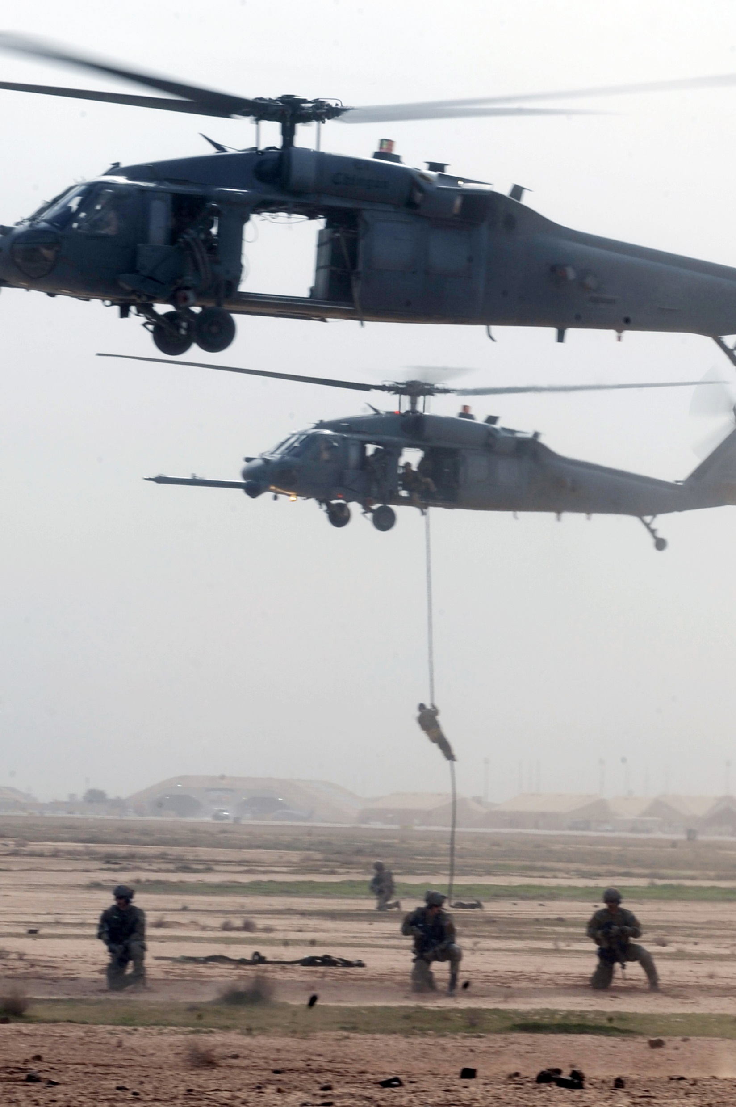

Slide 2
The greatest rescue story ever told!
Romans 5:6-11

Slide 3
I. God’s love for us is inconceivable in human terms… (Romans 5:6-8 )
“I shall sell my life dearly to my enemy fire but give it freely to rescue those in peril. With God’s help, I shall endeavor to be one of His noblest Works.” Fire Chief Bobbly Halton and the closing excerpt of his Firefighter’s Creed

Slide 4
I. God’s love for us is inconceivable in human terms… (Romans 5:6-8 )
“For while we were still weak, at the right time Christ died for the ungodly. For one will scarcely die for a righteous person—though perhaps for a good person one would dare even to die—but God shows his love for us in that while we were still sinners, Christ died for us.” Romans 5:6-8
“For while we were still helpless.” (New American Standard Bible)

Slide 5
I. God’s love for us is inconceivable in human terms… (Romans 5:6-8 )
“For while we were still weak, at the right time Christ died for the ungodly. For one will scarcely die for a righteous person—though perhaps for a good person one would dare even to die—but God shows his love for us in that while we were still sinners, Christ died for us.” Romans 5:6-8

Slide 6
I. God’s love for us is inconceivable in human terms… (Romans 5:6-8 )
“For while we were still weak, at the right time Christ died for the ungodly. For one will scarcely die for a righteous person—though perhaps for a good person one would dare even to die—but God shows his love for us in that while we were still sinners, Christ died for us.” Romans 5:6-8

Slide 7
II. Jesus Christ is God’s love in action who… (Romans 5:9-11)
Makes us right in God’s sight
“Since, therefore, we have now been justified by his blood.” Romans 5:9
“we have been made right in God’s sight by the blood of Christ.” Romans 5:9, New Living Translation

Slide 8
II. Jesus Christ is God’s love in action who… (Romans 5:9-11)
Makes us right in God’s sight
Saves us from the coming wrath of God
“Since, therefore, we have now been justified by his blood, much more shall we be saved by him from the wrath of God.” Romans 5:9
“For God has not destined us for wrath, but to obtain salvation through our Lord Jesus Christ.” 1 Thessalonians 5:9

Slide 9
II. Jesus Christ is God’s love in action who… (Romans 5:9-11)
Makes us right in God’s sight
Saves us from the coming wrath of God
Restores us to right relationship with God
“For if while we were enemies we were reconciled to God by the death of his Son...” Romans 5:10
“we have peace with God through our Lord Jesus Christ.” Romans 5:1

Slide 10
II. Jesus Christ is God’s love in action who… (Romans 5:9-11)
Makes us right in God’s sight
Saves us from the coming wrath of God
Restores us to right relationship with God
“For if while we were enemies we were reconciled to God by the death of his Son...” Romans 5:10
“All we like sheep have gone astray; we have turned—every one—to his own way.” Isaiah 53:6

Slide 11
II. Jesus Christ is God’s love in action who… (Romans 5:9-11)
Makes us right in God’s sight
Saves us from the coming wrath of God
Restores us to right relationship with God
“For if while we were enemies we were reconciled to God by the death of his Son...” Romans 5:10
“Love your enemies.” Matthew 5:44
“God so loved the world, that he gave his only Son, that whoever believes in him should not perish but have eternal life.” John 3:16

Slide 12
II. Jesus Christ is God’s love in action who… (Romans 5:9-11)
Makes us right in God’s sight
Saves us from the coming wrath of God
Restores us to right relationship with God
Saves us for the joy of a coming eternity with God
“For if while we were enemies we were reconciled to God by the death of his Son, much more, now that we are reconciled, shall we be saved by his life. More than that, we also rejoice in God through our Lord Jesus Christ, through whom we have now received reconciliation.” Romans 5:10-11

Slide 13
“…the Lord himself will come down from heaven with a commanding shout, with the voice of the archangel, and with the trumpet call of God. First, the believers who have died will rise from their graves. Then, together with them, we who are still alive and remain on the earth will be caught up in the clouds to meet the Lord in the air. Then we will be with the Lord forever.” 1 Thessalonians 4:16-17

Slide 14
II. Jesus Christ is God’s love in action who… (Romans 5:9-11)
Makes us right in God’s sight
Saves us from the coming wrath of God
Restores us to right relationship with God
Saves us for the joy of a coming eternity with God
“For if while we were enemies we were reconciled to God by the death of his Son, much more, now that we are reconciled, shall we be saved by his life. More than that, we also rejoice in God through our Lord Jesus Christ, through whom we have now received reconciliation.” Romans 5:10-11

Slide 15
III. The greatest rescue story ever told!

Slide 16
III. The greatest rescue story ever told!
“…so that in the coming ages he might show the immeasurable riches of his grace in kindness toward us in Christ Jesus.” Ephesians 2:7
But for those who trust in Jesus, Paul writes elsewhere in the bible that God rescued us…

