Slide 1
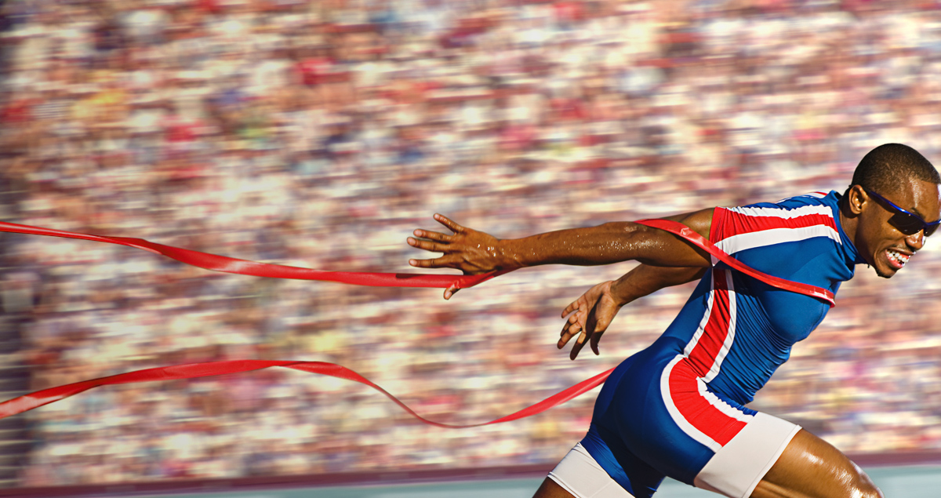
Press on to maturity!
A Sermon Series on the book of Hebrews

Slide 2
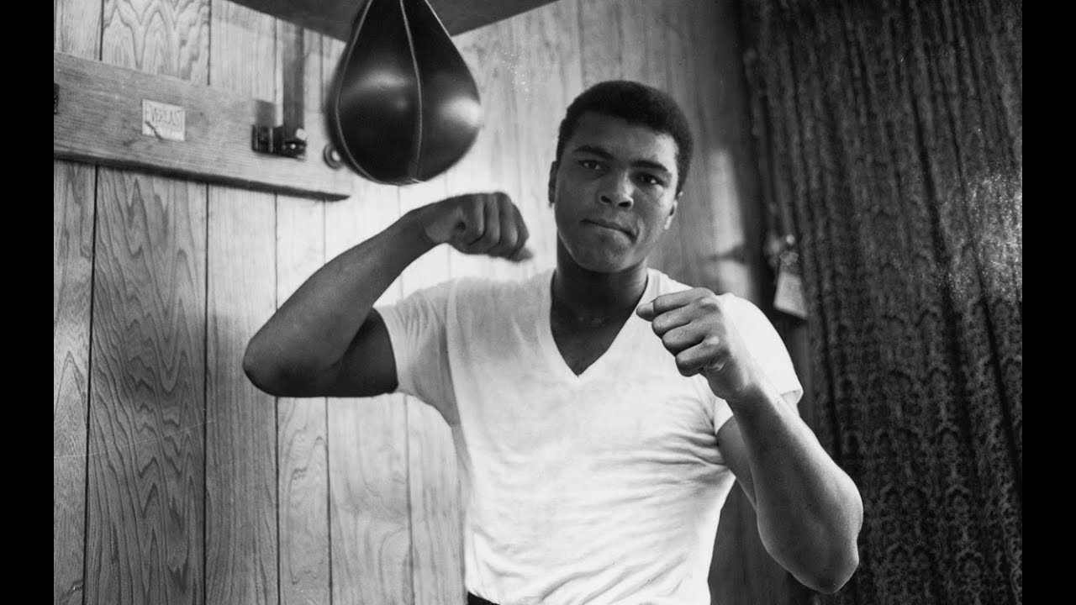
“Do you not know that in a race all the runners run, but only one receives the prize? So, run that you may obtain it. Every athlete exercises self-control in all things. They do it to receive a perishable wreath, but we an imperishable. So, I do not run aimlessly; I do not box as one beating the air. But I discipline my body and keep it under control, lest after preaching to others I myself should be disqualified.” 1 Corinthians 9:24-27

Slide 3
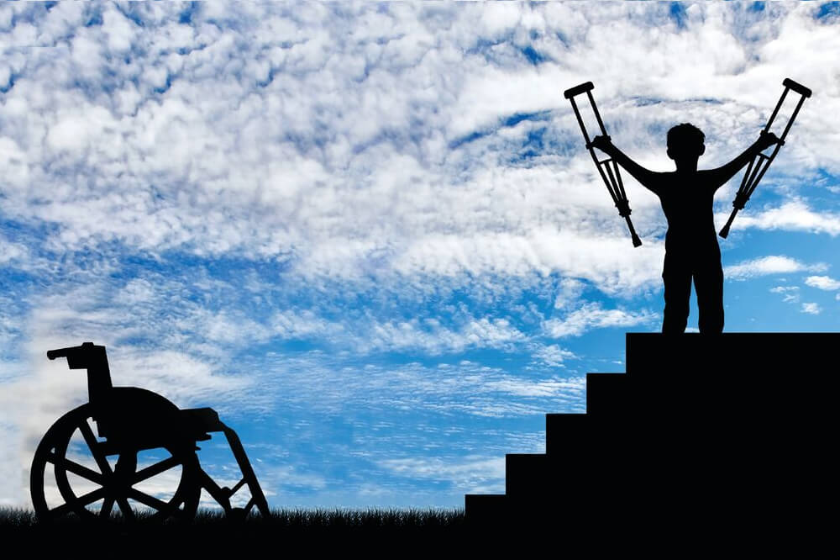
Genuine faith finishes the race: part 2
Hebrews 4:1-13

Slide 4
I. Assurance of salvation and a healthy fear of God go hand-in-hand…(verses 1-10)
“For if we go on sinning deliberately after receiving the knowledge of the truth, there no longer remains a sacrifice for sins, but a fearful expectation of judgment, and a fury of fire that will consume the adversaries.” Hebrews 10:26-27
“There will be tribulation and distress for every human being who does evil…but glory and honor and peace for everyone who does good…For God shows no partiality.” Romans 2:9-11

Slide 5
I. Assurance of salvation and a healthy fear of God go hand-in-hand…(verses 1-10)
Because the gospel brings no benefit to the disobedient (verses 1-2)
1 Therefore, while the promise of entering his rest still stands, let us fear lest any of you should seem to have failed to reach it. 2 For good news came to us just as to them, but the message they heard did not benefit them, because they were not united by faith with those who listened.

Slide 6
I. Assurance of salvation and a healthy fear of God go hand-in-hand…(verses 1-10)
Because the gospel brings no benefit to the disobedient (verses 1-2)
“The practical implication is clear: it is not the hearing of the gospel by itself that brings final salvation, but its appropriation by faith; and if that faith is a genuine faith, it will be a persistent faith.” F.F. Bruce

Slide 7
I. Assurance of salvation and a healthy fear of God go hand-in-hand…(verses 1-10)
Because the gospel brings no benefit to the disobedient (verses 1-2)
Because we enter into the promise of His rest now through the obedience of faith (verses 3-7)
3 For we who have believed enter that rest, as he has said, “As I swore in my wrath, ‘They shall not enter my rest,’ ”although his works were finished from the foundation of the world. 4 For he has somewhere spoken of the seventh day in this way: “And God rested on the seventh day from all his works.”

Slide 8
I. Assurance of salvation and a healthy fear of God go hand-in-hand…(verses 1-10)
Because the gospel brings no benefit to the disobedient (verses 1-2)
Because we enter into the promise of His rest now through the obedience of faith (verses 3-7)
5 And again in this passage he said, “They shall not enter my rest.” 6 Since therefore it remains for some to enter it, and those who formerly received the good news failed to enter because of disobedience, 7 again he appoints a certain day, “Today,” saying through David so long afterward, in the words already quoted, “Today, if you hear his voice, do not harden your hearts.”

Slide 9
I. Assurance of salvation and a healthy fear of God go hand-in-hand…(verses 1-10)
Because the gospel brings no benefit to the disobedient (verses 1-2)
Because we enter into the promise of His rest now through the obedience of faith (verses 3-7)
3 For we who have believed enter that rest, as he has said, “As I swore in my wrath, ‘They shall not enter my rest,’ ”although his works were finished from the foundation of the world … 6 Since therefore it remains for some to enter it, and those who formerly received the good news failed to enter because of disobedience

Slide 10
I. Assurance of salvation and a healthy fear of God go hand-in-hand…(verses 1-10)
Because the gospel brings no benefit to the disobedient (verses 1-2)
Because we enter into the promise of His rest now through the obedience of faith (verses 3-7)
Because the course of faith continues to the finish line (verses 8-10)
8 For if Joshua had given them rest, God would not have spoken of another day later on. 9 So then, there remains a Sabbath rest for the people of God, 10 for whoever has entered God’s rest has also rested from his works as God did from his.

Slide 11
I. Assurance of salvation and a healthy fear of God go hand-in-hand…(verses 1-10)
Because the gospel brings no benefit to the disobedient (verses 1-2)
Because we enter into the promise of His rest now through the obedience of faith (verses 3-7)
Because the course of faith continues to the finish line (verses 8-10)
“And I heard a voice from heaven saying, ‘Write this: Blessed are the dead who die in the Lord from now on.’ ‘Blessed indeed,’ says the Spirit, ‘that they may rest from their labors, for their deeds follow them!’” Revelation 14:13

Slide 12
II. Therefore, let each of us make every effort to finish the race (verses 11-13)
Respond obediently to the deep conviction God’s word brings (verses 11-12)
11 Let us therefore strive to enter that rest, so that no one may fall by the same sort of disobedience.
“To the pure, all things are pure, but to the defiled and unbelieving, nothing is pure; but both their minds and their consciences are defiled. They profess to know God, but they deny him by their works. They are detestable, disobedient, unfit for any good work.” Titus 1:15-16

Slide 13
II. Therefore, let each of us make every effort to finish the race (verses 11-13)
Respond obediently to the deep conviction God’s word brings (verses 11-12)
11 Let us therefore strive to enter that rest, so that no one may fall by the same sort of disobedience
12 For the word of God is living and active, sharper than any two-edged sword, piercing to the division of soul and of spirit, of joints and of marrow, and discerning the thoughts and intentions of the heart.

Slide 14
II. Therefore, let each of us make every effort to finish the race (verses 11-13)
Respond obediently to the deep conviction God’s word brings (verses 11-12)
Surrender to the mastery God seeks to have over you through the power of His word (verse 13)
13 And no creature is hidden from his sight, but all are naked and exposed to the eyes of him to whom we must give account.

Slide 15
Conclusion
James 2:19-20
19 You believe that God is one; you do well. Even the demons believe—and shudder! 20 Do you want to be shown, you foolish person, that faith apart from works is useless?
It proves itself as useless by…
Effectively denying the object of your faith
Effectively denying the purpose and power of God

Slide 16

Genuine faith finishes the race
“Therefore, since we are surrounded by so great a cloud of witnesses, let us also lay aside every weight, and sin which clings so closely, and let us run with endurance the race that is set before us, looking to Jesus, the founder and perfecter of our faith…” Hebrews 12:1-2

