Slide 1
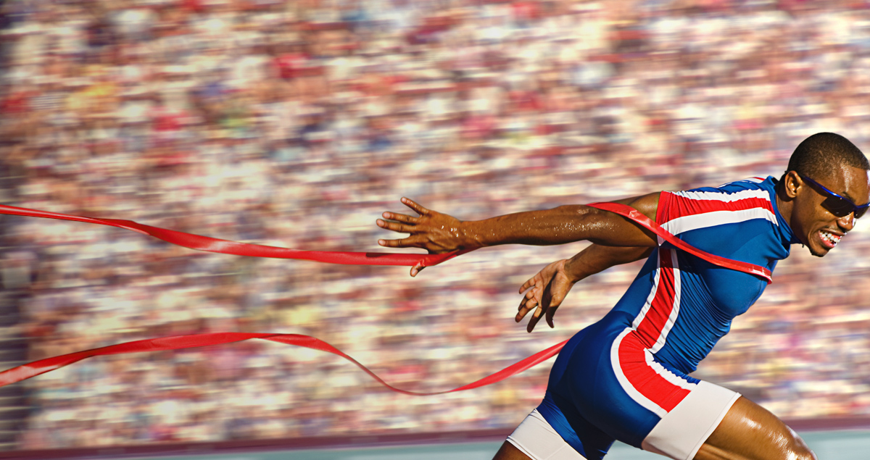
Press on to maturity!
A Sermon Series on the book of Hebrews

Slide 2
I. What is the background to the book of Hebrews?
Original audience, location and date
Author
Literary form
“I appeal to you, brothers, bear with my word of exhortation…” (13:22)
Portrayal of Jesus

Slide 3
II. What is the structure of the book of Hebrews?
Jesus is preeminent in every way over everyone and everything (1:1-2:18)
Don’t fail to heed Jesus’ voice, and so, follow the pattern of those in the Scriptures who failed to do so at great cost (3:1-4:13)
Therefore, do not stagnate or fall back in your walk, but rather, press on to maturity (4:14-6:20)
Jesus, who is our great High Priest, “is able to save to the uttermost those who draw near to God through him, since he always lives to make intercession for them” (7:1-7:28)

Slide 4
II. What is the structure of the book of Hebrews?
As our great High Priest, Jesus mediates a better covenant enacted on better promises (8:1-10:18)
With confidence in Jesus Christ, persevere in faith to the end, looking to Jesus, the founder and perfecter of our faith (10:19-12:29)

Slide 5
Hebrews 11 and the heroes of faith
Heroes of faith like Abraham who “was looking forward to the city that has foundations, whose designer and builder is God” (11:10)
Heroes of faith who “desire a better country, that is, a heavenly one” (11:16)
Heroes of faith like Moses who “considered the reproach of Christ greater wealth than the treasures of Egypt, for he was looking to the reward” (10:26)
Heroines of faith as well for “Women received back their dead by resurrection. Some were tortured, refusing to accept release, so that they might rise again to a better life” (11:35)

Slide 6
II. What is the structure of the book of Hebrews?
As our great High Priest, Jesus mediates a better covenant enacted on better promises (8:1-10:18)
With confidence in Jesus Christ, persevere in faith to the end, looking to Jesus, the founder and perfecter of our faith (10:19-12:29)
In light of everything taught, maintain your Christian confession in patience and hope, and live as Christians should (13:1-25)

Slide 7
Press on to maturity!
A Sermon Series on the book of Hebrews

