Slide 1
Our Finest Gifts we bring!
A Christmas sermon series

Slide 2
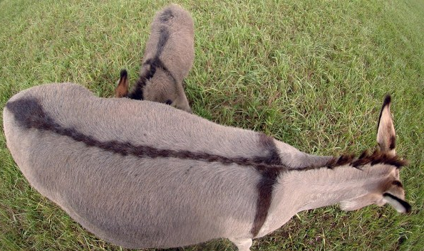
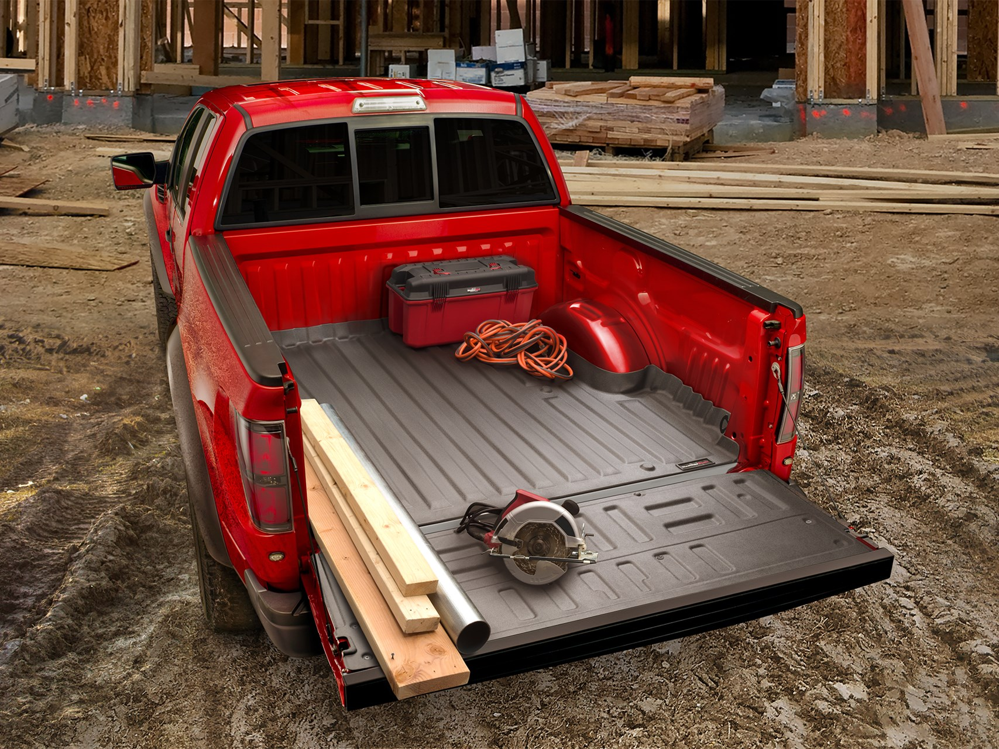
Put your things at the king’s disposal Matthew 21:1-7

Slide 3
I. What is Christ doing in today’s passage?
Jesus is fulfilling a prophecy of great historical significance (verses 4-5)
4 This took place to fulfill what was spoken by the prophet, saying, 5 “Say to the daughter of Zion, ‘Behold, your king is coming to you, humble, and mounted on a donkey, on a colt, the foal of a beast of burden.’”
“Rejoice greatly, O daughter of Zion! Shout aloud, O daughter of Jerusalem! Behold, your king is coming to you; righteous and having salvation is he, humble and mounted on a donkey, on a colt, the foal of a donkey.” Zechariah 9:9

Slide 4
I. What is Christ doing in today’s passage?
Jesus is fulfilling a prophecy of great historical significance (verses 4-5)
“Rejoice greatly, O daughter of Zion! Shout aloud, O daughter of Jerusalem! Behold, your king is coming to you; righteous and having salvation is he, humble and mounted on a donkey, on a colt, the foal of a donkey.” Zechariah 9:9
“I will cut off the chariot from Ephraim and the war horse from Jerusalem; and the battle bow shall be cut off, and he shall speak peace to the nations; his rule shall be from sea to sea…” Zechariah 9:10

Slide 5
I. What is Christ doing in today’s passage?
Jesus is fulfilling a prophecy of great historical significance (verses 4-5)
Jesus undertakes ordinary everyday activities (verses 1-3, 6-7)
3 If anyone says anything to you, you shall say, ‘The Lord needs them,’ and he will send them at once.
“For every beast of the forest is mine, the cattle on a thousand hills. I know all the birds of the hills, and all that moves in the field is mine. If I were hungry, I would not tell you, for the world and its fullness are mine.” Psalm 50:10-12

Slide 6
II. How does Christ involve people in His work?
Through the same kind of ordinary everyday activities Jesus Himself engaged in (verses 1-3, 6)
1 Now when they drew near to Jerusalem and came to Bethpage, to the Mount of Olives, then Jesus sent two disciples, 2 saying to them, “Go into the village in front of you, and immediately you will find a donkey tied, and a colt with her. Untie them and bring them to me. 3 If anyone says anything to you, you shall say, ‘The Lord needs them,’ and he will send them at once.” … 6 The disciples went and did as Jesus had directed them.

Slide 7
II. How does Christ involve people in His work?
Through the same kind of ordinary everyday activities Jesus Himself engaged in (verses 1-3, 6)
Through the offering of their possessions to serve His eternal purposes (verses 2-3, 7)
2 …Go into the village in front of you, and immediately you will find a donkey tied, and a colt with her. Untie them and bring them to me. 3 If anyone says anything to you, you shall say, ‘The Lord needs them,’ and he will send them at once.” … 7 They brought the donkey and the colt and put on them their cloaks, and he sat on them.

Slide 8
III. Put Your Things at the King’s Disposal
Our works are bound to Him
“Then the King will say to those on his right, ‘Come, you who are blessed by my Father, inherit the kingdom prepared for you from the foundation of the world.’” Matthew 25:34
“Truly, I say to you, as you did it to one of the least of these my brothers, you did it to me.” Matthew 25:40
“Whoever is generous to the poor lends to the Lord, and he will repay him for his deed.” Proverbs 19:17

Slide 9
III. Put Your Things at the King’s Disposal
Our works are bound to Him
Putting your things at the King’s disposal gives us access to everything at the King’s disposal!
“You will be enriched in every way to be generous in every way.” 2 Corinthians 9:11

Slide 10
III. Put Your Things at the King’s Disposal
Our works are bound to Him
Putting your things at the King’s disposal gives us access to everything at the King’s disposal!
“Well done, good and faithful servant. You have been faithful over a little; I will set you over much. Enter into the joy of your master.” Matthew 25:21

Slide 11
III. Put Your Things at the King’s Disposal
Our works are bound to Him
Putting your things at the King’s disposal gives us access to everything at the King’s disposal!
Seize the opportunity!
“Do not neglect to show hospitality to strangers, for thereby some have entertained angels unawares.” Hebrews 13:2
“…as you did it to one of the least of these my brothers, you did it to me.” Matthew 25:40

Slide 12
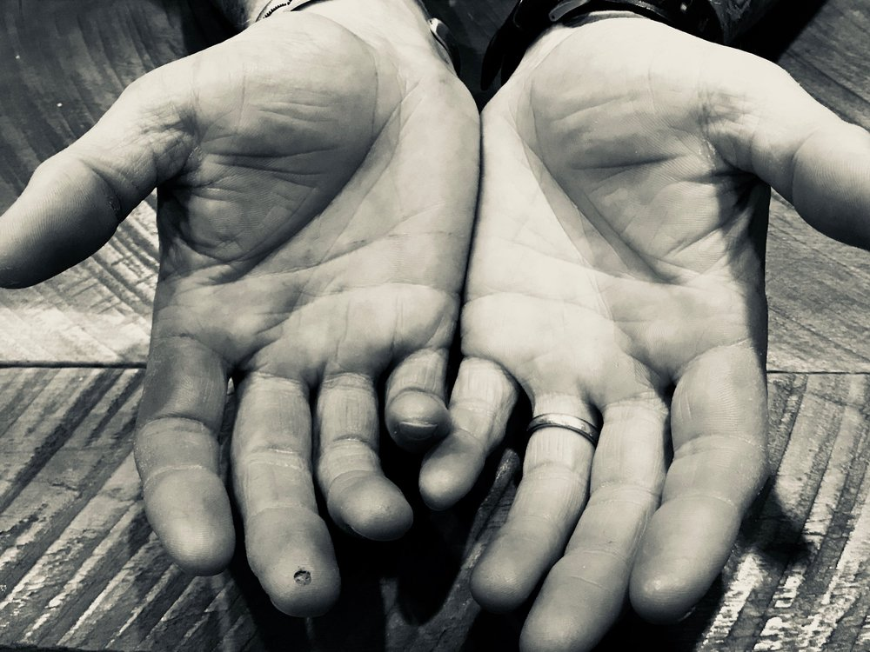
“Enter into the joy of your master.” Matthew 25:21
Put your things at the King’s disposal

