Slide 2
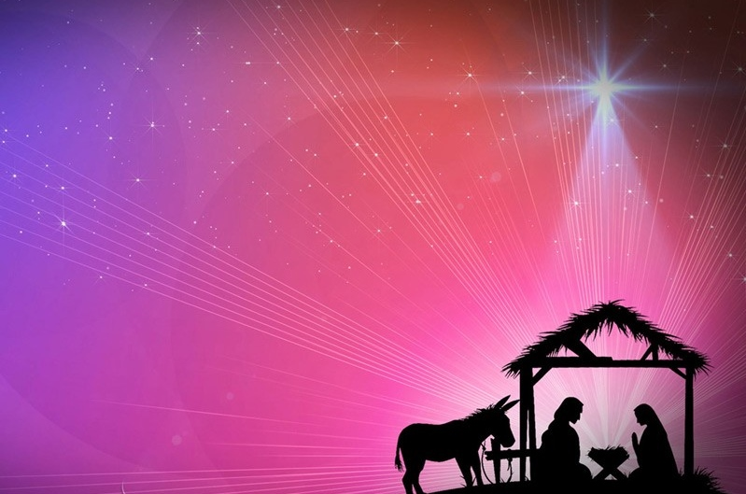
Our Finest Gifts we bring!
A Christmas sermon series
Pursue Radical reconciliation
Matthew 5:21-26

Slide 3
I. Our failure to reconcile leaves us liable to judgment (verses 21-22)
21 “You have heard that it was said to those of old, ‘You shall not murder; and whoever murders will be liable to judgment.’ 22 But I say to you that everyone who is angry with his brother will be liable to judgment; whoever insults his brother will be liable to the council; and whoever says, ‘You fool!’ will be liable to the hell of fire.”
22 “But I say to you that everyone who is angry with his brother shall be guilty before the court; and whoever says to his brother, ‘You good-for-nothing,’ shall be guilty before the supreme court; and whoever says, ‘You fool,’ shall be guilty enough to go into the fiery hell.” (NASB)

Slide 4
I. Our failure to reconcile leaves us liable to judgment (verses 21-22)
21 “You have heard that it was said to those of old, ‘You shall not murder; and whoever murders will be liable to judgment.’ 22 But I say to you that everyone who is angry with his brother will be liable to judgment; whoever insults his brother will be liable to the council; and whoever says, ‘You fool!’ will be liable to the hell of fire.”
My take on verses 21-22 is that God’s people need to know that He will just as readily judge inward attitudes as He will outward actions, and mindful of that, and knowing that He alone holds the power and authority to subject someone even to the judgement of hell, then we should heed Jesus’ warning about unresolved anger out of the fear of God.

Slide 5
II. Delaying reconciliation brings significant spiritual consequences (verses 23-26)
“Be angry and do not sin; do not let the sun go down on your anger, and give no opportunity to the devil.” Ephesians 4:26-27

Slide 6
II. Delaying reconciliation brings significant spiritual consequences (verses 23-26)
Right worship is impossible without interpersonal reconciliation (verses 23-24)
23 “So if you are offering your gift at the altar and there remember that your brother has something against you, 24 leave your gift there before the altar and go. First be reconciled to your brother, and then come and offer your gift.”

Slide 7
II. Delaying reconciliation brings significant spiritual consequences (verses 23-26)
“Make friends quickly…” NASB
Right worship is impossible without interpersonal reconciliation (verses 23-24)
Failure to pursue reconciliation in our relationships in the world carries the same risk of judgement (verses 25-26)
25 “Come to terms quickly with your accuser while you are going with him to court, lest your accuser hand you over to the judge, and the judge to the guard, and you be put in prison. 26 Truly, I say to you, you will never get out until you have paid the last penny.”

Slide 8
II. Delaying reconciliation brings significant spiritual consequences (verses 23-26)
Right worship is impossible without interpersonal reconciliation (verses 23-24)
Failure to pursue reconciliation in our relationships in the world carries the same risk of judgement (verses 25-26)
25 “Come to terms quickly with your accuser while you are going with him to court, lest your accuser hand you over to the judge, and the judge to the guard, and you be put in prison. 26 Truly, I say to you, you will never get out until you have paid the last penny.”
“If possible, so far as it depends on you, live peaceably with all.” Romans 12:18

Slide 9
III. Pursue radical reconciliation
In 2 Corinthians 5:18-19, Paul teaches that God, through Jesus Christ, has given us “the ministry of reconciliation,” (18) “entrusting to us the message of reconciliation” (19). So then, Paul concludes in 5:20 “Therefore we are ambassadors for Christ, as though God were making His plea through us. We plead with you on Christ’s behalf, ‘Be reconciled to God!’” (New English Translation)

Slide 10
III. Pursue radical reconciliation
We must have a sense of urgency over our need to reconcile
We need to recognize that the great battle for reconciliation occurs within ourselves
“Sometimes we presume to know why people don't meet our expectations, but so often we don't know the whole story.” Pastor Mark Mitchell

Slide 11
Our Finest Gifts we bring!
Give Him the gift of Radical reconciliation

