Slide 1
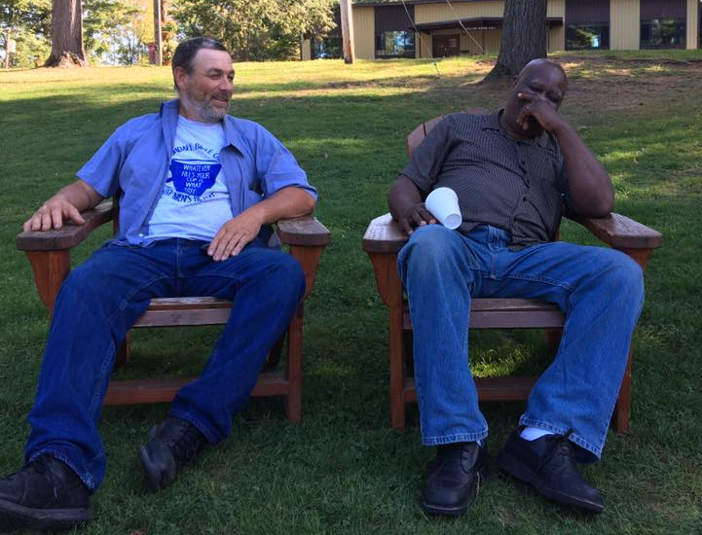
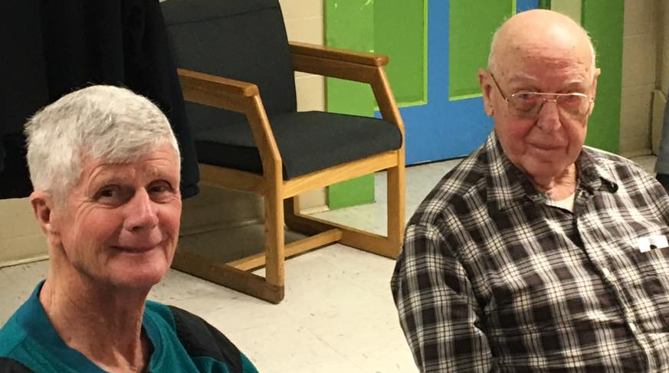
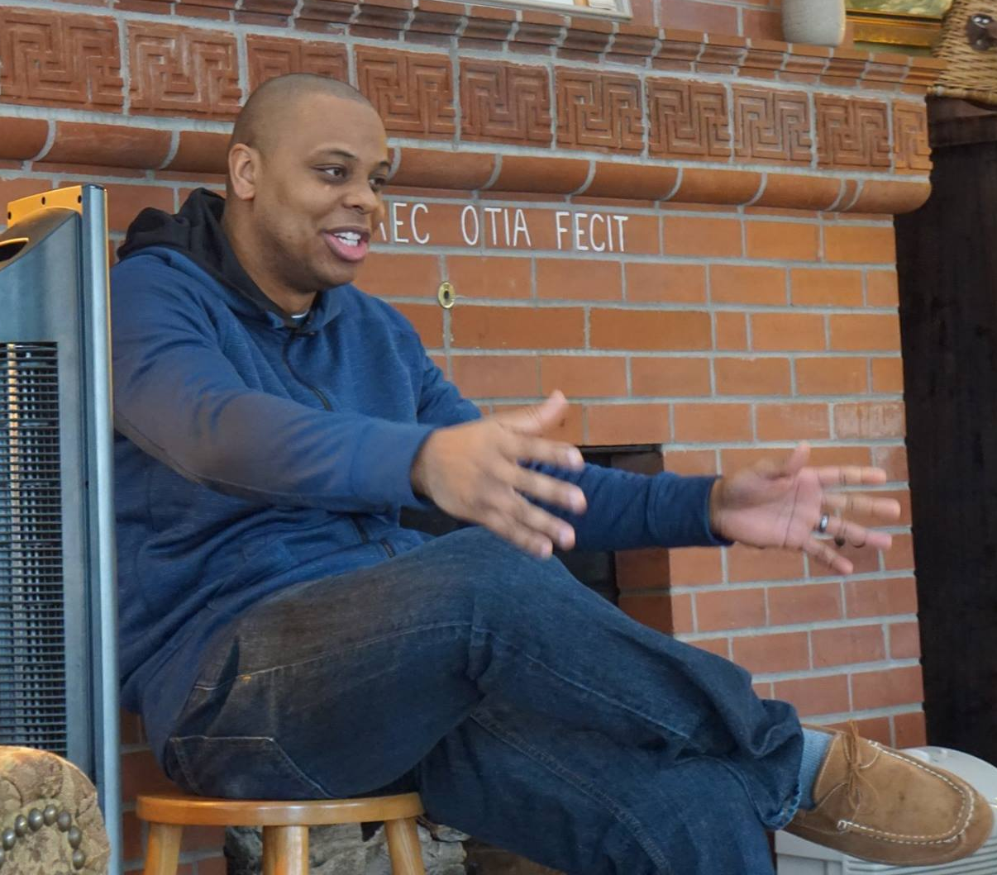
Leptondale on Demand

Slide 2
Discover the one…
…who is one with you!
Mark 10:1-12
Design
Demand
Discover

Slide 3
I. “One flesh” is a God-designed state-of-being acquired in marriage (verses 6-8)
Both man and woman were created by God (verse 6)
6 But from the beginning of creation, ‘God made them male and female.’

Slide 4
I. “One flesh” is a God-designed state-of-being acquired in marriage (verses 6-8)
Both man and woman were created by God (verse 6)
Man and woman find a very purposeful union in marriage (verses 7-8)
6 But from the beginning of creation, ‘God made them male and female.’ 7 ‘Therefore a man shall leave his father and mother and hold fast to his wife, 8 and the two shall become one flesh.’ So they are no longer two but one flesh.

Slide 5
I. “One flesh” is a God-designed state-of-being acquired in marriage (verses 6-8)
Both man and woman were created by God (verse 6)
Man and woman find a very purposeful union in marriage (verses 7-8)
Jesus has produced an image from Genesis 1 and 2 which “lifts marriage from being a mere contract of mutual convenience to an ‘ontological’ status. It is not merely that ‘one flesh’ should not be separated; it cannot. ” Dr. Abraham Kuruvilla

Slide 6
II. God’s demand for marriage is faithfulness to His design (verses 1-5, 9-12)
Divorce is a hard-hearted rejection of His design (verses 1-5)
1 And he left there and went to the region of Judea and beyond the Jordan, and crowds gathered to him again. And again, as was his custom, he taught them. 2 And Pharisees came up and in order to test him asked, “Is it lawful for a man to divorce his wife?” 3 He answered them, “What did Moses command you?” 4 They said, “Moses allowed a man to write a certificate of divorce and to send her away.” 5 And Jesus said to them, “Because of your hardness of heart he wrote you this commandment.

Slide 7
II. God’s demand for marriage is faithfulness to His design (verses 1-5, 9-12)
Divorce is a hard-hearted rejection of His design (verses 1-5)
Faithfulness to His design is demonstrated by our agreement with His design proven through our actions (verses 9-12)
We demonstrate faithfulness to His design by affirming His design (verse 9a)
We demonstrate faithfulness to His design in our obedience to His command not to separate (verse 9b)
We demonstrate faithfulness to His design through our lifelong commitment to marriage (verses 10-12, 8:34 & 10:29-30)

Slide 8
III. Discover the one who is one with you!
By praying for your spouse and your marriage
By discerning, affirming and supporting the personal interests of your spouse
By discerning, affirming and supporting the calling of your spouse

Slide 9
III. Discover the one who is one with you!
In his book Creation and Blessing, Old Testament scholar Allen Ross, speaking on the strife in Jacob’s marital relationships, states “To sacrifice things spiritual for things physical—to trade things that are above trade value—is tragic in the long run.”

Slide 10
Discover the one…
…who is one with you!
Mark 10:1-12

