Slide 1
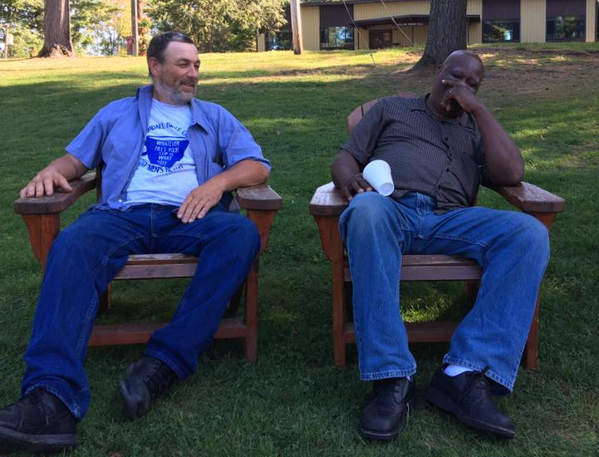
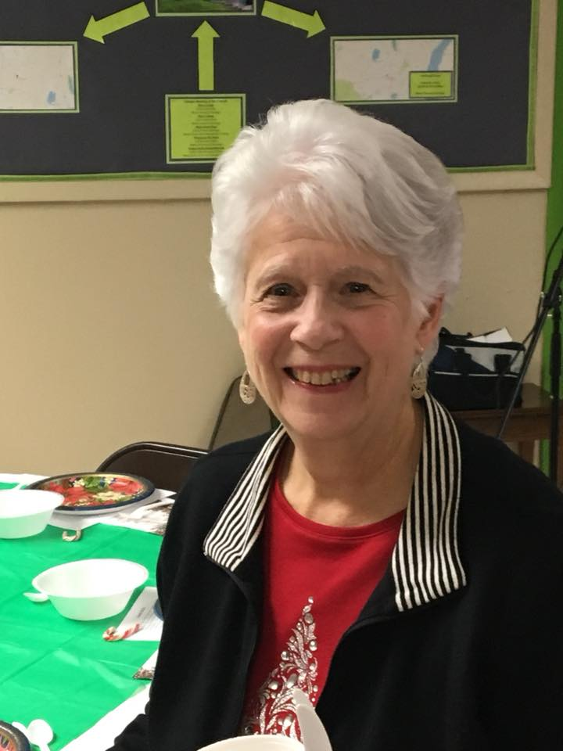
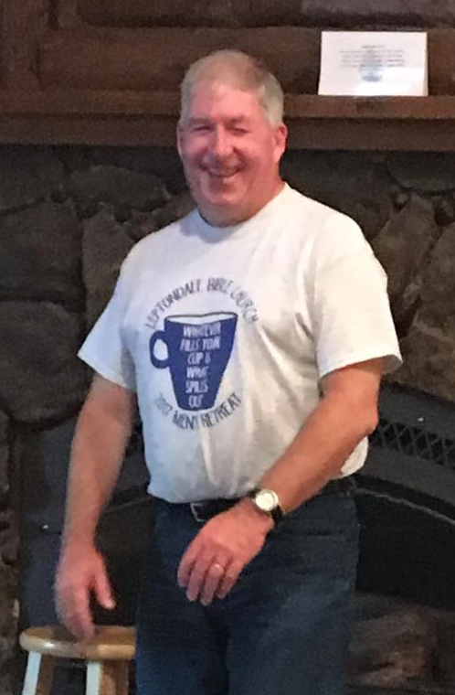
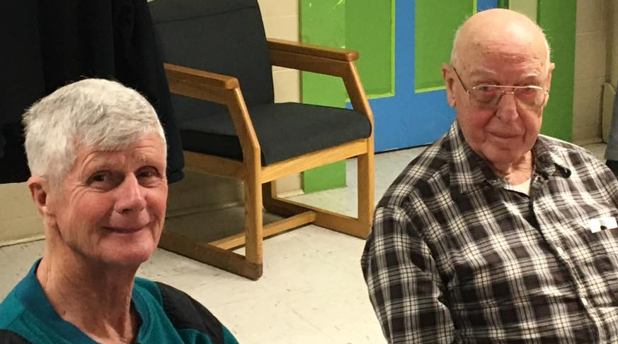
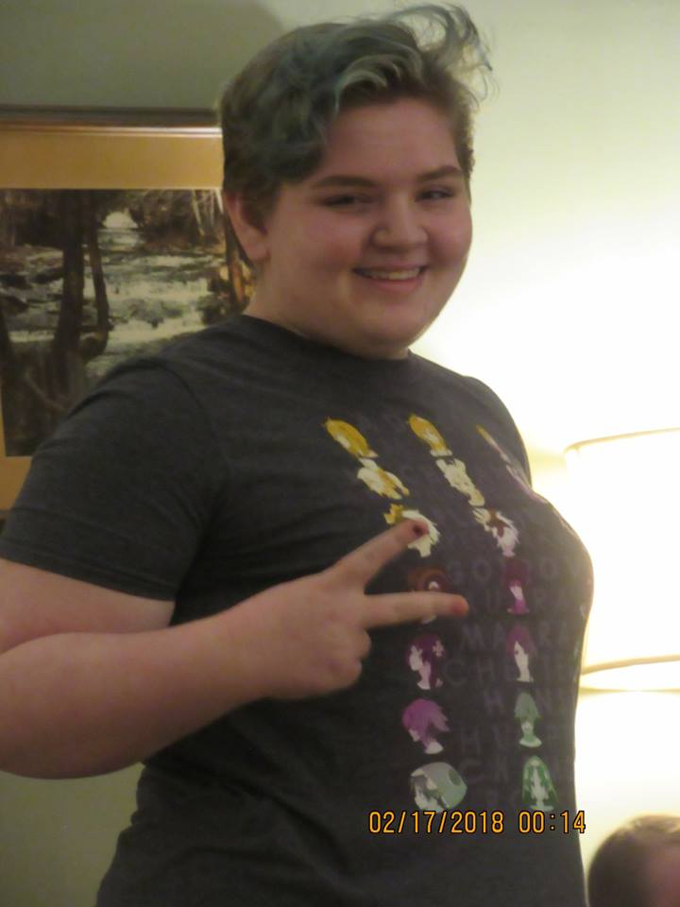
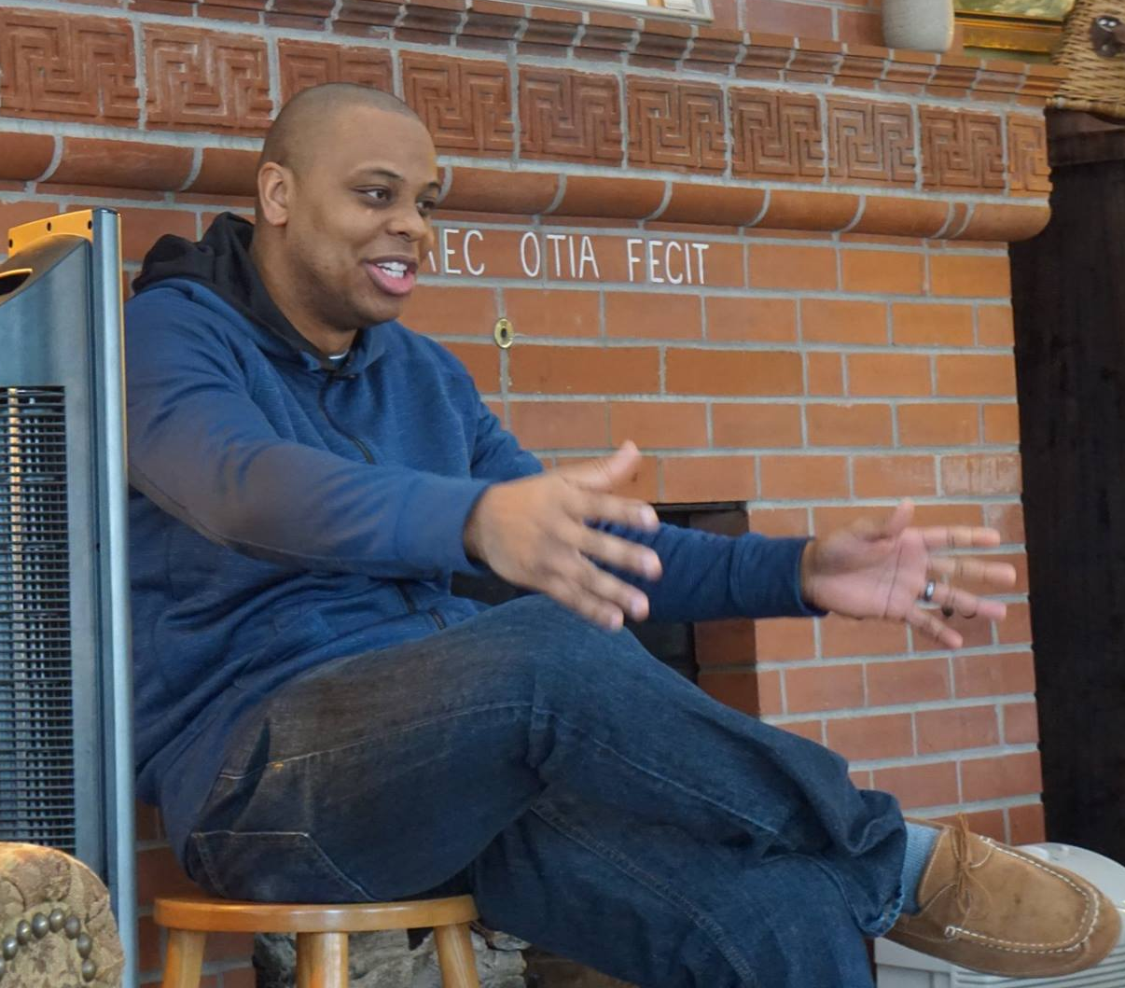
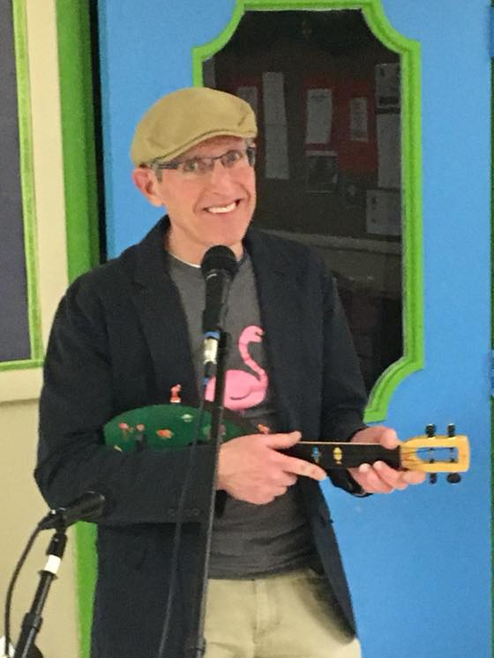
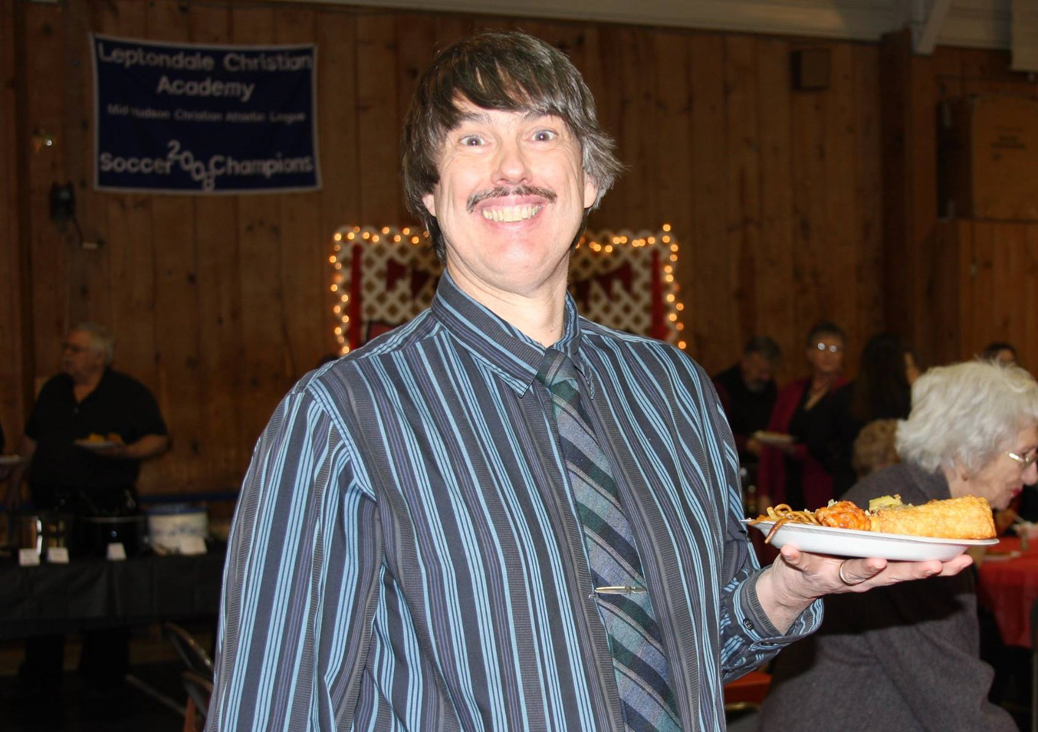
Leptondale on Demand

Slide 2
“Brothers, join in imitating me, and keep your eyes on those who walk according to the example you have in us.” Philippians 3:17

Slide 3
Be encouraging!
Acts 4:32-37

Slide 4
I. Barnabas actively encouraged his brothers and sisters in Christ . . .
By surrendering ownership of his own means to the Lord (Acts 4:32-37)
“For instance, there was Joseph, the one the apostles nicknamed Barnabas (which means ‘son of Encouragement ’ ) ” Acts 4:36, NLT
Encouragement – To positively inspire and spur on others through your words and actions

Slide 5
I. Barnabas actively encouraged his brothers and sisters in Christ . . .
By surrendering ownership of his own means to the Lord (Acts 4:32-37)
The body was unified (32)
The gospel prospered (33)
Grace abounded to all (33)
None were needy (34)
Encouragement – To positively inspire and spur on others through your words and actions

Slide 6
I. Barnabas actively encouraged his brothers and sisters in Christ . . .
By surrendering ownership of his own means to the Lord (Acts 4:32-37)
body unified / gospel prospers / Grace abounds to all / None needy
the key to advancing the gospel as a church is to be faithful in being the church
Encouragement – To positively inspire and spur on others through your words and actions

Slide 7
I. Barnabas actively encouraged his brothers and sisters in Christ . . .
By surrendering ownership of his own means to the Lord (Acts 4:32-37)
By surrendering his life to the direction of the Holy Spirit (Acts 13-14)
The door for the gospel was opened to the gentiles
These churches, which included gentiles, were strengthened and encouraged
Encouragement – To positively inspire and spur on others through your words and actions

Slide 8
I. Barnabas actively encouraged his brothers and sisters in Christ . . .
A & B - surrenders his means and his life
By surrendering fear over his reputation as he advocated for the marginalized
Integrating Paul into the life of the church (acts 9:23-31)
Affirming God’s grace to make His church in Antioch more diverse (Acts 11:19-30)
Standing by John Mark in the face of fierce opposition from Paul (Acts 13:13, 15:36-41, 2 Timothy 4:11 and Colossians 4:10)
Encouragement – To positively inspire and spur on others through your words and actions

Slide 9
Standing by John Mark in the face of fierce opposition from Paul
“Luke alone is with me. Get Mark and bring him with you, for he is very useful to me for ministry .” 2 Timothy 4:11
“Aristarchus my fellow prisoner greets you, and Mark the cousin of Barnabas (concerning whom you have received instructions—if he comes to you, welcome him) ” Colossians 4:10
Encouragement – To positively inspire and spur on others through your words and actions

Slide 10
Be encouraging!
How does this apply to us?
See you next Sunday for part 2!

