Slide 1
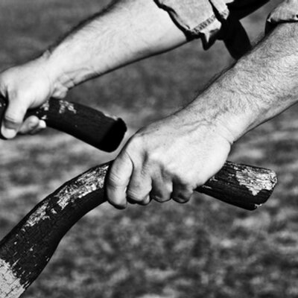
Living the Life

Slide 2
Be the Body!
1 Corinthians 12:12-27
“We are many parts of one body, and we all belong to each other.” Romans 12:5, NLT

Slide 3
I. The Holy Spirit unites Christ with all Christians as a diverse interdependent community
The church should function very much like a human body (verse 12)
“For just as the body is one and has many members, and all the members of the body, though many, are one body, so it is with Christ.”

Slide 4
I. The Holy Spirit unites Christ with all Christians as a diverse interdependent community
The church should function very much like a human body (verse 12)
The Holy Spirit’s power makes us a diverse interdependent community (verse 13)

Slide 5
II. Paul uses the human body to explain how the reality of being a diverse interdependent community in Christ applies to the local church
No part of the body of Christ is non-essential (verses 14-20)
How this is reflected in the human body (14-18)
How does this anatomy lesson apply to the church? (19-20)

Slide 6
II. Paul uses the human body to explain how the reality of being a diverse interdependent community in Christ applies to the local church
No part of the body of Christ is non-essential (verses 14-20)
No part of the body of Christ can claim pride of place (verses 21-27)
How this is reflected in the human body (21-24a)
How does this anatomy lesson apply to the church? (24b-27)

Slide 7
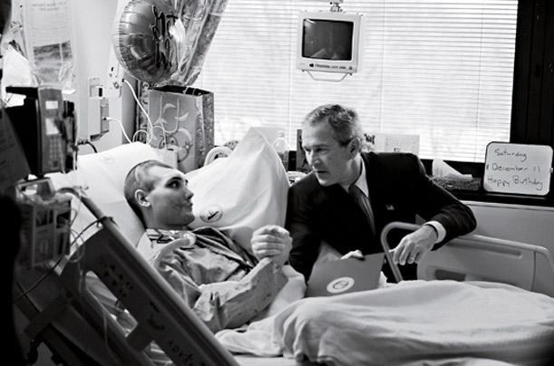
Ii.b. No part of the body of Christ can claim pride of place
The Mark of a Great Leader
“Servanthood begins where gratitude and applause ends.” Tim Keller

Slide 8
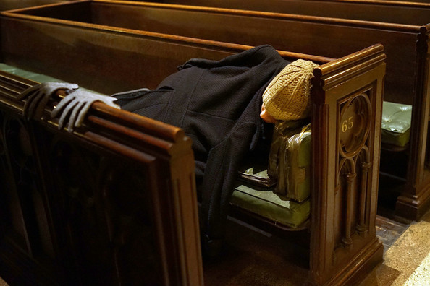
Ii.b. No part of the body of Christ can claim pride of place
The Mark of a Great Church

Slide 9
Be the Body!

