Slide 1
“What is your life? For you are a mist that appears for a little time and then vanishes.” James 4:14

Slide 2
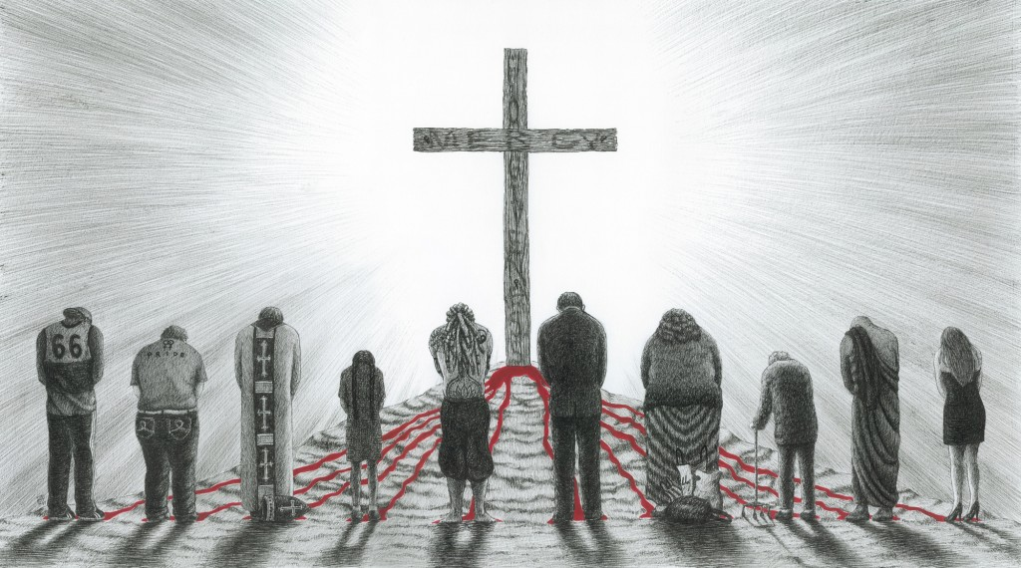
Believe in the Lord Jesus and you will be saved
Acts 16:25-34

Slide 3
“There are no ordinary people. You have never talked to a mere mortal…it is immortals whom we joke with, work with, marry, snub and exploit – immortal horrors or everlasting splendors.” C.S. Lewis

Slide 4
I. God arranged circumstances to reveal human character and need
“Roman imprisonment was preceded by being stripped naked and then flogged—a humiliating, painful, and bloody ordeal. The bleeding wounds went untreated as prisoners sat in painful leg or wrist chains. Mutilated, bloodstained clothing was not replaced, even in the cold of winter. Most cells were dark, especially the inner cells of a prison, like the one Paul and Silas inhabited in Philippi. Unbearable cold, lack of water, cramped quarters, and sickening stench from few toilets made sleeping difficult and waking hours miserable. Because of the miserable conditions, many prisoners begged for a speedy death. Others simply committed suicide.” Elesha Coffman

Slide 5
I. God arranged circumstances to reveal human character and need
These circumstances revealed Paul and Silas’ trust in God’s purposes (verses 25-28)
“The wicked, under pressure of affliction, curse God and blaspheme; the good, in the same affliction, offer up prayers and praises. This shows that what matters is the nature of the sufferer, not the nature of the sufferings. Stir a cesspit, and a foul stench arises; stir a perfume, and a delightful fragrance ascends. But the movement is identical.” Augustine

Slide 6
I. God arranged circumstances to reveal human character and need
These circumstances revealed Paul and Silas’ trust in God’s purposes (verses 25-28)
These circumstances revealed the jailer’s spiritual need (verses 29-30)

Slide 7
II. God used Paul and Silas to meet the jailer’s spiritual need in a way that exceeded his sense of need
Verses 31-34

Slide 8
III. Believe in the Lord Jesus and you will be saved!
“God made Christ, who never sinned, to be the offering for our sin, so that we could be made right with God through Christ.” 2 Corinthians 5:21, New Living Translation

Slide 9
III. Believe in the Lord Jesus and you will be saved!
“In my Father’s house are many rooms. If it were not so, would I have told you that I go to prepare a place for you? And if I go and prepare a place for you, I will come again and will take you to myself, that where I am you may be also.” John 14:2-3

