Slide 1
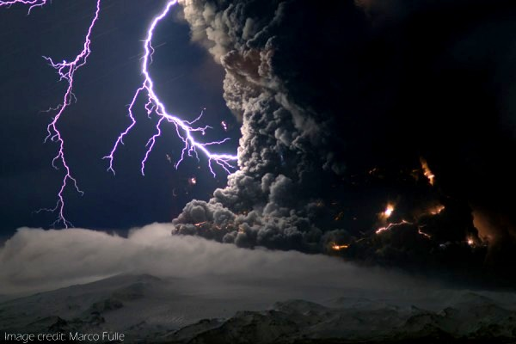
Worship God with Reverence and Awe!
Hebrews Chapter 12

Slide 2
I. God’s priority for us in worship is to come before Him as a holy community
Hebrews 12:1-17 — God’s expectations of His people as a worshipping community
“Look after each other so that none of you fails to receive the grace of God. Watch out that no poisonous root of bitterness grows up to trouble you, corrupting many.” Hebrews 12:15 (NLT)

Slide 3
II. Coming into the awesome tangible presence of our holy God terrified His people
Hebrews 12:18-21

Slide 4
III. We come into the presence of God and the whole heavenly host in a way that should move us to an even greater sense of reverence and awe
We come into the presence of God and the whole heavenly host (verses 22-24)
We have greater cause to be moved to a sense of reverence and awe than the people of Israel had at Sinai (verses 25-27)

Slide 5
“The author is employing an argument from the lesser to the greater: if judgment is certain on those who do not heed God’s speaking on earth, how much more certain is judgment on those who do not heed His speaking from heaven. The author stresses the certainty of judgment, however, in terms of the impossibility of escape…Those who seek their security in ‘created things’ will share in the dissolution of the created order in the final shakeup, while God’s pilgrim people who accept hardships in full trust in God as their security will be vindicated; theirs will be a ‘kingdom that cannot be shaken.’” David Allen, commentary on Hebrews 12:22-27, New American Commentary

Slide 6
IV. Worship God with reverence and awe!
What is reverence and awe?
“For I the Lord do not change; therefore you, O children of Jacob, are not consumed.” Malachi 3:6

Slide 7
IV. Worship God with reverence and awe!
What is reverence and awe?
In the Scriptures, reverence and awe is consistently the avenue to intimacy with the Father

Slide 8
IV.B Reverence and awe: the avenue to intimacy with the Father
With Jesus
“In the days of his flesh, Jesus offered up prayers and supplications, with loud cries and tears, to him who was able to save him from death, and he was heard because of his reverence.” Hebrews 5:7
“Our Father in heaven, your name be honored as holy. Your kingdom come. Your will be done on earth as it is in heaven.” Matthew 6:9-11 (CSB)

Slide 9
IV.B Reverence and awe: the avenue to intimacy with the Father
With Isaiah
Isaiah 6:1-7

Slide 10
IV.B Reverence and awe: the avenue to intimacy with the Father
With John
“When I saw him, I fell at his feet as though dead. But he laid his right hand on me, saying, ‘Fear not…’” John 1:17

Slide 11
IV.B Reverence and awe: the avenue to intimacy with the Father
In Malachi
“So shall you know that I have sent this command to you, that my covenant with Levi may stand, says the Lord of hosts…” Malachi 2:4
“…My covenant with him was one of life and peace, and I gave them to him. It was a covenant of fear, and he feared me. He stood in awe of my name.” Malachi 2:5

Slide 12
V. Our new order of worship is intended to foster our movement from reverence and awe to intimacy!
Prelude, Prayer and meditation
Welcome and invocation
Exaltation and response
Praise
Prayer and thanksgiving
The word of God
Fellowship
Blessed and sent!
Reverence and Awe
Intimacy with God

