Slide 1
The Millennium: The future 1000-year reign of Christ on earth
Christs return and the Resurrection
Christ’s 1000-year reign
The Final Judgment
The Age of Eternity

Slide 2
The Millennium: The future 1000-year reign of Christ on earth
Christs return and the Resurrection
Christ’s 1000-year reign
The Final Judgment
The Age of Eternity
Church Age and Great Tribulation

Slide 3
The Millennium: The future 1000-year reign of Christ on earth
Christs return and the Resurrection
Christ’s 1000-year reign
The Final Judgment
The Age of Eternity

Slide 4
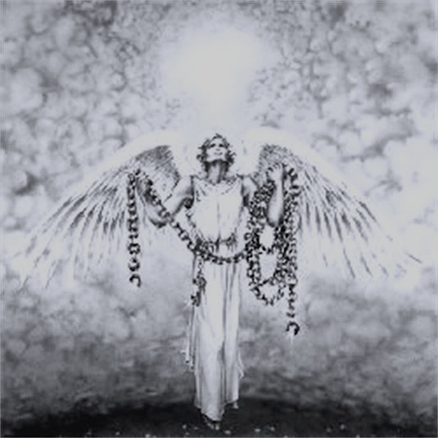
Revelation 20:1-15
Victory + Vindication!

Slide 5
I. The 1000-Year reign of Christ will glorify God by bringing final victory over every enemy of God
Christ’s reign will glorify God by humiliating a proud adversary
Christ’s reign will bring the blessings of victory to God’s people of all ages

Slide 6
To whom is the authority to judge being committed in 20:4?
“Do you not know that the saints will judge the world?” 1 Corinthians 6:2
“[Jesus’ disciples will] sit on thrones judging the twelve tribes of Israel” Luke 22:30
“He will rule [the nations] with a rod of iron” Revelation 19:15
“The one who conquers and who keeps my works until the end, to him I will give authority over the nations, and he will rule them with a rod of iron, as when earthen pots are broken in pieces, even as I myself have received authority from my Father” Revelation 2:26-27

Slide 7
II. The 1000-Year reign of Christ will bring the full vindication of God’s judgment
Christ’s reign will bring vindication to God’s people
“…do you not know that the saints will judge the world? … Do you not know that we are to judge angels?” 1 Corinthians 6:2-3

Slide 8
II. The 1000-Year reign of Christ will bring the full vindication of God’s judgment
Christ’s reign will bring vindication to God’s people
Christ’s reign will vindicate God in His final judgment
“They did not repent and give him glory…People gnawed their tongues in anguish and cursed the God of heaven for their pain and sores. They did not repent of their deeds.” Revelation 16:9 & 11

Slide 9
III. Where do you stand?
“Therefore the wicked will not stand in the judgment, nor sinners in the congregation of the righteous” Psalm 1:5
“The one who conquers will have this heritage, and I will be his God and he will be my son. But as for the cowardly, the faithless, the detestable, as for murderers, the sexually immoral, sorcerers, idolaters, and all liars, their portion will be in the lake that burns with fire and sulfur, which is the second death.” Revelation 21:7-8

Slide 10
“Works are unmistakable evidence of the loyalty of the heart; they express either belief or unbelief, faithfulness or unfaithfulness. The judgment will reveal through the records whether or not the loyalties were with God and the Lamb or with God’s enemies. John’s theology of faith and its inseparable relation to works is the same as Jesus’ and Paul’s (John 5:29; Romans 2:6–16). This judgment is not a balancing of good works over bad works. Those who have their names in the Lamb’s book of life will also have records of righteous deeds. The opposite will be true as well. The imagery reflects the delicate balance between grace and obedience.”
Alan Johnson, Emeritus Professor of New Testament and Christian Ethics at Wheaton College

Slide 11
“Do not be deceived: God is not mocked, for whatever one sows, that will he also reap. For the one who sows to his own flesh will from the flesh reap corruption, but the one who sows to the Spirit will from the Spirit reap eternal life. And let us not grow weary of doing good, for in due season we will reap, if we do not give up.” Galatians 6:7-9

