Slide 1
“The Great Commission Part 2: Bread from the Table”
Matthew 15:21-28
Context
Contact
Confession

Slide 2
I. A gentile Canaanite woman strikes a faithful contrast with the leaders of God’s chosen people

Slide 3
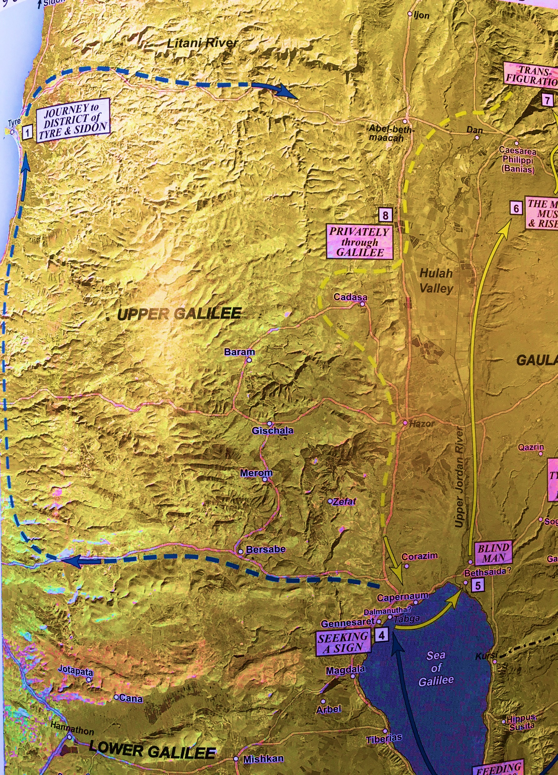

Slide 4
I. A gentile Canaanite woman strikes a faithful contrast with the leaders of God’s chosen people
Jesus’ encounter with a gentile Canaanite woman is a positive contrast to Israel’s religious leaders (15:1-20)
Jesus is most concerned with His disciple’s lingering desire to align their hearts and minds with the teaching of religious leaders who have rejected their Lord, King and Messiah

Slide 5
II. Jesus makes an unlikely contact in an unlikely place for a profound purpose
Jesus makes an unlikely contact in an unlikely place (verses 21-23)
Jesus is acting for a profound purpose (verse 24)

Slide 6
III. The Confession of a Canaanite woman confirmed God’s plan of salvation
The Canaanite woman’s confession proves faithful in a multi-dimensional way (verses 25-28)
The woman assumed the posture of worship (25)
“But she came and worshiped him…” (NLT, verse 25)
The woman’s faith rises to the challenge of a great test (26-27)

Slide 7
III. The Confession of a Canaanite woman confirmed God’s plan of salvation
The Canaanite woman’s confession proves faithful in a multi-dimensional way (verses 25-27)
Jesus exalts the Canaanite woman’s faith to a high place (verse 28)
Once more “to the Jew first”

Slide 8
“Oh, the depth of the riches and wisdom and knowledge of God! How unsearchable are his judgments and how inscrutable his ways! For who has known the mind of the Lord, or who has been his counselor?”
Romans 11:33-34

