Slide 1
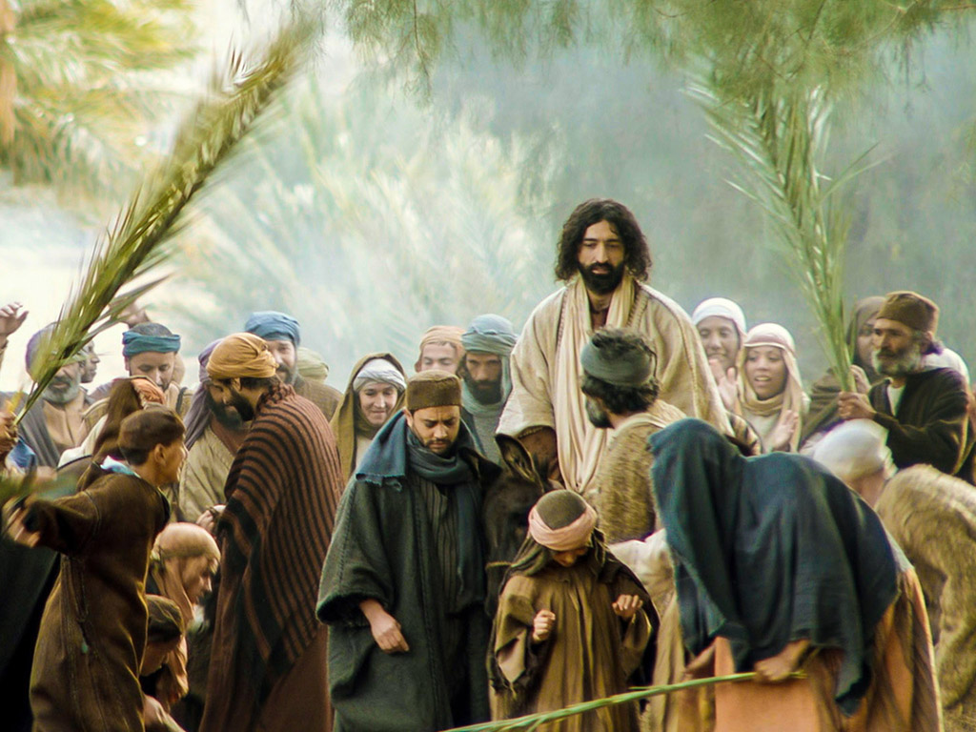
“Who Are We?”
Matthew 21:1-11

Slide 2
I. Jesus, the Son of David and the King of Israel, is THE occasion!
Jesus comes intentionally and precisely to present Himself as King (verses 1-5)
Jesus comes exercising the King’s authority (verses 1-3, 6-9)
Jesus comes with the King’s divine power and influence (verses 5-9)

Slide 3
II. Who Are We? A Fickle Crowd
The disciples were inconsistent in their walk
The people remaining within Jerusalem may be the most consistent part of the crowd (verse 10)
The crowd was willing to meet their own expectations

Slide 4
“Who Are We?”
“Are We a Fickle Crowd?”

