Slide 1
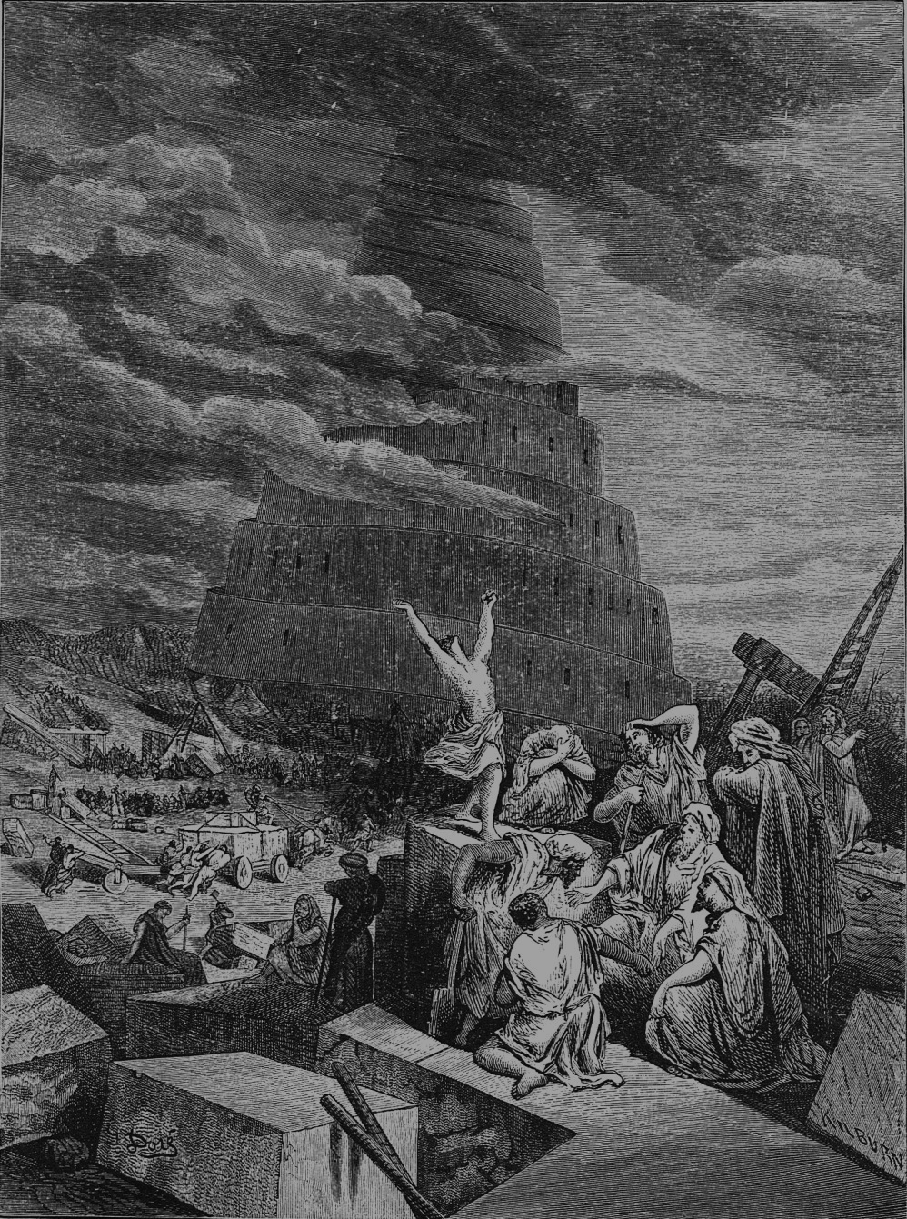
“A Race Divided is Grace Provided”
Genesis 10:32—11:9, 12:1-3
The nations…
in the plan for redemption
as the civilizational framework for eternal blessing

Slide 2
I. God’s creation of the nations: part of His plan for our redemption
The nations are a redemptive measure to restrain the sinfulness of mankind (Verses 11:1-9)
  Left unrestrained, mankind embraces the destructiveness of pride (1-4)
  God divided humanity into nations to restrain us from the sin of pride (5-9)
  The nations restrain mankind from the proliferation of wickedness (Genesis 4-6 & Romans 13:1-4)

Slide 3
“Let every person be subject to the governing authorities. For there is no authority except from God, and those that exist have been instituted by God. Therefore, whoever resists the authorities resists what God has appointed, and those who resist will incur judgment. For rulers are not a terror to good conduct, but to bad. Would you have no fear of the one who is in authority? Then do what is good, and you will receive his approval, for he is God’s servant for your good. But if you do wrong, be afraid, for he does not bear the sword in vain. For he is the servant of God, an avenger who carries out God’s wrath on the wrongdoer.”
Romans 13:1-4

Slide 4
I. God’s creation of the nations: part of His plan for our redemption
The nations are a redemptive measure to restrain the sinfulness of mankind (Verses 11:1-9)
The nations are an object of God’s work of eternal redemption
  If the church is Christ’s chosen vehicle to spread the gospel, the nations are the roads the church travels (Matthew 28:19)
  Redeemed nations will endure as a feature of eternal civilization (Revelation 21:24-26)

Slide 5
“By its light will the nations walk, and the kings of the earth will bring their glory into it, and its gates will never be shut by day—and there will be no night there. They will bring into it the glory and the honor of the nations”
Revelation 21:24-26

Slide 6
II. God’s creation of a great nation will bring eternal blessing to all the nations
God’s plan of redemption broadens in scope to the nations.(verses 12:2-3)
God’s work of redemption narrows in scope to one man (verses 12:3 & Galatians 3)

Slide 7
III. Learn the lessons of a race divided and grace provided!
Yield to the obstacles He casts before our pride
Yield to His call to redeem the nations (Acts 1:8 & 8:1)

