Slide 1
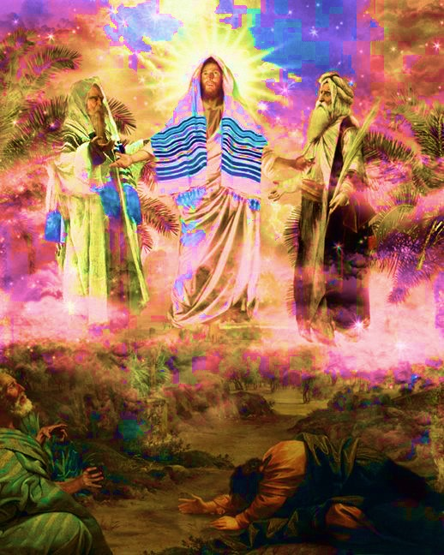
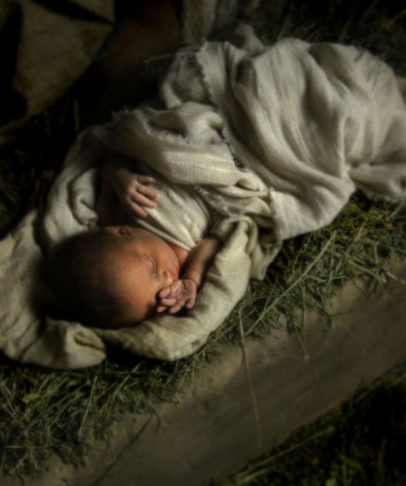
The King and the Prophets
Jesus Messiah…
…the Consolation of Israel*
Isaiah 61:1-11
(*Luke 2:25)

Slide 2
Preview
Content of the good news
The basis for the good news
The faithful’s response to the good news

Slide 3
I. The Messiah proclaims the good news!
The Messiah will lift faithful Israel from despair into the splendor of His glory (verses 1-3)
The Messiah will transform faithful Israel’s existence into everlasting joy (verses 4-7)
“…in order that in the coming ages he might show the incomparable riches of his grace”
Ephesians 2:7

Slide 4
II. God’s faithfulness to His people is the basis for the good news
Because of God’s faithfulness, Israel will be eternally rewarded (verse 8)
Because of God’s faithfulness, the nations will regard Israel as uniquely blessed (verse 9)
“But if their transgression means riches for the world, and their loss means riches for the Gentiles, how much greater riches will their full inclusion bring!”
Romans 11:12

Slide 5
III. Delight and rejoicing is the faithful’s response to the good news (verses 10-11)

Slide 6
IV. What is our response to the good news?
Jay Walker, founder of Priceline.com
“You live today as though your beliefs about the future really will be fulfilled.”

Slide 7
And if we don’t live today as though these beliefs about the future really will be fulfilled, then one might have cause to wonder what it was we believed in the first place.

