Slide 3
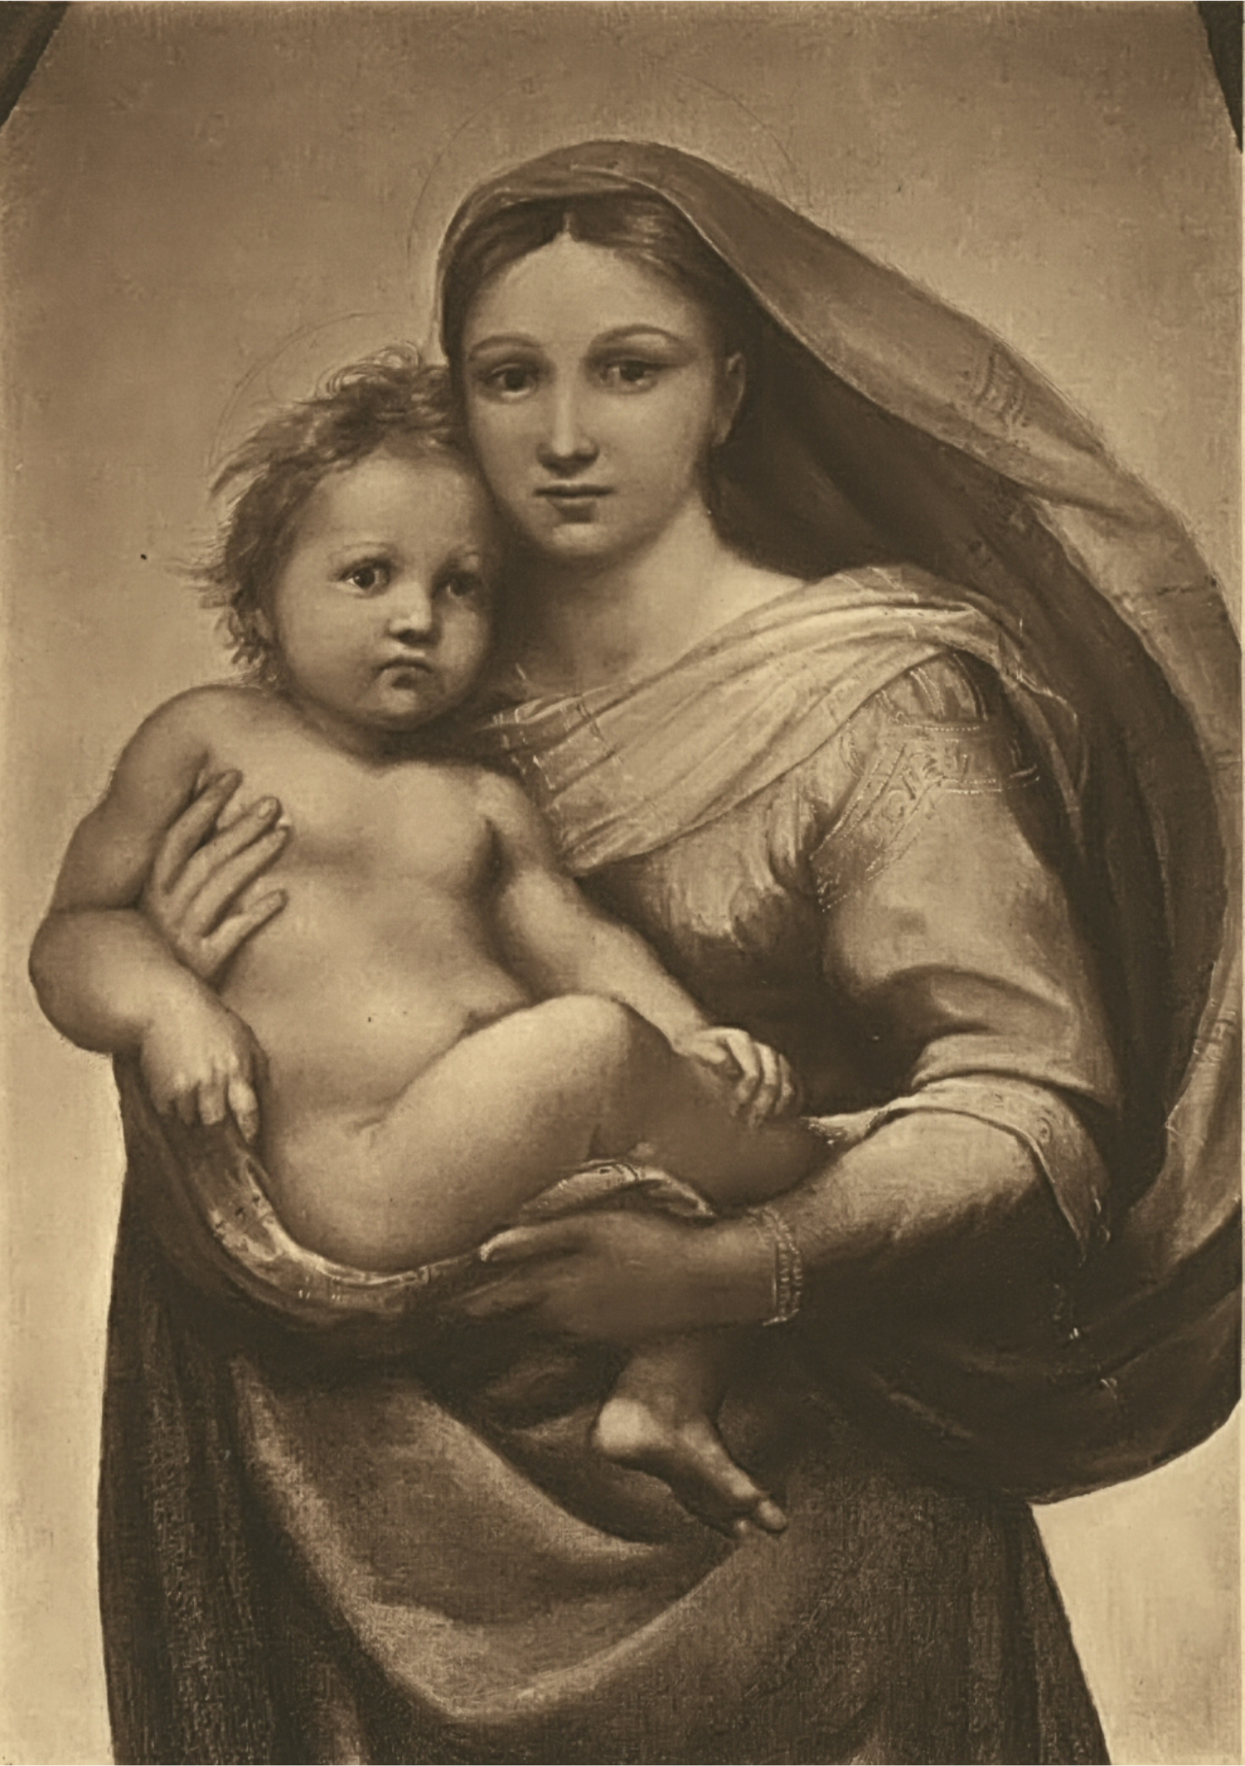
The King and the Prophets
What Child is This?
Part 2
Isaiah 9:1-7
Isaiah -> Matthew?
What Child is this? … take 2

Slide 4
I. How does Mathew make the connection between a child born as a sign during Ahaz’ reign and Jesus Christ being the fulfillment of that sign?
Who are the mother and the son in Ahaz’ time?
How does Matthew connect Mary and Jesus to Isaiah’s virgin and Immanuel?
Mary and Jesus - and no others - are the ones Isaiah is referring to
The virgin and son in Ahaz’ time only are the ones Isaiah is referring to
The Holy Spirit inspired Matthew with new revelation that Isaiah’s prophecy had its ultimate fulfillment in Mary and Jesus
Inspired by the Holy Spirit, Matthew shares the dual fulfillment of Isaiah’s prophecy which Isaiah himself reveals

Slide 5
Isaiah -> Matthew: Dual fulfillment
“All this took place to fulfill what the Lord had said through the prophet: ‘The virgin will conceive and give birth to a son, and they will call him Immanuel’ (which means “God with us”)” Matthew 1:22-23.
“So when you see standing in the holy place ‘the abomination that causes desolation,’ spoken of through the prophet Daniel (let the reader understand)” Matthew 24:15.

Slide 6
Isaiah -> Matthew: Dual fulfillment
Matthew is pointing his readers to a specific part of a dual reference in Isaiah
“Immanuel” Used as a Name in 7:14 & 8:8, and used literally as “God is with us” in 8:10
In 8:8, the Assyrians will “sweep on into Judah, swirling over it, passing through it and reaching up to the neck. Its outspread wings will cover the breadth of your land Immanuel!”
In 8:9-10, “Raise the war cry, you nations, and be shattered! Listen, all you distant lands. Prepare for battle, and be shattered! Prepare for battle, and be shattered! Devise your strategy, but it will be thwarted; propose your plan, but it will not stand, for God is with us.”

Slide 7
II. What child is this?
Isaiah 9:1— “nevertheless…” (NIV, NLT, KJV, NKJV, HCSB)

Slide 8
FOREVER!!!!
His government … peace … no end
The government will be on
His shoulders
He will reign on David’s throne and over His kingdom…
Everlasting Father
Prince of Peace
Wonderful Counselor
Mighty God

Slide 9
IIi. How do we receive the hope Jesus Messiah — the One who came and will come again — has given to us?
Do not live in fear!
Trust in God’s eternal promises to us through Christ!
Stand firm in God’s eternal promises to us through Christ!

