Slide 1
The Wedding at Cana
John 2:1-11

Slide 2
“On the third day there was a wedding at Cana in Galilee, and the mother of Jesus was there. Jesus also was invited to the wedding with his disciples. When the wine ran out, the mother of Jesus said to him, “They have no wine.” And Jesus said to her, “Woman, what does this have to do with me? My hour has not yet come.””
(Joh 2:1-4 ESV)

Slide 3
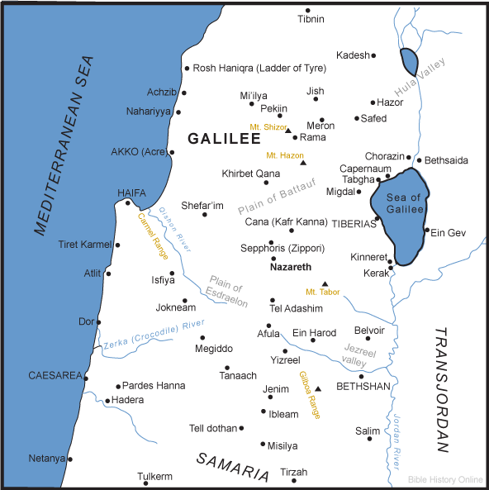

Slide 4
And Jesus said to them, " Can you make wedding guests fast while the bridegroom is with them?
(ESVST) Luk 5:34

Slide 5
“When the wine ran out, the mother of Jesus said to him, “They have no wine.” And Jesus said to her, “Woman, what does this have to do with me? My hour has not yet come.” His mother said to the servants, “Do whatever he tells you.””
(Joh 2:3-5 ESV)

Slide 6
26 When Jesus saw his mother and the disciple whom he loved standing nearby, he said to his mother, " Woman, behold, your son!" 27 Then he said to the disciple, " Behold, your mother!" And from that hour the disciple took her to his own home. (ESVST) Jn 19:26-27

Slide 7
So they were seeking to arrest him, but no one laid a hand on him, because his hour had not yet come.
(ESVST) Jn 7:30
20 These words he spoke in the treasury, as he taught in the temple; but no one arrested him, because his hour had not yet come.
(ESVST) Jn 8:20

Slide 8
And Jesus answered them, "The hour has come for the Son of Man to be glorified (ESVST) Jn 12:23
" Now is my soul troubled. And what shall I say? ' Father, save me from this hour '? But for this purpose I have come to this hour. (ESVST) Jn 12:27

Slide 9
Now before the Feast of the Passover, when Jesus knew that his hour had come to depart out of this world to the Father, having loved his own who were in the world, he loved them to the end.
(ESVST) Jn 13:1
When Jesus had spoken these words, he lifted up his eyes to heaven, and said, " Father, the hour has come; glorify your Son that the Son may glorify you,
(ESVST) Jn 17:1

Slide 10
Perceiving then that they were about to come and take him by force to make him king, Jesus withdrew again to the mountain by himself.
(ESVST) Jn 6:15

Slide 11
“Because for every matter there is a time and judgment, Though the misery of man increases greatly. For he does not know what will happen; So who can tell him when it will occur?”
(Ec 8:6-7 NKJV)
“He said to them, “It is not for you to know times or seasons that the Father has fixed by his own authority.”
(Ac 1:7 ESV)

Slide 12
“But I trust in you, O LORD; I say, “You are my God.” My times are in your hand; rescue me from the hand of my enemies and from my persecutors!”
(Ps 31:14-15 ESV).

Slide 13
“Now there were six stone water jars there for the Jewish rites of purification, each holding twenty or thirty gallons. Jesus said to the servants, “Fill the jars with water.” And they filled them up to the brim. And he said to them, “Now draw some out and take it to the master of the feast.” So they took it.”
(Joh 2:6-8 ESV)

Slide 14
“And no one puts new wine into old wineskins. If he does, the new wine will burst the skins and it will be spilled, and the skins will be destroyed. But new wine must be put into fresh wineskins.”
(Lu 5:37-38 ESV)

Slide 15
“Indeed, I count everything as loss because of the surpassing worth of knowing Christ Jesus my Lord. For his sake I have suffered the loss of all things and count them as rubbish, in order that I may gain Christ” (Php 3:8 ESV)

Slide 16
(For the Pharisees and all the Jews do not eat unless they wash their hands properly, holding to the tradition of the elders, and when they come from the marketplace, they do not eat unless they wash. And there are many other traditions that they observe, such as the washing of cups and pots and copper vessels and dining couches.)
Mar 7:2-4

Slide 17
By this the Holy Spirit indicates that the way into the holy places is not yet opened as long as the first section is still standing
(which is symbolic for the present age). According to this arrangement, gifts and sacrifices are offered that cannot perfect the conscience of the worshiper, but deal only with food and drink and various washings, regulations for the body imposed until the time of reformation.
(ESVST) Heb 9:8-10

Slide 18
“He is the radiance of the glory of God and the exact imprint of his nature, and he upholds the universe by the word of his power. After making purification for sins, he sat down at the right hand of the Majesty on high,”
(Heb 1:3 ESV)

Slide 19
“he entered once for all into the holy places, not by means of the blood of goats and calves but by means of his own blood, thus securing an eternal redemption. For if the sprinkling of defiled persons with the blood of goats and bulls and with the ashes of a heifer sanctifies for the purification of the flesh, how much more will the blood of Christ, who through the eternal Spirit offered himself without blemish to God, purify our conscience from dead works to serve the living God.” (Heb 9:12-14 ESV)

Slide 20
“But if we walk in the light, as he is in the light, we have fellowship with one another, and the blood of Jesus his Son cleanses us from all sin.”
(1Jo 1:7 ESV)

Slide 21
And do not get drunk with wine, which is debauchery, but be filled by the Spirit, (ESVST) Eph 5:18

Slide 22
And he took a cup, and when he had given thanks he gave it to them, saying, " Drink of it, all of you, for this is my blood of the covenant, which is poured out for many for the forgiveness of sins. I tell you I will not drink again of this fruit of the vine until that day when I drink it new with you in my Father 's kingdom."
(ESVST) Mat 26:27-29

Slide 23
“Now there were six stone water jars there for the Jewish rites of purification, each holding twenty or thirty gallons. Jesus said to the servants, “Fill the jars with water.” And they filled them up to the brim. And he said to them, “Now draw some out and take it to the master of the feast.” So they took it.”
(Joh 2:6-8 ESV)

Slide 24
“And he said to them, “Now draw some out and take it to the master of the feast.” So they took it. When the master of the feast tasted the water now become wine, and did not know where it came from (though the servants who had drawn the water knew), the master of the feast called the bridegroom and said to him, “Everyone serves the good wine first, and when people have drunk freely, then the poor wine. But you have kept the good wine until now.” (Joh 2:8-10 ESV)

Slide 25
“Do not be deceived, my beloved brothers. Every good gift and every perfect gift is from above, coming down from the Father of lights with whom there is no variation or shadow due to change.”
(Jas 1:16-17 ESV)

Slide 26
““The kingdom of heaven is like treasure hidden in a field, which a man found and covered up. Then in his joy he goes and sells all that he has and buys that field.
“Again, the kingdom of heaven is like a merchant in search of fine pearls, who, on finding one pearl of great value, went and sold all that he had and bought it.”
(Mt 13:44-46 ESV)

Slide 27
Now to him who is able to do far more abundantly than all that we ask or think, according to the power at work within us
(ESVST) Eph 3:20

Slide 28
Now when he was in Jerusalem at the Passover Feast, many believed in his name when they saw the signs that he was doing. But Jesus on his part did not entrust himself to them, because he knew all people and needed no one to bear witness about man, for he himself knew what was in man.
(ESVST) Jn 2:23-25

Slide 29
“This, the first of his signs, Jesus did at Cana in Galilee, and manifested his glory. And his disciples believed in him.”
(Joh 2:11 ESV)

