Slide 1
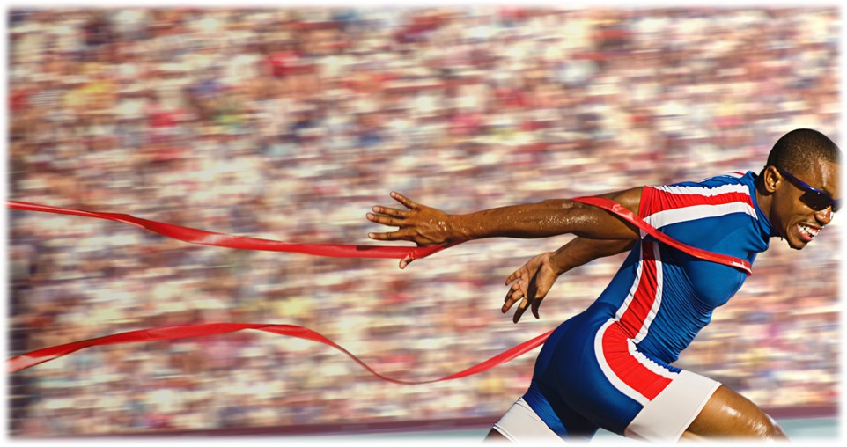
Press on to maturity!

Slide 2
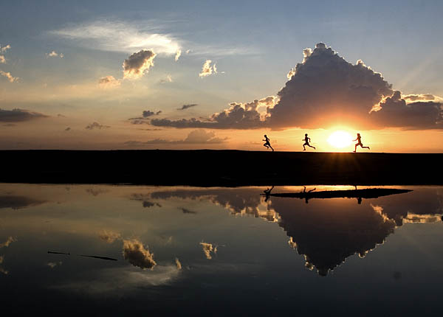
Run like we’re heirs to the kingdom! Hebrews 12:14-29

Slide 3
I. The heirs to the Kingdom must strive to guard its holiness (verses 14-17)
14 Strive for peace with everyone, and for the holiness without which no one will see the Lord.
“If possible, so far as it depends on you, live peaceably with all.” Romans 12:18
“Blessed are the peacemakers, for they shall be called sons of God.” Matthew 5:9

Slide 4
I. The heirs to the Kingdom must strive to guard its holiness (verses 14-17)
14 Strive for peace with everyone, and for the holiness without which no one will see the Lord.
God “disciplines us for our good, that we may share his holiness.” Hebrews 12:10

Slide 5
God’s grace produces holiness in us
Jesus Christ has made it possible for us to “find grace to help in time of need.” Hebrews 4:16
This “grace of God” is “training us to renounce ungodliness and worldly passions, and to live self-controlled, upright, and godly lives in the present age.” Titus 2:11-12
We know from the example of Enoch in Hebrews 11 that we walk with God as “those who earnestly seek him.” Hebrews 11:6, NIV
“Truly, truly, I say to you, unless one is born again he cannot see the kingdom of God.” John 3:3

Slide 6
I. The heirs to the Kingdom must strive to guard its holiness (verses 14-17)
15 See to it that no one fails to obtain the grace of God; that no “root of bitterness” springs up and causes trouble, and by it many become defiled…
“…let us consider how to provoke one another to love and good deeds, not neglecting to meet together, as is the habit of some, but encouraging one another, and all the more as you see the Day approaching.” Hebrews 10:24-25, NRSV

Slide 7
I. The heirs to the Kingdom must strive to guard its holiness (verses 14-17)
16 that no one is sexually immoral or unholy like Esau, who sold his birthright for a single meal. 17 For you know that afterward, when he desired to inherit the blessing, he was rejected, for he found no chance to repent, though he sought it with tears.
“Esau came in from the field, and he was exhausted. And Esau said to Jacob, ‘Let me eat some of that red stew, for I am exhausted!’ …Jacob said, ‘Sell me your birthright now.’ Esau said, ‘I am about to die; of what use is a birthright to me?’ Jacob said, ‘Swear to me now.’ So he swore to him and sold his birthright to Jacob. Then Jacob gave Esau bread and lentil stew, and he ate and drank and rose and went his way. Thus, Esau despised his birthright.” Genesis 25:29-34

Slide 8
I. The heirs to the Kingdom must strive to guard its holiness (verses 14-17)
16 that no one is sexually immoral or unholy like Esau, who sold his birthright for a single meal. 17 For you know that afterward, when he desired to inherit the blessing, he was rejected, for he found no chance to repent, though he sought it with tears.
“Esau said to his father, ‘Have you but one blessing, my father? Bless me, even me also, O my father.’ And Esau lifted up his voice and wept…Now Esau hated Jacob because of the blessing with which his father had blessed him, and Esau said to himself, ‘The days of mourning for my father are approaching; then I will kill my brother Jacob.’” Genesis 27:38, 41

Slide 9
II. We are heirs to a majestic Kingdom because of a better covenant (verses 18-24)
Under the old covenant, God’s presence prompted intense fear and separation (verses 18-21)
18 For you have not come to what may be touched, a blazing fire and darkness and gloom and a tempest 19 and the sound of a trumpet and a voice whose words made the hearers beg that no further messages be spoken to them. 20 For they could not endure the order that was given, “If even a beast touches the mountain, it shall be stoned.” 21 Indeed, so terrifying was the sight that Moses said, “I tremble with fear.”

Slide 10
II. We are heirs to a majestic Kingdom because of a better covenant (verses 18-24)
Under the old covenant, God’s presence prompted intense fear and separation (verses 18-21)
Under the new covenant, the heirs can draw near to God with confidence (verses 22-24)
22 But you have come to Mount Zion and to the city of the living God, the heavenly Jerusalem, and to innumerable angels in festal gathering, 23 and to the assembly of the firstborn who are enrolled in heaven, and to God, the judge of all, and to the spirits of the righteous made perfect, 24 and to Jesus, the mediator of a new covenant, and to the sprinkled blood that speaks a better word than the blood of Abel.

Slide 11
a better covenant
Because of Jesus Christ, “we feel sure of better things…that belong to salvation.” 6:9
We have “a better hope…through which we draw near to God” (7:19) because Jesus is “the guarantor of a better covenant.” 7:22
He “has obtained a ministry that is as much more excellent than the old as the covenant he mediates is better, since it is enacted on better promises.” 8:6
All because “the sprinkled blood” of our great high priest “speaks a better word than the blood of Abel.” 12:24
Better = An inheritance of all things as joint heirs with the Savior who “upholds the universe by the word of his power.” 1:3

Slide 12
III. Under any covenant with Him, our God is worthy of our obedience, gratitude, and reverence and awe (verses 25-29)
25 See that you do not refuse him who is speaking. For if they did not escape when they refused him who warned them on earth, much less will we escape if we reject him who warns from heaven.
“…how shall we escape if we neglect such a great salvation?” Hebrews 2:3

Slide 13
III. Under any covenant with Him, our God is worthy of our obedience, gratitude, and reverence and awe (verses 25-29)
26 At that time his voice shook the earth, but now he has promised, “Yet once more I will shake not only the earth but also the heavens.” 27 This phrase, “Yet once more,” indicates the removal of things that are shaken—that is, things that have been made—in order that the things that cannot be shaken may remain.

Slide 14
III. Under any covenant with Him, our God is worthy of our obedience, gratitude, and reverence and awe (verses 25-29)
26 At that time his voice shook the earth, but now he has promised, “Yet once more I will shake not only the earth but also the heavens.” 27 This phrase, “Yet once more,” indicates the removal of things that are shaken—that is, things that have been made—in order that the things that cannot be shaken may remain.
28 Therefore let us be grateful for receiving a kingdom that cannot be shaken, and thus let us offer to God acceptable worship, with reverence and awe…
“with holy fear and awe.” New Living Translation

Slide 15
III. Under any covenant with Him, our God is worthy of our obedience, gratitude, and reverence and awe (verses 25-29)
29 for our God is a consuming fire.
“Jesus Christ is the same yesterday and today and forever.” Hebrews 13:8

