Slide 1
Press on to maturity!
“For whatever was written in former days was written for our instruction, that through endurance and through the encouragement of the Scriptures we might have hope.” Romans 15:4

Slide 2
A Great Cloud of Witnesses! Part 3
Hebrews 11:23-31

Slide 3
I. The Scriptures reveal a great “cloud of witnesses” whose examples teach us how to live this life of faith (verses 23-31)
The example of Moses’ parents (verse 23)
23 By faith Moses, when he was born, was hidden for three months by his parents, because they saw that the child was beautiful, and they were not afraid of the king’s edict.

Slide 4
I.A. The example of Moses’ parents (verse 23)
23 By faith Moses, when he was born, was hidden for three months by his parents, because they saw that the child was beautiful, and they were not afraid of the king’s edict.
In what way did Moses’ parents’ life demonstrate they embraced the testimony of God as supreme?
“At this time Moses was born; and he was beautiful in God’s sight.” Acts 7:20

Slide 5
I.A. The example of Moses’ parents (verse 23)
23 By faith Moses, when he was born, was hidden for three months by his parents, because they saw that the child was beautiful, and they were not afraid of the king’s edict.
In what way did Moses’ parents’ life demonstrate they embraced the testimony of God as supreme?
“Every son that is born to the Hebrews you shall cast into the Nile, but you shall let every daughter live.” Exodus 1:22

Slide 6
I.A. The example of Moses’ parents (verse 23)
23 By faith Moses, when he was born, was hidden for three months by his parents, because they saw that the child was beautiful, and they were not afraid of the king’s edict.
Moses’ parents experienced God’s commendation
“When the child grew older, she brought him to Pharaoh’s daughter, and he became her son…” Exodus 2:10

Slide 7
I.A. The example of Moses’ parents (verse 23)
What is the “take away” from this example of faith?
Don’t let worldly powers drive you to a fear which quenches your faith, and when you act in faith, never underestimate the great and mighty things God may do through your actions. He calls us to be faithful in the possible (safely cast your child on the Nile) so that He can do the impossible (raise up a man through whom He would deliver a nation from slavery)!

Slide 8
I.B. The example of Moses (verses 24-28)
24 By faith Moses, when he was grown up, refused to be called the son of Pharaoh’s daughter, 25 choosing rather to be mistreated with the people of God than to enjoy the fleeting pleasures of sin. 26 He considered the reproach of Christ greater wealth than the treasures of Egypt, for he was looking to the reward. 27 By faith he left Egypt, not being afraid of the anger of the king, for he endured as seeing him who is invisible. 28 By faith he kept the Passover and sprinkled the blood, so that the Destroyer of the firstborn might not touch them.

Slide 9
I.B. The example of Moses (verses 24-28)
24 By faith Moses, when he was grown up, refused to be called the son of Pharaoh’s daughter, 25 choosing rather to be mistreated with the people of God than to enjoy the fleeting pleasures of sin. 26 He considered the reproach of Christ greater wealth than the treasures of Egypt, for he was looking to the reward.
In what way did Moses’ life demonstrate he embraced the testimony of God as supreme?
“Now Moses was faithful in all God’s house as a servant, to testify to the things that were to be spoken later.” Hebrews 3:5

Slide 10
I.B. The example of Moses (verses 24-28)
24 By faith Moses, when he was grown up, refused to be called the son of Pharaoh’s daughter, 25 choosing rather to be mistreated with the people of God than to enjoy the fleeting pleasures of sin. 26 He considered the reproach of Christ greater wealth than the treasures of Egypt, for he was looking to the reward.
In what way did Moses’ life demonstrate he embraced the testimony of God as supreme?
“…you endured a hard struggle with sufferings, sometimes being publicly exposed to reproach and affliction, and sometimes being partners with those so treated…since you knew that you yourselves had a better possession and an abiding one. Therefore, do not throw away your confidence, which has a great reward.” Hebrews 10:32-35

Slide 11
I.B. The example of Moses (verses 24-28)
27 By faith he left Egypt, not being afraid of the anger of the king, for he endured as seeing him who is invisible.
In what way did Moses’ life demonstrate he embraced the testimony of God as supreme?
27 …for he endured as seeing the One who is unseen. (Literal translation of the Greek text)

Slide 12
I.B. The example of Moses (verses 24-28)
28 By faith he kept the Passover and sprinkled the blood, so that the Destroyer of the firstborn might not touch them.
In what way did Moses’ life demonstrate he embraced the testimony of God as supreme?
“To kill lambs and smear their blood on Israelite doorposts would seem from a human perspective no more sensible than Noah’s building of a boat on dry land, but Moses was prepared to take God at his word.” R.T. France in his commentary on verse 28

Slide 13
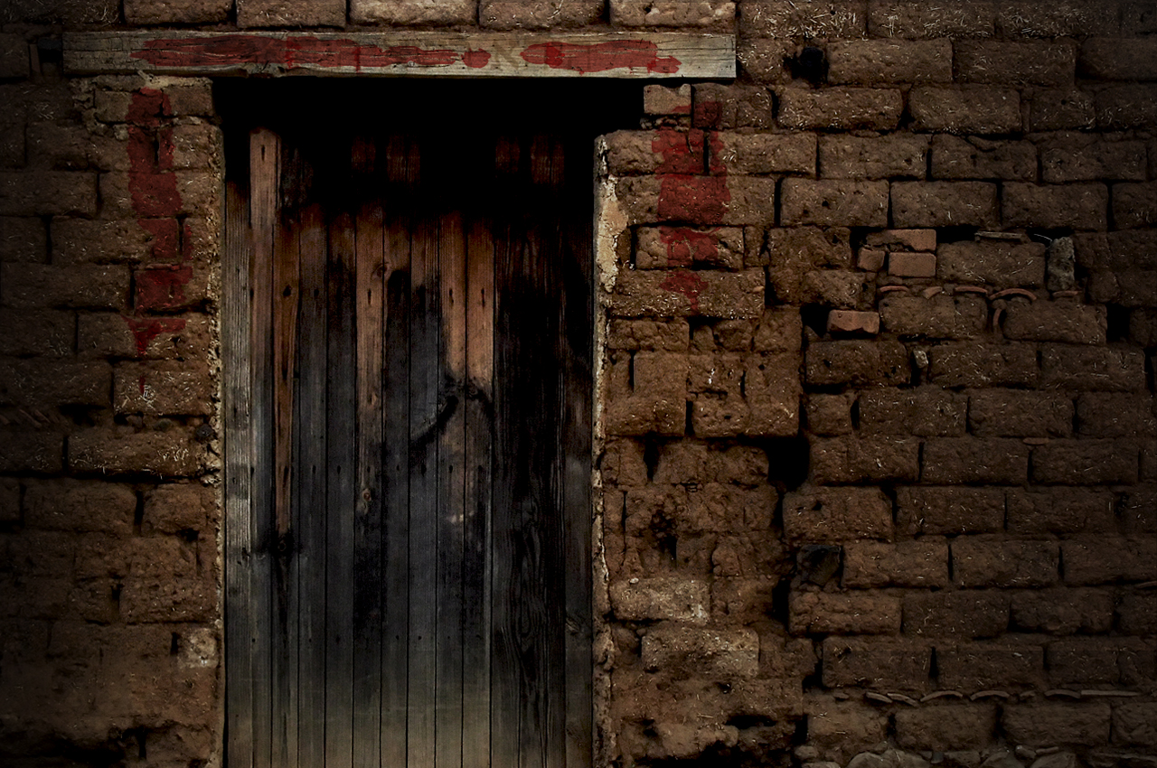
I.B. The example of Moses (verses 24-28)
Moses experienced God’s commendation
“Now Moses was faithful in all God’s house as a servant, to testify to the things that were to be spoken later.” Hebrews 3:5

Slide 14
I.B. The example of Moses (verses 24-28)
What is the “take away” from this example of faith?
Reject the temptation to worldly ways in your life, especially when they offer deliverance from the path of suffering God’s ways purposefully lead you into. And when God’s path brings you into the path of powerful adversaries, remember those adversaries are ultimately powerless on a path that is eternal. There was power in the blood of a lamb in Moses’ time; how much more power is there in the blood of The Lamb in our time and for all time!

Slide 15
I.C. The example of the people (verses 29-30)
29 By faith the people crossed the Red Sea as on dry land, but the Egyptians, when they attempted to do the same, were drowned. 30 By faith the walls of Jericho fell down after they had been encircled for seven days.
In what way did the people demonstrate they embraced the testimony of God as supreme?

Slide 16
I.C. The example of the people (verses 29-30)
“They said to Moses, ‘Is it because there are no graves in Egypt that you have taken us away to die in the wilderness? What have you done to us in bringing us out of Egypt? Is not this what we said to you in Egypt: “Leave us alone that we may serve the Egyptians”? For it would have been better for us to serve the Egyptians than to die in the wilderness.’ And Moses said to the people, ‘Fear not, stand firm, and see the salvation of the Lord, which he will work for you today. For the Egyptians whom you see today, you shall never see again. The Lord will fight for you, and you have only to be silent.’” Exodus 14:11-14
“The Lord said to Moses, ‘Why do you cry to me? Tell the people of Israel to go forward.’” Exodus 14:15

Slide 17
I.C. The example of the people (verses 29-30)
29 By faith the people crossed the Red Sea as on dry land, but the Egyptians, when they attempted to do the same, were drowned. 30 By faith the walls of Jericho fell down after they had been encircled for seven days.
In what way did the people demonstrate they embraced the testimony of God as supreme?
“Israel saw the great power that the Lord used against the Egyptians, so the people feared the Lord, and they believed in the Lord and in his servant Moses.” Exodus 14:31

Slide 18
I.C. The example of the people (verses 29-30)
29 By faith the people crossed the Red Sea as on dry land, but the Egyptians, when they attempted to do the same, were drowned. 30 By faith the walls of Jericho fell down after they had been encircled for seven days.
In what way did the people demonstrate they embraced the testimony of God as supreme?
“…on the face of it, nothing could seem more foolish than for grown men to march around a strong fortress for seven days on end, led by seven priests blowing rams’ horns. Who ever heard of a fortress being captured that way?” F.F. Bruce in his commentary on verse 30

Slide 19
I.C. The example of the people (verses 29-30)
29 By faith the people crossed the Red Sea as on dry land, but the Egyptians, when they attempted to do the same, were drowned. 30 By faith the walls of Jericho fell down after they had been encircled for seven days.
The people experienced God’s commendation
“…the people shouted, and the trumpets were blown. As soon as the people heard the sound of the trumpet, the people shouted a great shout, and the wall fell down flat, so that the people went up into the city, every man straight before him, and they captured the city.” Joshua 6:20

Slide 20
I.C. The example of the people (verses 29-30)
What is the “take away” from this example of faith?
It is possible, by God’s grace, to walk faithfully as a community, and we need to keep in mind that His directions to us can, and often will, be like nothing we’ve ever thought of or done. Furthermore, in both of these examples, God led His people through His appointed leaders, Moses and Joshua. This leads us to an important take away the author of Hebrews will bring to our notice in 13:17: “Obey your leaders and submit to them, for they are keeping watch over your souls, as those who will have to give an account. Let them do this with joy and not with groaning, for that would be of no advantage to you.”

Slide 21
I.D. The example of Rahab (verse 31)
31 By faith Rahab the prostitute did not perish with those who were disobedient, because she had given a friendly welcome to the spies.
In what way did Rahab’s life demonstrate she embraced the testimony of God as supreme?
Rahab concludes on the basis of the testimony she has heard “for the Lord your God, he is God in the heavens above and on the earth beneath.” Joshua 2:11
“Blessed are those who have not seen and yet have believed.” John 20:29

Slide 22
I.D. The example of Rahab (verse 31)
31 By faith Rahab the prostitute did not perish with those who were disobedient, because she had given a friendly welcome to the spies.
Rahab experienced God’s commendation
“Rahab the prostitute and her father’s household and all who belonged to her, Joshua saved alive. And she has lived in Israel to this day, because she hid the messengers whom Joshua sent to spy out Jericho.” Joshua 6:25
Matthew records in the midst of his genealogy of Jesus Christ “and Salmon the father of Boaz by Rahab, and Boaz the father of Obed by Ruth, and Obed the father of Jesse, and Jesse the father of David the king.” Matthew 1:5-6

Slide 23
I.D. The example of Rahab (verse 31)
What is the “take away” from this example of faith?
God’s grace overflows towards the faithful as Rahab’s family was delivered along with her, just as Noah’s was and just as Lot’s was. God is good all the time and can be trusted to be good all the time. And His goodness, grace, mercy and glory are not withheld because of your past. In God’s economy, a pagan prostitute who turns to Him doesn’t have her past held over her head. To the contrary, He exalts the likes of these into the line of kings and the King of kings! If this is all true, then let your faith be courageous in every way and against all odds, just like Rahab’s!

