Slide 1
Press on to maturity!

Slide 2
Customer
An “invisible” power
Wireless Connectivity

Slide 3
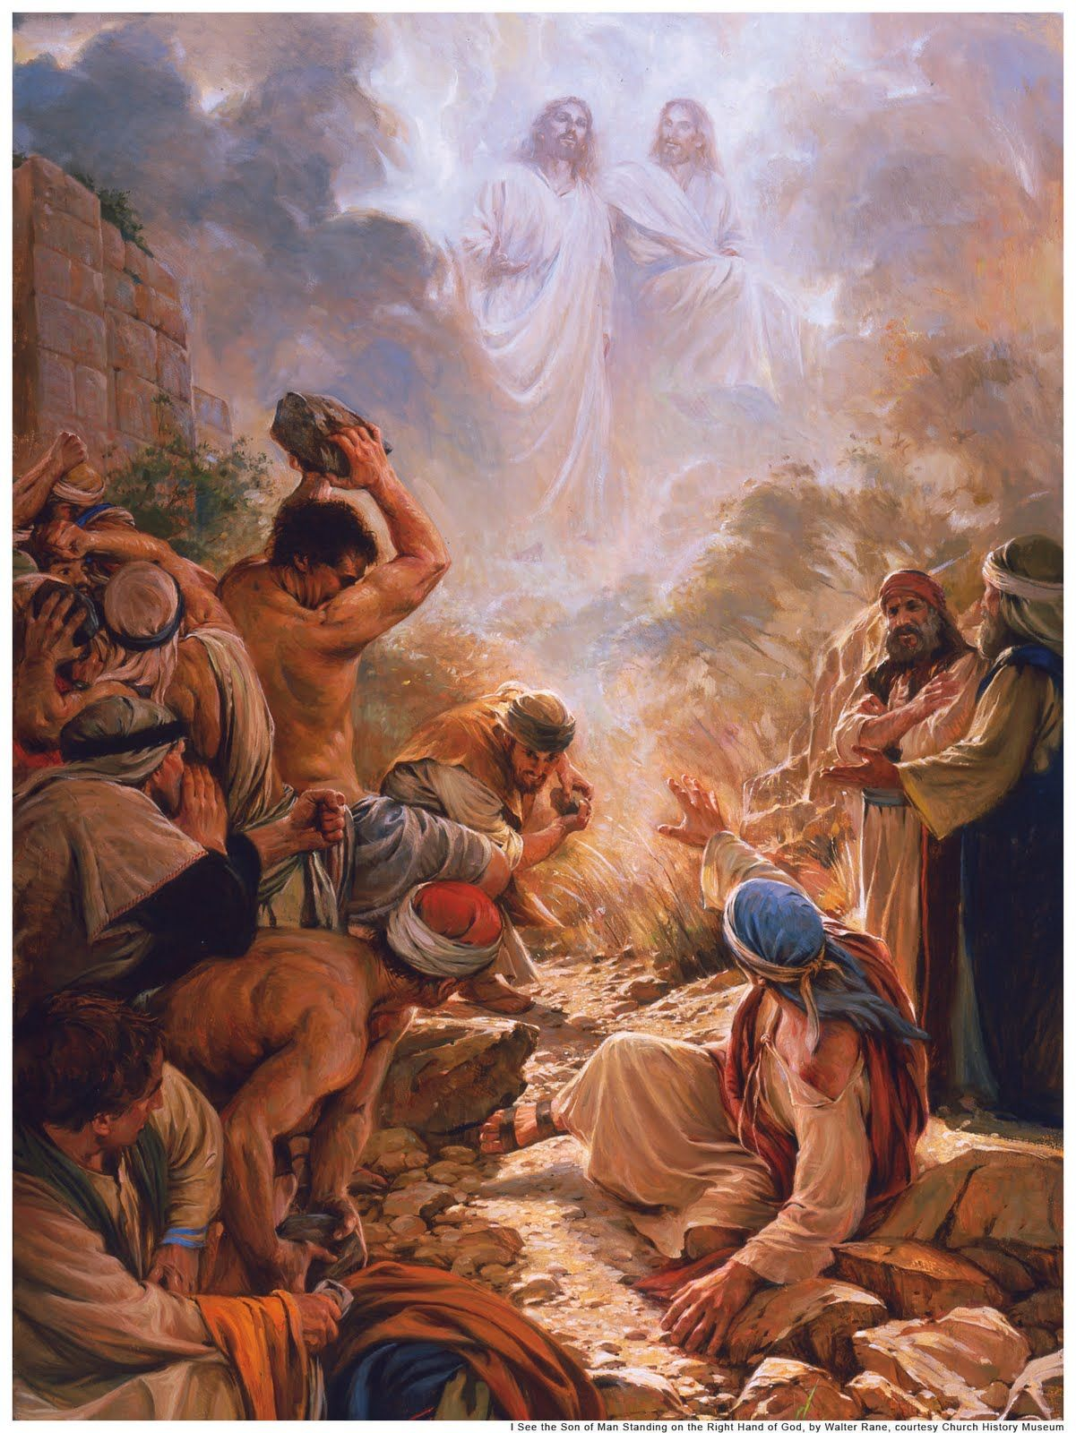
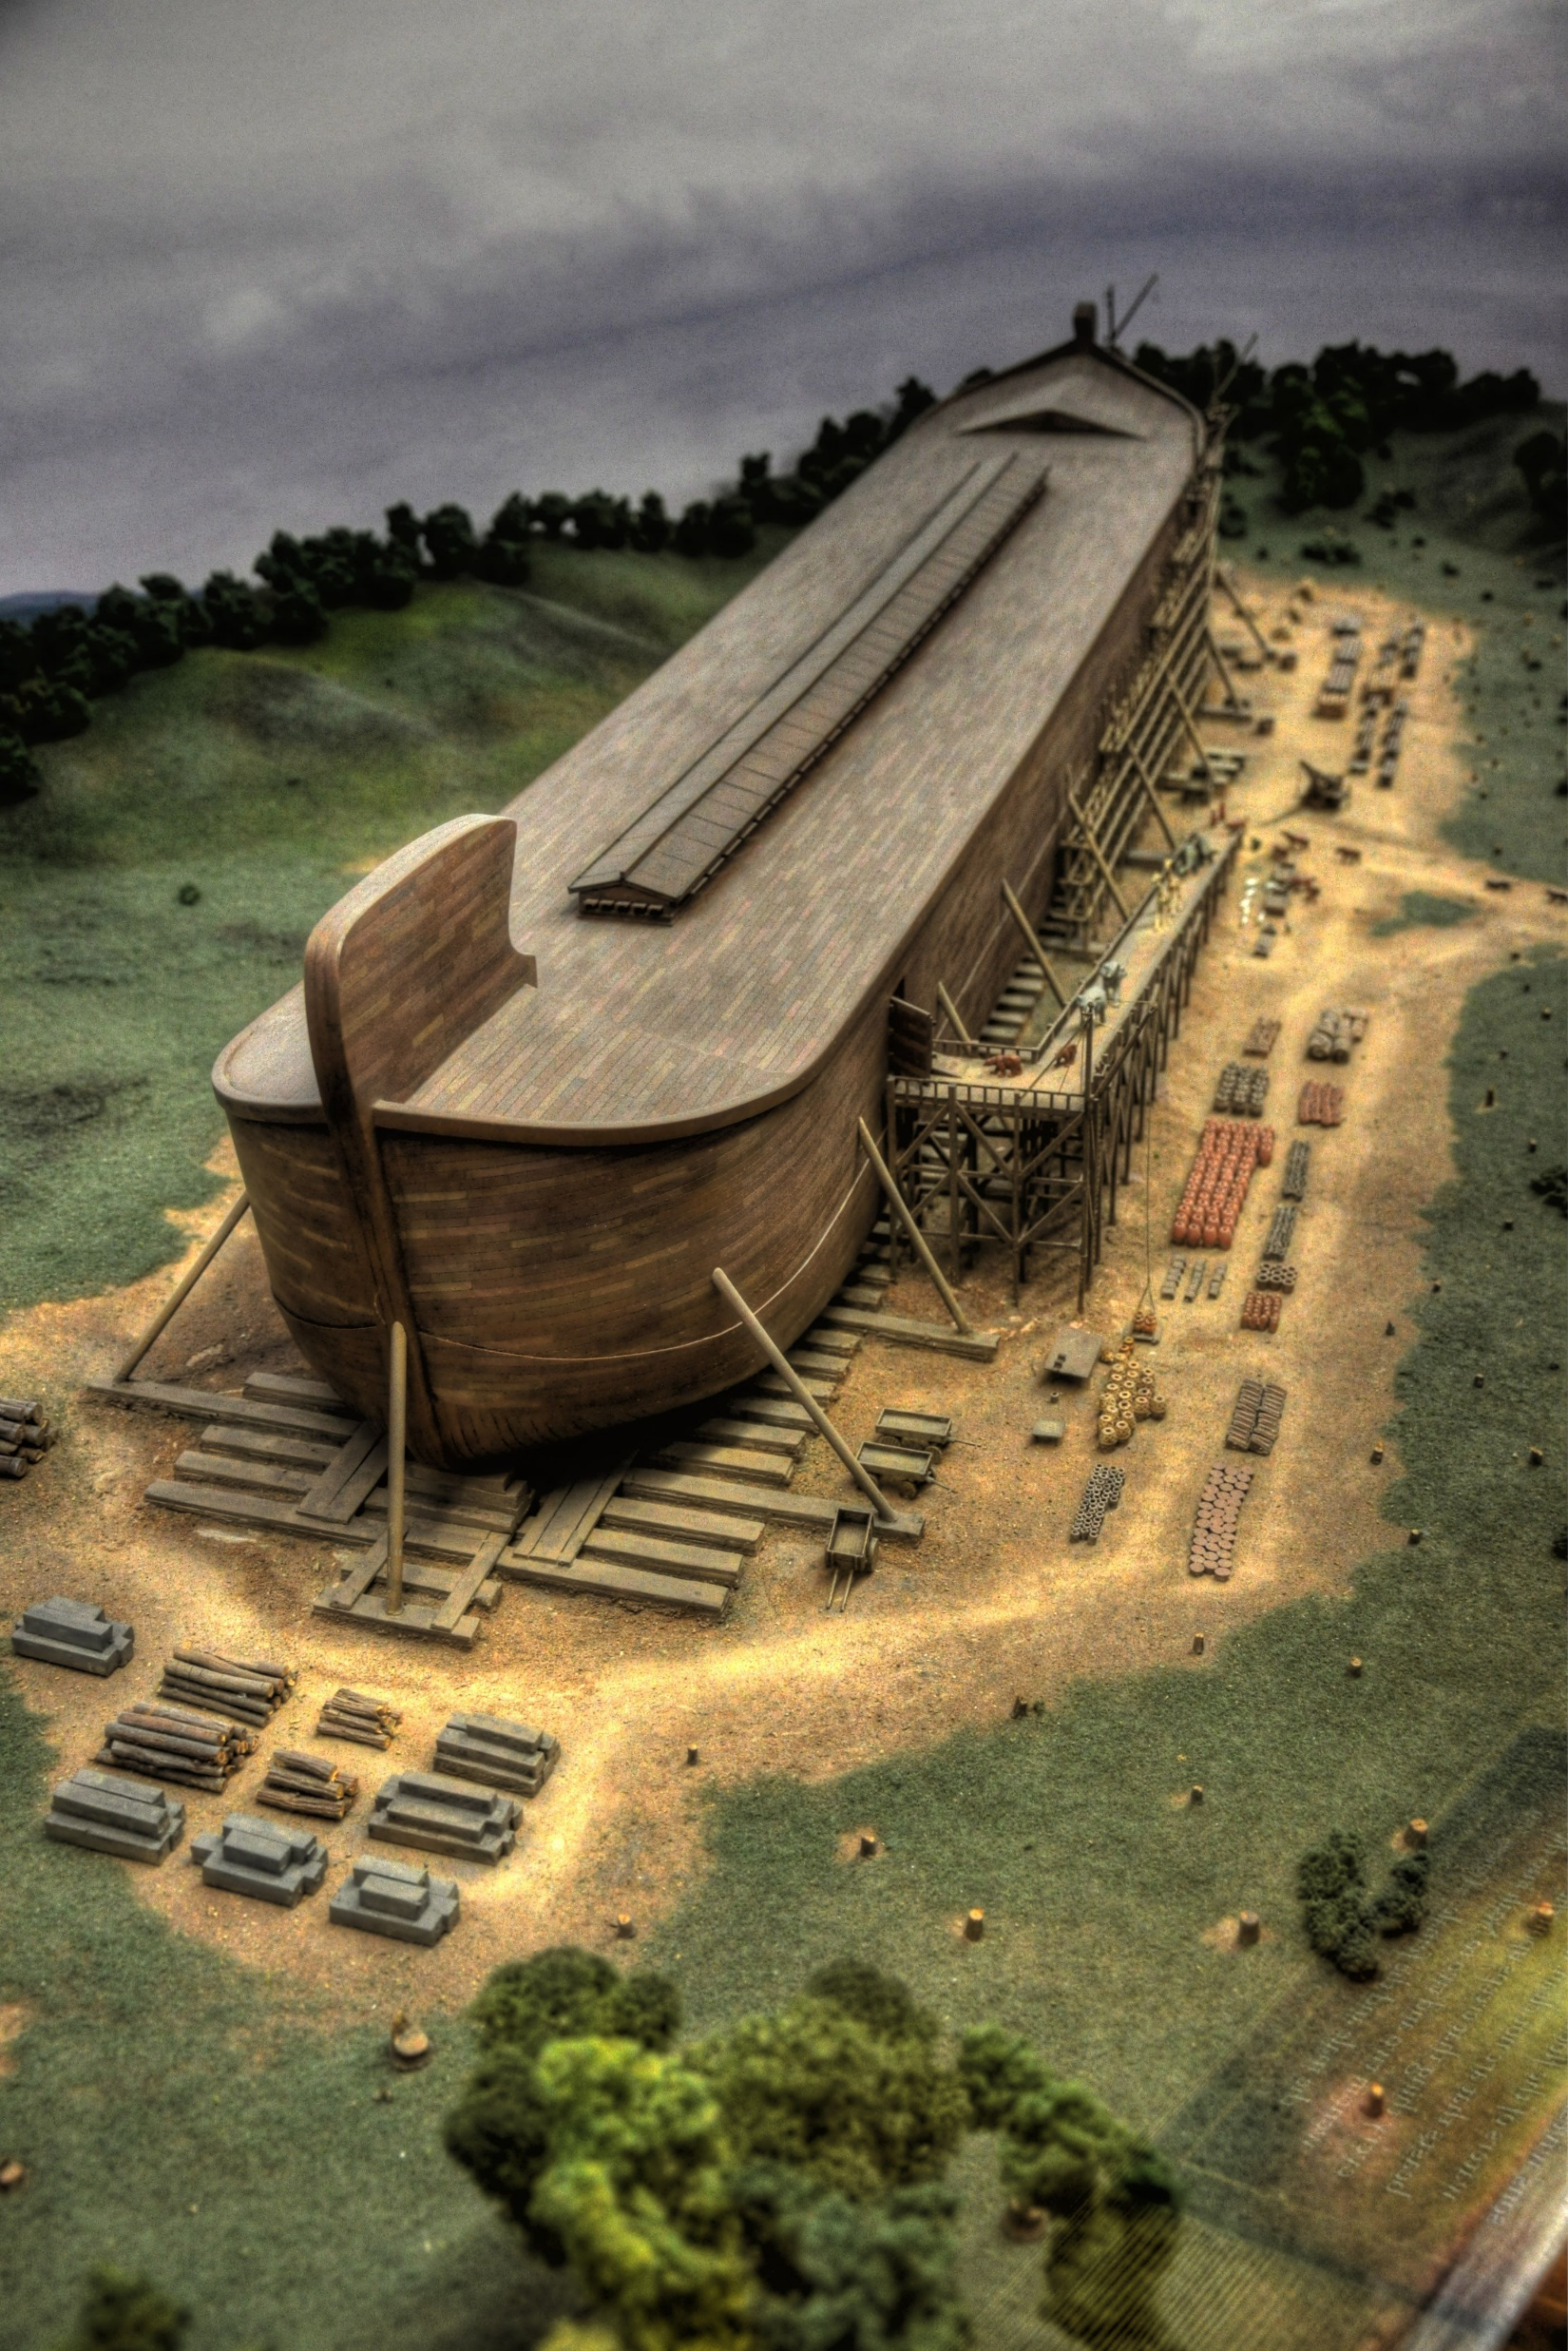
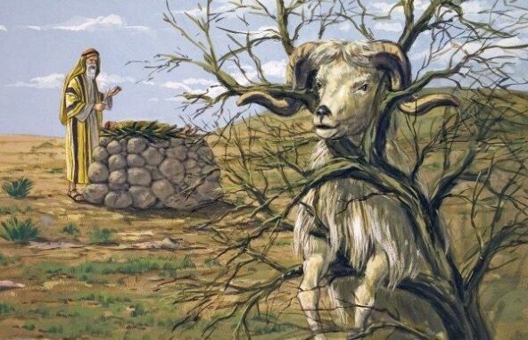
Righteous
An “invisible” power
The power of God

Slide 4
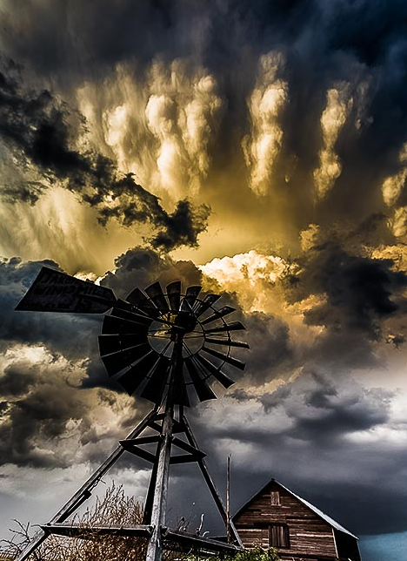
A Great Cloud of Witnesses! Part 1
Hebrews 11:1-7

Slide 5
I. A life of faith takes God at His word, lives accordingly and experiences His commendation (verses 1-3)
Faith exalts the testimony of God over the testimony of the visible order (verse 3)
3 By faith we understand that the universe was created by the word of God, so that what is seen was not made out of things that are visible.
“And God said, ‘Let there be light,’ and there was light.” Genesis 1:3

Slide 6
I. A life of faith takes God at His word, lives accordingly and experiences His commendation (verses 1-3)
Faith exalts the testimony of God over the testimony of the visible order (verse 3)
3 By faith we understand that the universe was created by the word of God, so that what is seen was not made out of things that are visible.
We are all without excuse because God’s “…invisible attributes, namely, his eternal power and divine nature, have been clearly perceived, ever since the creation of the world, in the things that have been made…” Romans 1:20

Slide 7
I. A life of faith takes God at His word, lives accordingly and experiences His commendation (verses 1-3)
Faith exalts the testimony of God over the testimony of the visible order (verse 3)
Faith embraces the testimony of God as supreme and lives accordingly (verse 1)
1 Now faith is the assurance of things hoped for, the conviction of things not seen.
1 Now faith is the reality of what is hoped for, the proof of what is not seen. (Christian Standard Bible)

Slide 8
I. A life of faith takes God at His word, lives accordingly and experiences His commendation (verses 1-3)
Faith exalts the testimony of God over the testimony of the visible order (verse 3)
Faith embraces the testimony of God as supreme and lives accordingly (verse 1)
1 Now faith is the assurance of things hoped for, the conviction of things not seen.
“…be transformed by the renewing of your mind, so that you may prove what the will of God is…” Romans 12:2, NASB

Slide 9
I. A life of faith takes God at His word, lives accordingly and experiences His commendation (verses 1-3)
Faith exalts the testimony of God over the testimony of the visible order (verse 3)
Faith embraces the testimony of God as supreme and lives accordingly (verse 1)
Through this life of faith, the invisible reality of God is experienced (verses 1-2)
1 Now faith is the assurance of things hoped for, the conviction of things not seen. 2 For by it the people of old received their commendation.”

Slide 10
II. The Scriptures reveal a great “cloud of witnesses” whose examples teach us how to live this life of faith (verses 4-7)
The example of Abel (verse 4)
4 By faith Abel offered to God a more acceptable sacrifice than Cain, through which he was commended as righteous, God commending him by accepting his gifts. And through his faith, though he died, he still speaks.

Slide 11
II.A. The example of Abel (verse 4)
4 By faith Abel offered to God a more acceptable sacrifice than Cain, through which he was commended as righteous, God commending him by accepting his gifts. And through his faith, though he died, he still speaks.
In what way did Abel’s life demonstrate he embraced the testimony of God as supreme?
“In the course of time Cain brought to the Lord an offering of the fruit of the ground, and Abel also brought of the firstborn of his flock and of their fat portions. And the Lord had regard for Abel and his offering, but for Cain and his offering he had no regard.” Genesis 4:3-5

Slide 12
II.A. The example of Abel (verse 4)
4 By faith Abel offered to God a more acceptable sacrifice than Cain, through which he was commended as righteous, God commending him by accepting his gifts. And through his faith, though he died, he still speaks.
Abel experienced God’s commendation
“In the course of time Cain brought to the Lord an offering of the fruit of the ground, and Abel also brought of the firstborn of his flock and of their fat portions. And the Lord had regard for Abel and his offering, but for Cain and his offering he had no regard.” Genesis 4:3-5

Slide 13
II.A. The example of Abel (verse 4)
4 By faith Abel offered to God a more acceptable sacrifice than Cain, through which he was commended as righteous, God commending him by accepting his gifts. And through his faith, though he died, he still speaks.
Abel experienced God’s commendation
“The voice of your brother’s blood is crying to me from the ground.” Genesis 4:10
“‘O Sovereign Lord, holy and true, how long before you will judge and avenge our blood on those who dwell on the earth?’ Then they were each given a white robe and told to rest a little longer.” Revelation 6:10-11

Slide 14
II.A. The example of Abel (verse 4)
4 By faith Abel offered to God a more acceptable sacrifice than Cain, through which he was commended as righteous, God commending him by accepting his gifts. And through his faith, though he died, he still speaks.
Abel experienced God’s commendation
“…you have need of endurance, so that when you have done the will of God you may receive what is promised.” Hebrews 10:36
“Consider him who endured from sinners such hostility against himself, so that you may not grow weary or fainthearted. In your struggle against sin you have not yet resisted to the point of shedding your blood.” Hebrews 12:3-4

Slide 15
II.A. The example of Abel (verse 4)
The “take away” from Abel’s example
Always offer to God what is best and first and trust Him with the results, and should the results be hostility from sinners, even to the point of death, then trust in Him to sustain you by His power as you heed His command to endure in such times.

Slide 16
II.B. The example of Enoch (verses 5-6)
5 By faith Enoch was taken up so that he should not see death, and he was not found, because God had taken him. Now before he was taken, he was commended as having pleased God. 6 And without faith it is impossible to please him, for whoever would draw near to God must believe that he exists and that he rewards those who seek him.
In what way did Enoch’s life demonstrate he embraced the testimony of God as supreme?
Enoch “walked with God.” Genesis 5:22 & 24

Slide 17
Enoch “walked with god”
“Enoch walked with God because he was His friend and liked His company, because he was going in the same direction as God, and had no desire for anything but what lay in God's path. We walk with God when He is in all our thoughts; not because we consciously think of Him at all times, but because He is naturally suggested to us by all we think of; as when any person or plan or idea has become important to us, no matter what we think of, our thought is always found recurring to this favorite object, so with the godly man everything has a connection with God and must be ruled by that connection.” 19th century Scottish theologian Marcus Dods

Slide 18
II.B. The example of Enoch (verses 5-6)
5 By faith Enoch was taken up so that he should not see death, and he was not found, because God had taken him. Now before he was taken, he was commended as having pleased God. 6 And without faith it is impossible to please him, for whoever would draw near to God must believe that he exists and that he rewards those who seek him.
“rewards those who earnestly seek him” NIV
In what way did Enoch’s life demonstrate he embraced the testimony of God as supreme?
Enoch “walked with God.” Genesis 5:22 & 24

Slide 19
II.B. The example of Enoch (verses 5-6)
5 By faith Enoch was taken up so that he should not see death, and he was not found, because God had taken him. Now before he was taken, he was commended as having pleased God.
Enoch experienced God’s commendation

Slide 20
II.B. The example of Enoch (verses 5-6)
The “take away” from Enoch’s example
The life of faith we’re called to is a moment-by-moment, day-by-day, year-by-year, joyful and earnest pursuit of a life in submission to God’s will. It’s a heart and soul walk which realizes that in seeking and walking with God, we experience the life He gives; the life of incomparable worth and consuming joy. And like Enoch, we too will be delivered from the finality of death through this life of faith to include the great hope we all have of being delivered like Enoch - to not experience physical death - for Paul teaches that those who are alive when Christ returns “will be caught up together with them in the clouds to meet the Lord in the air, and so we will always be with the Lord.” (1 Thessalonians 4:17)

Slide 21
II.C. The example of Noah (verse 7)
7 By faith Noah, being warned by God concerning events as yet unseen, in reverent fear constructed an ark for the saving of his household. By this he condemned the world and became an heir of the righteousness that comes by faith.
“Our God is a consuming fire.” Hebrews 12:29
In what way did Noah’s life demonstrate he embraced the testimony of God as supreme?
Noah “walked with God.” Genesis 6:9

Slide 22
II.C. The example of Noah (verse 7)
7 By faith Noah, being warned by God concerning events as yet unseen, in reverent fear constructed an ark for the saving of his household. By this he condemned the world and became an heir of the righteousness that comes by faith.
Noah experienced God’s commendation
“The men of Nineveh will rise up at the judgment with this generation and condemn it, for they repented at the preaching of Jonah, and behold, something greater than Jonah is here.” Luke 11:32
“Faith is the reality of what is hoped for, the proof of what is not seen.” (verse 1, CSB)

Slide 23
II.C. The example of Noah (verse 7)
The “take away” from Noah’s example
Be unwavering in your trust in the unseen reality of God despite your circumstances for He is faithful to confirm your trust, and as you walk with Him, don’t lose sight of the fact that a close walk with God sustains a “reverent fear” of God. And like Noah, always know that no set of present or future circumstances, to include God’s wrath being brought upon the entire world, will keep you from inheriting God’s promises for eternity to His faithful people.

