Slide 1
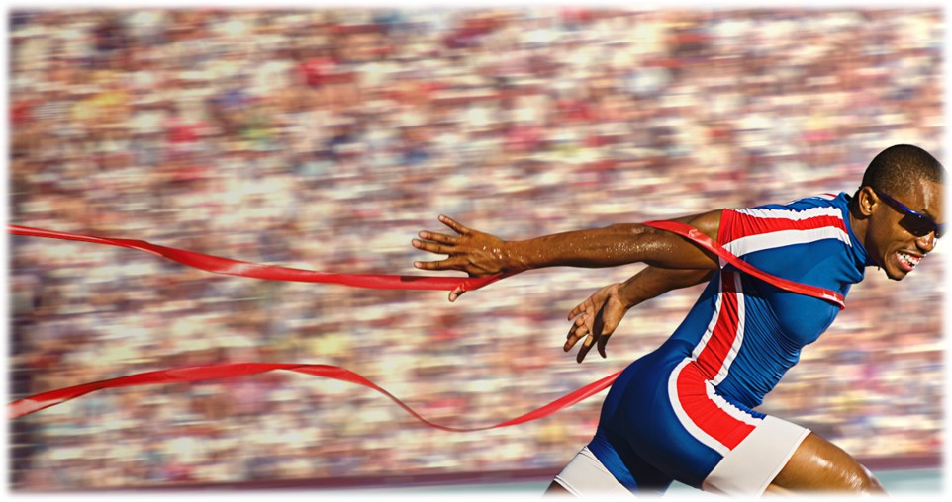
Press on to maturity!

Slide 2
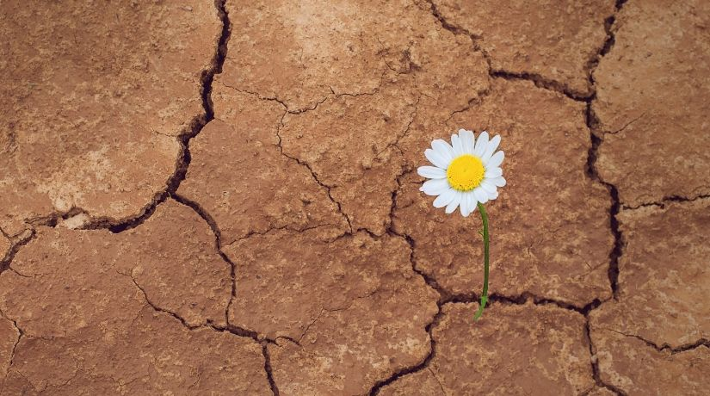
Endure to the end and be saved!
Hebrews 10:32-39

Slide 3
I. We joyfully endure to the end because our hope is for eternity (verses 32-34)
32 But recall the former days when, after you were enlightened, you endured a hard struggle with sufferings

Slide 4
I. We joyfully endure to the end because our hope is for eternity (verses 32-34)
32 But recall the former days when, after you were enlightened, you endured a hard struggle with suffering 33 sometimes being publicly exposed to reproach and affliction, and sometimes being partners with those so treated. 34 For you had compassion on those in prison, and you joyfully accepted the plundering of your property…
“Remember the word that I said to you: ‘A servant is not greater than his master.’ If they persecuted me, they will also persecute you…But all these things they will do to you on account of my name, because they do not know him who sent me.” John 15:20-21

Slide 5
I. We joyfully endure to the end because our hope is for eternity (verses 32-34)
32 But recall the former days when, after you were enlightened, you endured a hard struggle with suffering 33 sometimes being publicly exposed to reproach and affliction, and sometimes being partners with those so treated. 34 For you had compassion on those in prison, and you joyfully accepted the plundering of your property, since you knew that you yourselves had a better possession and an abiding one.
“Blessed are you when people hate you and when they exclude you and revile you and spurn your name as evil, on account of the Son of Man! Rejoice in that day, and leap for joy, for behold, your reward is great in heaven.” Luke 6:22-23

Slide 6
II. We endure to the end because our confidence is in God’s will (verses 35-39)
“Ladies, don’t forget the rummage sale. It’s a chance to get rid of those things not worth keeping around the house. Bring your husbands.” Reported to have been announced in a church bulletin ☺

Slide 7
II. We endure to the end because our confidence is in God’s will (verses 35-39)
God’s will for our lives is to surrender it to Him now in order to receive His eternal reward (verses 35-36)
35 Therefore do not throw away your confidence, which has a great reward. 36 For you have need of endurance, so that when you have done the will of God you may receive what is promised.
“Let us then with confidence draw near to the throne of grace, that we may receive mercy and find grace to help in time of need.” Hebrews 4:16

Slide 8
II. We endure to the end because our confidence is in God’s will (verses 35-39)
God’s will for our lives is to surrender it to Him now in order to receive His eternal reward (verses 35-36)
A life so surrendered to God will be confident at Christ’s return (verses 37-39)
37 For, “Yet a little while, and the coming one will come and will not delay; 38 but my righteous one shall live by faith, and if he shrinks back, my soul has no pleasure in him.”
“And he will be upheld, for the Lord is able to make him stand.” Romans 14:4

Slide 9
II. We endure to the end because our confidence is in God’s will (verses 35-39)
God’s will for our lives is to surrender it to Him now in order to receive His eternal reward (verses 35-36)
A life so surrendered to God will be confident at Christ’s return (verses 37-39)
37 For, “Yet a little while, and the coming one will come and will not delay; 38 but my righteous one shall live by faith, and if he shrinks back, my soul has no pleasure in him.”
39 But we are not of those who shrink back and are destroyed, but of those who have faith and preserve their souls

Slide 10
II. We endure to the end because our confidence is in God’s will (verses 35-39)
Verse 38 …my righteous one shall live by faith…
It is the faith of those who, “by God’s power are being guarded through faith for a salvation ready to be revealed in the last time.” 1 Peter 1:5
Endurance in our life of faith to the end must be our unquestioned commitment because it is the life God promises to produce in us.
But we walk in the obedience of faith, not in our own confidence to endure, but in the confidence that the Lord Jesus is able make us endure.

Slide 11
III. Endure to the end and be saved!
“faith is the assurance of things hoped for…” Hebrews 11:1
“Even the demons believe—and shudder!” James 2:19
We gain assurance of our salvation because God proves Himself faithful in real and vivid and irrefutable ways in our lives through His “grace to help in time of need.” Hebrews 4:16

Slide 12
Jesus teaches us that suffering for His name’s sake is a blessing
“Blessed are you when people hate you and when they exclude you and revile you and spurn your name as evil, on account of the Son of Man! Rejoice in that day, and leap for joy…” Luke 6:22-23
When the council called in the apostles, “they beat them and charged them not to speak in the name of Jesus, and let them go. Then they left the presence of the council, rejoicing that they were counted worthy to suffer dishonor for the name.” Acts 5:40-41

Slide 13
Jesus teaches us that suffering for His name’s sake is a blessing
“Blessed are you when people hate you and when they exclude you and revile you and spurn your name as evil, on account of the Son of Man! Rejoice in that day, and leap for joy…” Luke 6:22-23
“But rejoice insofar as you share Christ’s sufferings, that you may also rejoice and be glad when his glory is revealed. If you are insulted for the name of Christ, you are blessed, because the Spirit of glory and of God rests upon you.” 1 Peter 4:13-14

Slide 14
III. Endure to the end and be saved!
“Through him we have also obtained access by faith into this grace in which we stand, and we rejoice in hope of the glory of God. Not only that, but we rejoice in our sufferings, knowing that suffering produces endurance, and endurance produces character, and character produces hope, and hope does not put us to shame, because God’s love has been poured into our hearts through the Holy Spirit who has been given to us.” Romans 5:2-5

Slide 15
Endure to the end and be saved!

