Slide 1
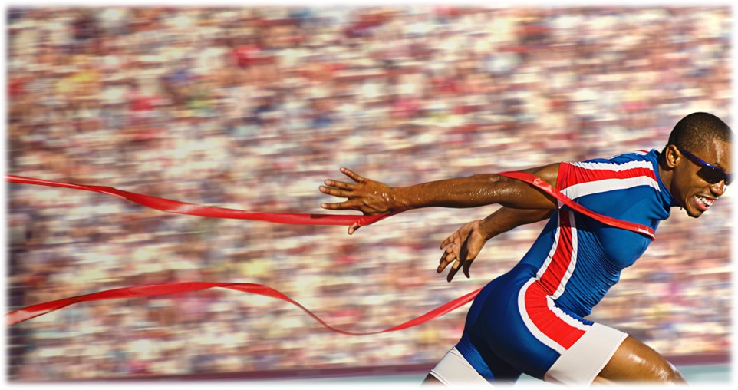
Press on to maturity!
“The United States is enduring an unprecedented crisis of trust. This is the first time that a massive drop in trust has not been linked to a pressing economic issue or catastrophe … In fact, it's the ultimate irony that it's happening at a time of prosperity, with the stock market and employment rates in the US at record highs.” Richard Edelman, president and CEO of Edelman PR company

Slide 2
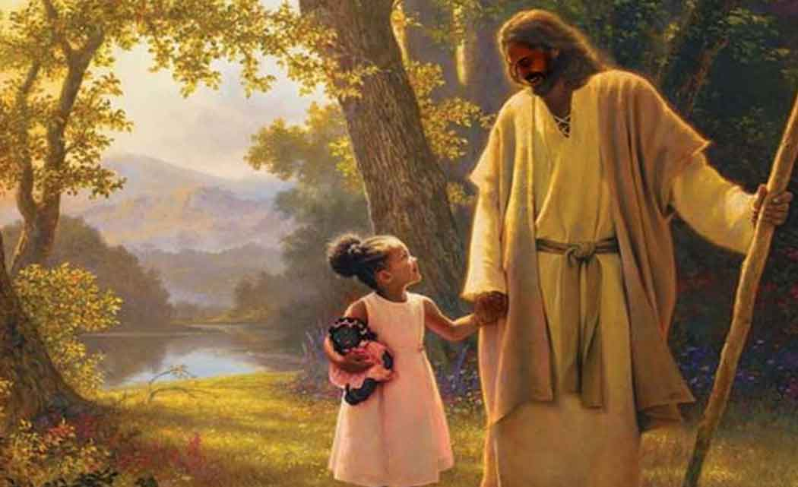
Be saved to the uttermost!
Hebrews 7:20-28

Slide 3
I. Jesus is the guarantor of a better covenant… (verses 20-28)
“Christ has obtained a ministry that is as much more excellent than the old as the covenant he mediates is better, since it is enacted on better promises.” Hebrews 8:6

Slide 4
I. Jesus is the guarantor of a better covenant… (verses 20-28)
Because the Lord swore an oath to give Him an everlasting priesthood (verses 20-22)
God desired to give us the greatest possible assurance in our salvation, so much so, that “…when God desired to show more convincingly to the heirs of the promise the unchangeable character of his purpose, he guaranteed it with an oath.” Hebrews 6:17

Slide 5
I. Jesus is the guarantor of a better covenant… (verses 20-28)
Because the Lord swore an oath to give Him an everlasting priesthood (verses 20-22)
20 And it was not without an oath. For those who formerly became priests were made such without an oath, 21 but this one was made a priest with an oath by the one who said to him: “The Lord has sworn and will not change his mind, ‘You are a priest forever.’” 22 This makes Jesus the guarantor of a better covenant.

Slide 6
I. Jesus is the guarantor of a better covenant… (verses 20-28)
Because the Lord swore an oath to give Him an everlasting priesthood (verses 20-22)
Because His intercession for us as our high priest never ceases (verses 23-25)
23 The former priests were many in number, because they were prevented by death from continuing in office, 24 but he holds his priesthood permanently, because he continues forever. 25 Consequently, he is able to save to the uttermost those who draw near to God through him, since he always lives to make intercession for them.

Slide 7
I. Jesus is the guarantor of a better covenant… (verses 20-28)
Because the Lord swore an oath to give Him an everlasting priesthood (verses 20-22)
Because His intercession for us as our high priest never ceases (verses 23-25)
23 The former priests were many in number, because they were prevented by death from continuing in office, 24 but he holds his priesthood permanently, because he continues forever. 25 Consequently, he is able to save to the uttermost those who draw near to God through him, since he always lives to make intercession for them.

Slide 8
I. Jesus is the guarantor of a better covenant… (verses 20-28)
Because the Lord swore an oath to give Him an everlasting priesthood (verses 20-22)
Because His intercession for us as our high priest never ceases (verses 23-25)
Remember all the way back in 4:14, the author of Hebrews wrote “Since then we have a great high priest who has passed through the heavens…” alluding to the fact that Jesus has returned to the Father’s right hand, but as 6:19-20 indicates, He did so as “a hope that enters into the inner place behind the curtain, where Jesus has gone as a forerunner on our behalf, having become a high priest forever.”

Slide 9
I. Jesus is the guarantor of a better covenant… (verses 20-28)
Because the Lord swore an oath to give Him an everlasting priesthood (verses 20-22)
Because His intercession for us as our high priest never ceases (verses 23-25)
23 The former priests were many in number, because they were prevented by death from continuing in office, 24 but he holds his priesthood permanently, because he continues forever. 25 Consequently, he is able to save to the uttermost those who draw near to God through him, since he always lives to make intercession for them.

Slide 10
I. Jesus is the guarantor of a better covenant… (verses 20-28)
Because the Lord swore an oath to give Him an everlasting priesthood (verses 20-22)
Because His intercession for us as our high priest never ceases (verses 23-25)
“Who shall bring any charge against God’s elect? It is God who justifies. Who is to condemn? Christ Jesus is the one who died—more than that, who was raised—who is at the right hand of God, who indeed is interceding for us.” Romans 8:33-34

Slide 11
I. Jesus is the guarantor of a better covenant… (verses 20-28)
Because of His everlasting priesthood (verses 20-22)
Because of ceaseless intercession (verses 23-25)
Because His intercession for us as our high priest is perfect…
Because His character is perfect
26 For it was indeed fitting that we should have such a high priest, holy, innocent, unstained, separated from sinners, and exalted above the heavens.

Slide 12
I. Jesus is the guarantor of a better covenant… (verses 20-28)
Because of His everlasting priesthood (verses 20-22)
Because of ceaseless intercession (verses 23-25)
Because His intercession for us as our high priest is perfect…
Because His character is perfect
Because His sacrifice is eternally effective
27 He has no need, like those high priests, to offer sacrifices daily, first for his own sins and then for those of the people, since he did this once for all when he offered up himself.

Slide 13
I. Jesus is the guarantor of a better covenant… (verses 20-28)
Because of His everlasting priesthood (verses 20-22)
Because of ceaseless intercession (verses 23-25)
Because His intercession for us as our high priest is perfect…
Because His character is perfect
Because His sacrifice is eternally effective
Therefore, the likes of Abel, Enoch, Noah, Abraham, Moses, Rahab, David and many more, “though commended through their faith, did not receive what was promised, since God had provided something better for us, that apart from us they should not be made perfect.” Hebrews 11:39-40

Slide 14
I. Jesus is the guarantor of a better covenant… (verses 20-28)
Because of His everlasting priesthood (verses 20-22)
Because of ceaseless intercession (verses 23-25)
Because His intercession for us as our high priest is perfect…
Because His character is perfect
Because His sacrifice is eternally effective
Because He is the perfect Son of the Father who appointed Him
28 For the law appoints men in their weakness as high priests, but the word of the oath, which came later than the law, appoints a Son who has been made perfect forever.

Slide 15
Jesus being “made perfect”
21 but this one was made a priest with an oath…‘You are a priest forever.’
28 …the word of the oath…appoints a Son who has been made perfect forever.
26 it was indeed fitting that we should have such a high priest…
2:10 For it was fitting that he, for whom and by whom all things exist, in bringing many sons to glory, should make the founder of their salvation perfect through suffering.
5:8-10 Although he was a son, he learned obedience through what he suffered. And being made perfect, he became the source of eternal salvation to all who obey him, being designated by God a high priest after the order of Melchizedek”

Slide 16
II. Be saved to the uttermost!
25 Consequently, he is able to save to the uttermost those who draw near to God through him, since he always lives to make intercession for them.

Slide 17
Be saved to the uttermost!

