Slide 1
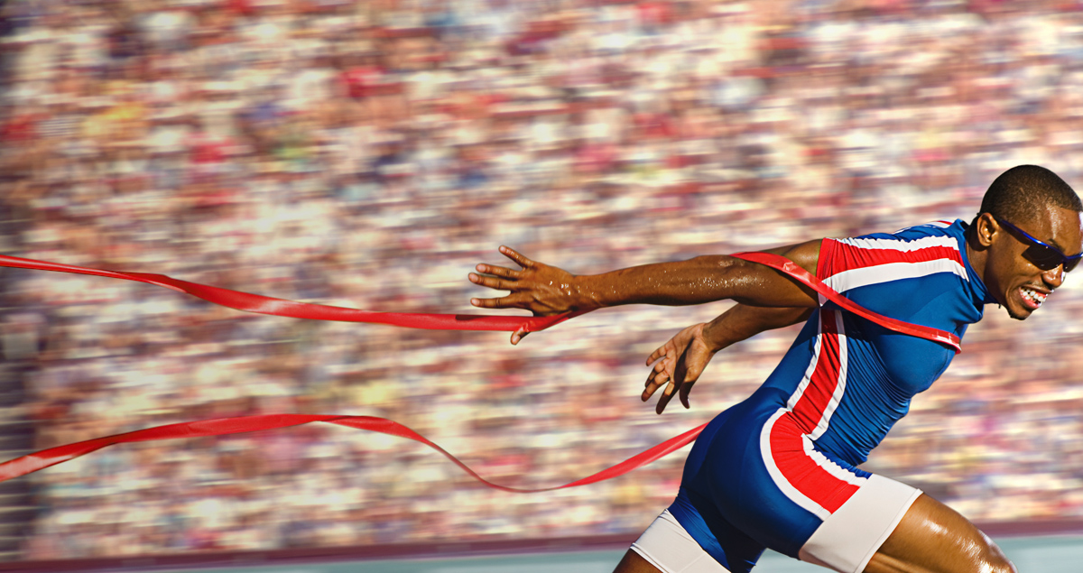
Press on to maturity!
A Sermon Series on the book of Hebrews

Slide 2
“For we have come to share in Christ, if indeed we hold our original confidence firm to the end.” Hebrews 3:14

Slide 3
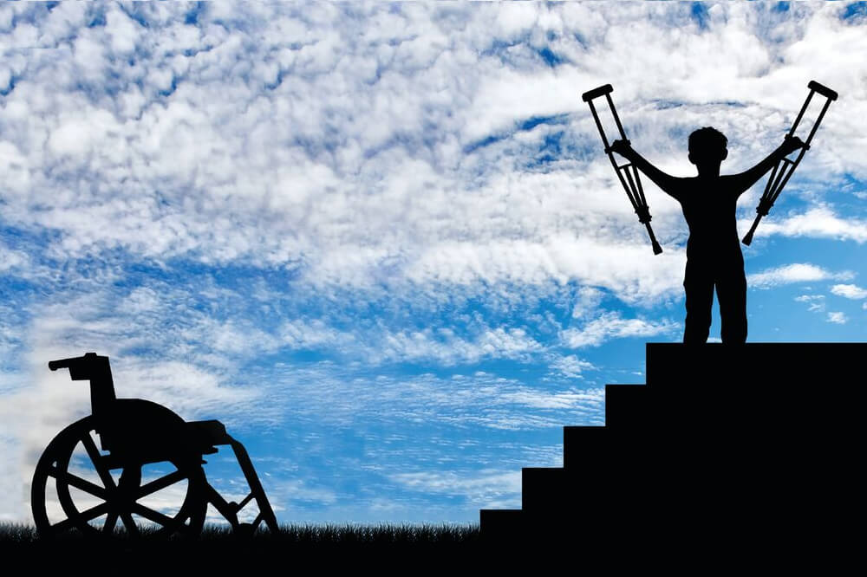
Genuine faith finishes the race: part 1
Hebrews 3:7-19

Slide 4
I. Professed faith in God will be put to the test of obedience (verses 7-11, 14)
7 Therefore, as the Holy Spirit says, “Today, if you hear his voice…”

Slide 5
I. Professed faith in God will be put to the test of obedience (verses 7-11, 14)
Unbelief will be revealed, through testing, by its persistent disobedience (verses 7-11)
7 Therefore, as the Holy Spirit says, “Today, if you hear his voice…” 8 do not harden your hearts as in the rebellion, on the day of testing in the wilderness, 9 where your fathers put me to the test and saw my works for forty years. 10 Therefore I was provoked with that generation, and said, ‘They always go astray in their heart; they have not known my ways.’

Slide 6
I. Professed faith in God will be put to the test of obedience (verses 7-11, 14)
Unbelief will be revealed, through testing, by its persistent disobedience (verses 7-11)
11 As I swore in my wrath, ‘They shall not enter my rest.’”
“…none of the men who have seen my glory and my signs that I did in Egypt and in the wilderness, and yet have put me to the test these ten times and have not obeyed my voice, shall see the land that I swore to give to their fathers.” Numbers 14:22-23

Slide 7
I. Professed faith in God will be put to the test of obedience (verses 7-11, 14)
Unbelief will be revealed, through testing, by its persistent disobedience (verses 7-11)
Genuine faith will persist in obedience (verse 14 & Numbers 14:1-30)
14 For we have come to share in Christ, if indeed we hold our original confidence firm to the end.

Slide 8
Numbers 14: Caleb & Joshua stand out as models of genuine faith
“And Joshua the son of Nun and Caleb the son of Jephunneh, who were among those who had spied out the land, tore their clothes and said to all the congregation of the people of Israel, ‘The land, which we passed through to spy it out, is an exceedingly good land. If the Lord delights in us, he will bring us into this land and give it to us, a land that flows with milk and honey. Only do not rebel against the Lord. And do not fear the people of the land, for they are bread for us. Their protection is removed from them, and the Lord is with us; do not fear them.’” Numbers 14:6-9

Slide 9
Numbers 14: Caleb & Joshua stand out as models of genuine faith
“…my servant Caleb, because he has a different spirit and has followed me fully, I will bring into the land into which he went, and his descendants shall possess it … your dead bodies shall fall in this wilderness, and of all your number, listed in the census from twenty years old and upward, who have grumbled against me, not one shall come into the land where I swore that I would make you dwell, except Caleb the son of Jephunneh and Joshua the son of Nun.” Numbers 14:24, 29-30

Slide 10
II. Therefore, the church must “exhort one another every day” to walk in obedience… (verses 12-13)
Through individual self-examination (verse 12)
12 Take care, brothers, lest there be in any of you an evil, unbelieving heart, leading you to fall away from the living God.
“unbelieving heart that forsakes the living God.” New English Translation

Slide 11
II. Therefore, the church must “exhort one another every day” to walk in obedience… (verses 12-13)
Through individual self-examination (verse 12)
12 Take care, brothers, lest there be in any of you an evil, unbelieving heart, leading you to fall away from the living God.
“And the ones on the rock are those who, when they hear the word, receive it with joy. But these have no root; they believe for a while, and in time of testing fall away.” Luke 8:13

Slide 12
II. Therefore, the church must “exhort one another every day” to walk in obedience… (verses 12-13)
Through individual self-examination (verse 12)
Through corporate encouragement and correction to “hold our original confidence firm to the end” (verse 13)
13 But exhort one another every day, as long as it is called “today,” that none of you may be hardened by the deceitfulness of sin.

Slide 13
II. Therefore, the church must “exhort one another every day” to walk in obedience… (verses 12-13)
Through individual self-examination (verse 12)
Through corporate encouragement and correction to “hold our original confidence firm to the end” (verse 13)
“Let us hold fast the confession of our hope without wavering, for he who promised is faithful. And let us consider how to stir up one another to love and good works, not neglecting to meet together, as is the habit of some, but encouraging one another, and all the more as you see the Day drawing near.” Hebrews 10:23-25

Slide 14
III. Because the disobedience of unbelief will not lead to His rest (verses 14-19)
15 As it is said, “Today, if you hear his voice, do not harden your hearts as in the rebellion.” 16 For who were those who heard and yet rebelled? Was it not all those who left Egypt led by Moses? 17 And with whom was he provoked for forty years? Was it not with those who sinned, whose bodies fell in the wilderness? 18 And to whom did he swear that they would not enter his rest, but to those who were disobedient? 19 So we see that they were unable to enter because of unbelief.

Slide 15
III. Because the disobedience of unbelief will not lead to His rest (verses 14-19)
18 And to whom did he swear that they would not enter his rest, but to those who were disobedient? 19 So we see that they were unable to enter because of unbelief.
“Israel saw the great power that the Lord used against the Egyptians, so the people feared the Lord, and they believed in the Lord and in his servant Moses.” Exodus 14:31
“How long will this people despise me? And how long will they not believe in me, in spite of all the signs that I have done among them?” Numbers 14:11

Slide 16
III. Because the disobedience of unbelief will not lead to His rest (verses 14-19)
18 And to whom did he swear that they would not enter his rest, but to those who were disobedient? 19 So we see that they were unable to enter because of unbelief.

Slide 17
III. Because the disobedience of unbelief will not lead to His rest (verses 14-19)
14 For we have come to share in Christ, if indeed we hold our original confidence firm to the end.
15 As it is said…
Verses 15-18
19 So we see that they were unable to enter because of unbelief.

Slide 18
III. Because the disobedience of unbelief will not lead to His rest (verses 14-19)
14 For we have come to share in Christ, if indeed we hold our original confidence firm to the end.
Those who do not are, like the rebellious among the people of Israel, those whose unbelief will be revealed by their persistent disobedience in times of testing…
“Those who, when they hear the word, receive it with joy. But these have no root; they believe for a while, and in time of testing fall away.” Luke 8:13

Slide 19

Genuine faith finishes the race: part 2
“Therefore, while the promise of entering his rest still stands, let us fear lest any of you should seem to have failed to reach it.” Hebrews 4:1
Hebrews 4:1-13

