Slide 1
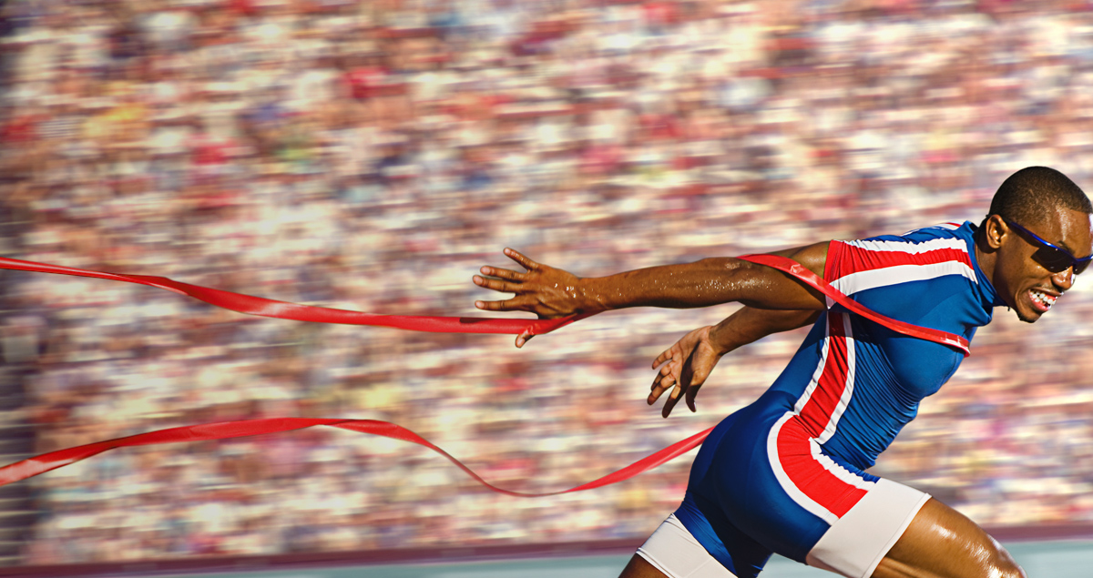
Press on to maturity!
A Sermon Series on the book of Hebrews

Slide 2
“People do not drift toward holiness. Apart from grace-driven effort, people do not gravitate toward godliness, prayer, obedience to Scripture, faith, and delight in the Lord. We drift toward compromise and call it tolerance; we drift toward disobedience and call it freedom; we drift toward superstition and call it faith. We cherish the indiscipline of lost self-control and call it relaxation; we slouch toward prayerlessness and delude ourselves into thinking we have escaped legalism; we slide toward godlessness and convince ourselves we have been liberated.” D.A. Carson

Slide 3

Are we neglecting “such a great salvation”?
Hebrews 2:1-4
“we must pay much closer attention to what we have heard, lest we drift away from it.”

Slide 4
I. Are we careless with the truth of the gospel which we have heard?(verse 1)
1 Therefore we must pay much closer attention to what we have heard, lest we drift away from it.
“For it is time for judgment to begin at the household of God; and if it begins with us, what will be the outcome for those who do not obey the gospel of God?” 1 Peter 4:17

Slide 5
II. Are we unconcerned about the great salvation we’ve received?
Do we realize God’s former covenant with His people Israel proved to be reliable?(verse 2)
2 For since the message declared by angels proved to be reliable, and every transgression or disobedience received a just retribution…

Slide 6
II. Are we unconcerned about the great salvation we’ve received?
Do we realize God’s former covenant with His people Israel proved to be reliable?(verse 2)
Do we realize how much more reliable His new covenant will prove to be? (verses 3-4)
3 how shall we escape if we neglect such a great salvation?
“See that you do not refuse him who is speaking. For if they did not escape when they refused him who warned them on earth, much less will we escape if we reject him who warns from heaven.” Hebrews 12:25

Slide 7
II. Are we unconcerned about the great salvation we’ve received?
Do we realize God’s former covenant with His people Israel proved to be reliable?(verse 2)
Do we realize how much more reliable His new covenant will prove to be? (verses 3-4)
3 how shall we escape if we neglect such a great salvation?
“not like the covenant that I made with their fathers on the day when I took them by the hand to bring them out of the land of Egypt. For they did not continue in my covenant, and so I showed no concern for them, declares the Lord.” Hebrews 8:9

Slide 8
II. Are we unconcerned about the great salvation we’ve received?
Do we realize God’s former covenant with His people Israel proved to be reliable?(verse 2)
Do we realize how much more reliable His new covenant will prove to be? (verses 3-4)
  It was declared at first by the Lord (verse 3)
3 how shall we escape if we neglect such a great salvation? It was declared at first by the Lord, and it was attested to us by those who heard,

Slide 9
3 It was declared at first by the Lord…
“…the great salvation proclaimed in the gospel was brought to earth by no angel, but by the Son of God himself. To treat it lightly, therefore, must expose one to sanctions even more awful than those which safeguarded the law…our author was afraid that his readers, succumbing to more or less subtle pressures, might become liable to those sanctions—if not by an overt renunciation of the gospel, then possibly by detaching themselves increasingly from its public profession until it ceased to have any influence upon their lives.” F.F. Bruce

Slide 10
II. Are we unconcerned about the great salvation we’ve received?
Do we realize God’s former covenant with His people Israel proved to be reliable?(verse 2)
Do we realize how much more reliable His new covenant will prove to be? (verses 3-4)
  It was declared at first by the Lord (verse 3)
  It was attested to by those who heard from the Lord (verse 3)
3 how shall we escape if we neglect such a great salvation? It was declared at first by the Lord, and it was attested to us by those who heard,

Slide 11
3 …it was attested to us by those who heard,
“But the Helper, the Holy Spirit, whom the Father will send in my name, he will teach you all things and bring to your remembrance all that I have said to you.” John 14:26

Slide 12
II. Are we unconcerned about the great salvation we’ve received?
Do we realize God’s former covenant with His people Israel proved to be reliable?(verse 2)
Do we realize how much more reliable His new covenant will prove to be? (verses 3-4)
  It was declared at first by the Lord
  It was attested to by those who heard from the Lord
  It was confirmed by God through mighty works of His power (verse 4)
  4 …God also bore witness by signs and wonders and various miracles and by gifts of the Holy Spirit distributed according to his will.”

Slide 13
III. Drifting leads to danger, not deliverance
“For it is impossible, in the case of those who have once been enlightened, who have tasted the heavenly gift, and have shared in the Holy Spirit, and have tasted the goodness of the word of God and the powers of the age to come, and then have fallen away, to restore them again to repentance, since they are crucifying once again the Son of God to their own harm and holding him up to contempt. For land that has drunk the rain that often falls on it, and produces a crop useful to those for whose sake it is cultivated, receives a blessing from God. But if it bears thorns and thistles, it is worthless and near to being cursed, and its end is to be burned.” Hebrews 6:4-8

Slide 14
III. Drifting leads to danger, not deliverance
“For if we go on sinning deliberately after receiving the knowledge of the truth, there no longer remains a sacrifice for sins, but a fearful expectation of judgment, and a fury of fire that will consume the adversaries.” Hebrews 10:26-27

Slide 15
“For you have not come to what may be touched, a blazing fire and darkness and gloom and a tempest and the sound of a trumpet and a voice whose words made the hearers beg that no further messages be spoken to them. For they could not endure the order that was given, ‘If even a beast touches the mountain, it shall be stoned.’ Indeed, so terrifying was the sight that Moses said, ‘I tremble with fear.’ But you have come to Mount Zion and to the city of the living God, the heavenly Jerusalem, and to innumerable angels in festal gathering, and to the assembly of the firstborn who are enrolled in heaven, and to God, the judge of all, and to the spirits of the righteous made perfect, and to Jesus, the mediator of a new covenant, and to the sprinkled blood that speaks a better word than the blood of Abel. See that you do not refuse him who is speaking. For if they did not escape when they refused him who warned them on earth, much less will we escape if we reject him who warns from heaven. At that time his voice shook the earth, but now he has promised, ‘Yet once more I will shake not only the earth but also the heavens.’” Hebrews 12:18-26

