Slide 1
Our Finest Gifts we bring!
A Christmas sermon series
“I go out to preach with two propositions in mind. First, every person ought to give his life to Christ. Second, whether or not anyone else gives him his life, I will give him mine.” Jonathan Edwards (1703-1758)

Slide 2
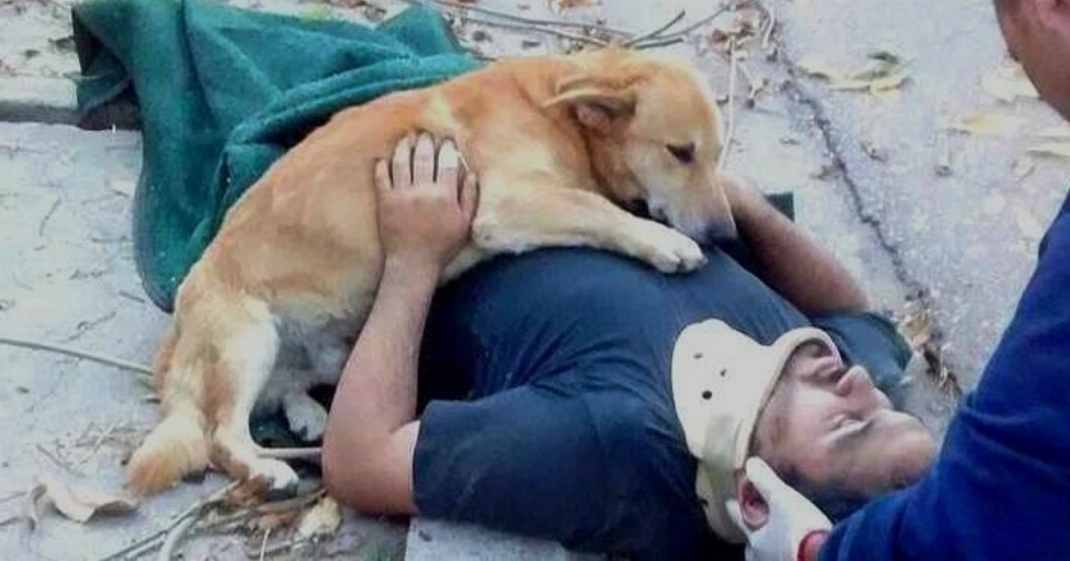
Devote Yourself to the Lord’s Calling
1 Timothy 4:6-16

Slide 3
I. Devote yourself to a Godly life
“Train yourself for godliness” (verses 6-10)
6 If you put these things before the brothers, you will be a good servant of Christ Jesus, being trained in the words of the faith and of the good doctrine that you have followed. 7 Have nothing to do with irreverent, silly myths. Rather train yourself for godliness;
Point 1: A godly life is a life persistently lived on the basis of a right understanding of God’s word
“Do your best to present yourself to God as one approved, a worker who has no need to be ashamed, rightly handling the word of truth.” 2 Timothy 2:15

Slide 4
I. Devote yourself to a Godly life
“Train yourself for godliness” (verses 6-10)
6 If you put these things before the brothers, you will be a good servant of Christ Jesus, being trained in the words of the faith and of the good doctrine that you have followed. 7 Have nothing to do with irreverent, silly myths. Rather train yourself for godliness;
Point 2: The best way to dispel self-evident nonsense is to not even give it the time of day

Slide 5
I. Devote yourself to a Godly life
“Train yourself for godliness” (verses 6-10)
6 If you put these things before the brothers, you will be a good servant of Christ Jesus, being trained in the words of the faith and of the good doctrine that you have followed. 7 Have nothing to do with irreverent, silly myths. Rather train yourself for godliness;
Point 3: We train ourselves for godliness in our disciplined devotion to the task

Slide 6
I. Devote yourself to a Godly life
“Train yourself for godliness” (verses 6-10)
Be an example to all believers (verses 11-12)
11 Command and teach these things. 12 Let no one despise you for your youth, but set the believers an example in speech, in conduct, in love, in faith, in purity.

Slide 7
II. Devote yourself in the practice of your ministry (verses 13-16)
13 “Until I come, devote yourself to the public reading of Scripture, to exhortation, to teaching.”
“On the day called Sunday, all who live in cities or in the country gather together to one place, and the memoirs of the apostles or the writings of the prophets are read, as long as time permits; then, when the reader has ceased, the one presiding over the worship service verbally instructs, and exhorts to the imitation of these good things.” Justin Martyr (100-165 A.D.)

Slide 8
II. Devote yourself in the practice of your ministry (verses 13-16)
14 Do not neglect the gift you have, which was given you by prophecy when the council of elders laid their hands on you. 15 Practice these things, immerse yourself in them, so that all may see your progress. 16 Keep a close watch on yourself and on the teaching. Persist in this, for by so doing you will save both yourself and your hearers.

Slide 9
II. Devote yourself in the practice of your ministry (verses 13-16)
14 Do not neglect the gift you have, which was given you by prophecy when the council of elders laid their hands on you. 15 Practice these things, immerse yourself in them, so that all may see your progress. 16 Keep a close watch on yourself and on the teaching. Persist in this, for by so doing you will save both yourself and your hearers.

Slide 10
II. Devote yourself in the practice of your ministry (verses 13-16)
14 Do not neglect the gift you have, which was given you by prophecy when the council of elders laid their hands on you. 15 Practice these things, immerse yourself in them, so that all may see your progress. 16 Keep a close watch on yourself and on the teaching. Persist in this, for by so doing you will save both yourself and your hearers.

Slide 11
II. Devote yourself in the practice of your ministry (verses 13-16)
14 Do not neglect the gift you have, which was given you by prophecy when the council of elders laid their hands on you. 15 Practice these things, immerse yourself in them, so that all may see your progress. 16 Keep a close watch on yourself and on the teaching. Persist in this, for by so doing you will save both yourself and your hearers.

Slide 12
III. Devote Yourself to the Lord’s Calling
Pursue a godly life
“Christ is not valued at all, unless he is valued above all.” Augustine of Hippo (354-430 A.D.)
“Lying weakly on his back and barely able to speak, he answered in a hoarse whisper, ‘Pray that I will be faithful to Jesus until my last breath.’” Os Guinness speaking of John Stott

Slide 13
III. Devote Yourself to the Lord’s Calling
Pursue a godly life
Devote yourself to your ministry
“The Church is like a great ship being pounded by the waves of life's different stresses. Our duty is not to abandon ship, but to keep her on course.” Boniface (672-754 A.D.)

Slide 14
III. Devote Yourself to the Lord’s Calling
Pursue a godly life
Devote yourself to your ministry
“Not that I have already obtained this or am already perfect, but I press on to make it my own, because Christ Jesus has made me his own. Brothers, I do not consider that I have made it my own. But one thing I do: forgetting what lies behind and straining forward to what lies ahead, I press on toward the goal for the prize of the upward call of God in Christ Jesus.” Philippians 3:12-14
“Let those of us who are mature think this way, and if in anything you think otherwise, God will reveal that also to you.” Philippians 3:15

