Slide 2
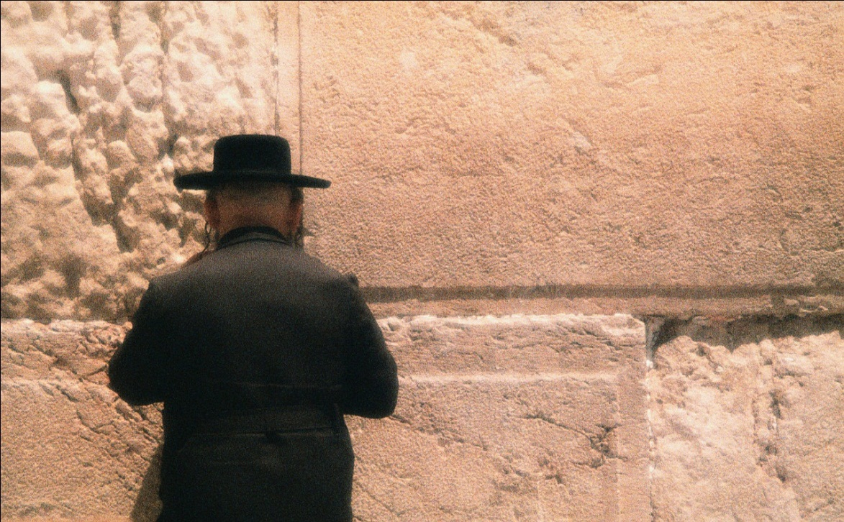
“Brethren, my heart’s desire and prayer to God for Israel is that they may be saved.” (Romans 10:1)

Slide 3
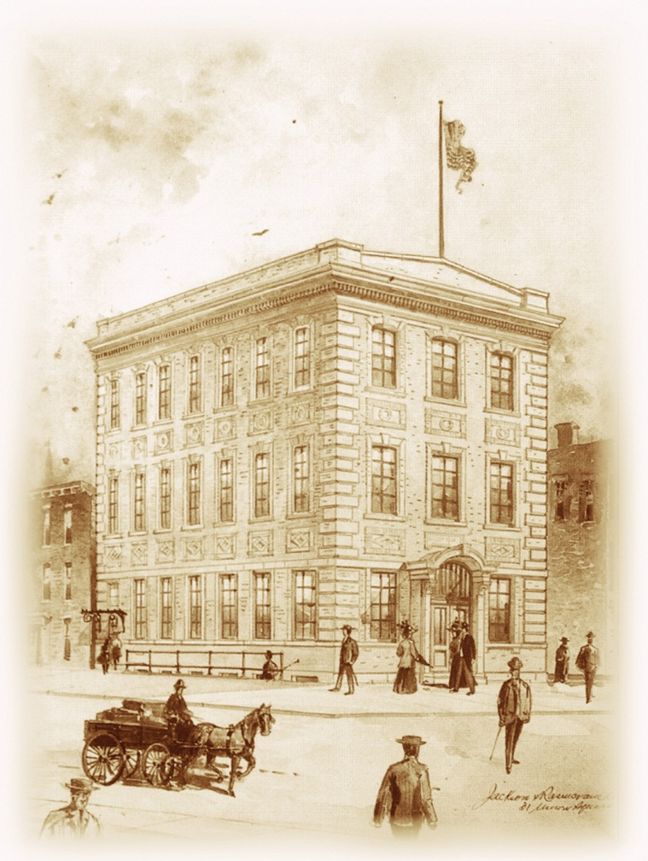
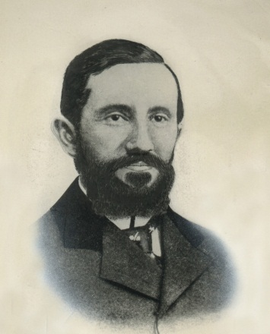
Chosen People Ministries was founded in 1894 by Rabbi Leopold Cohn

Slide 4
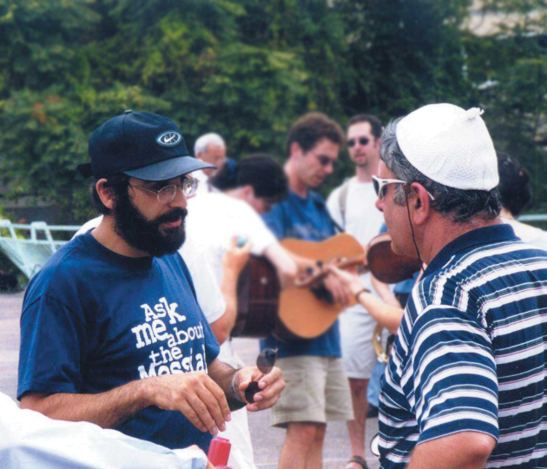
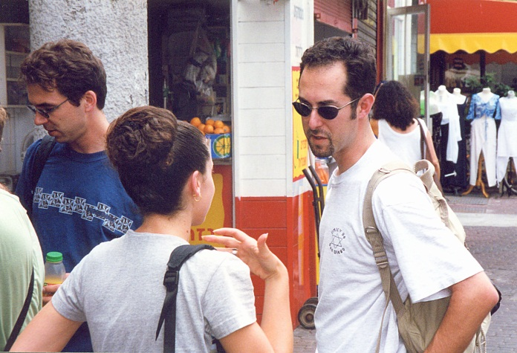
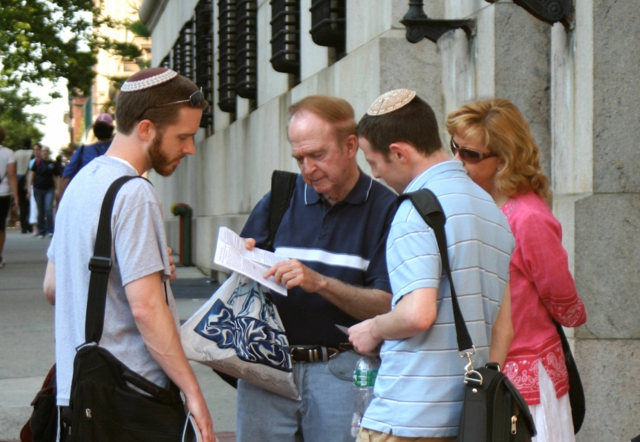
We proclaim the Gospel to the Jew first and also to the Gentile, and equip others to do the same

Slide 5
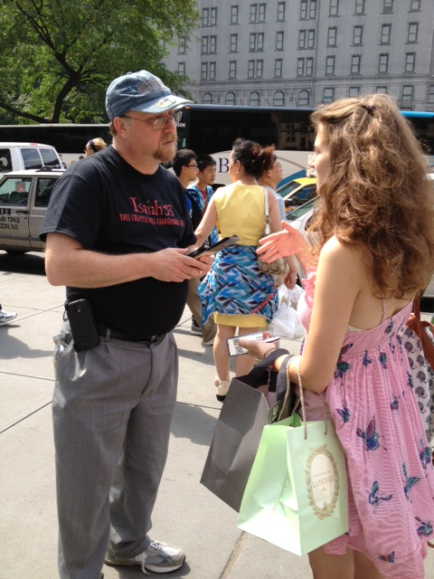
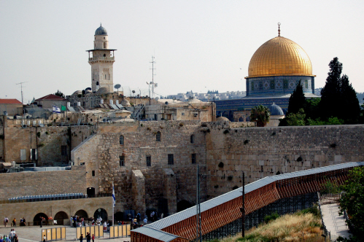
Short-Term Missions Trips
Sharing the Gospel on the streets of New York City
Summer outreach in Israel

Slide 6
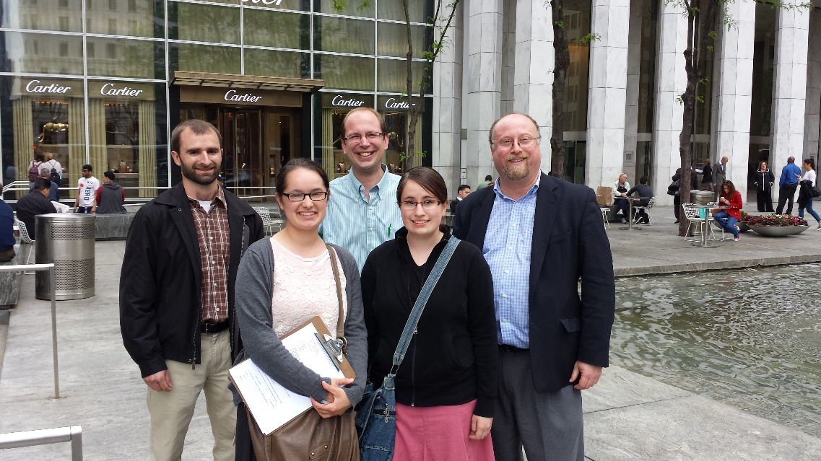
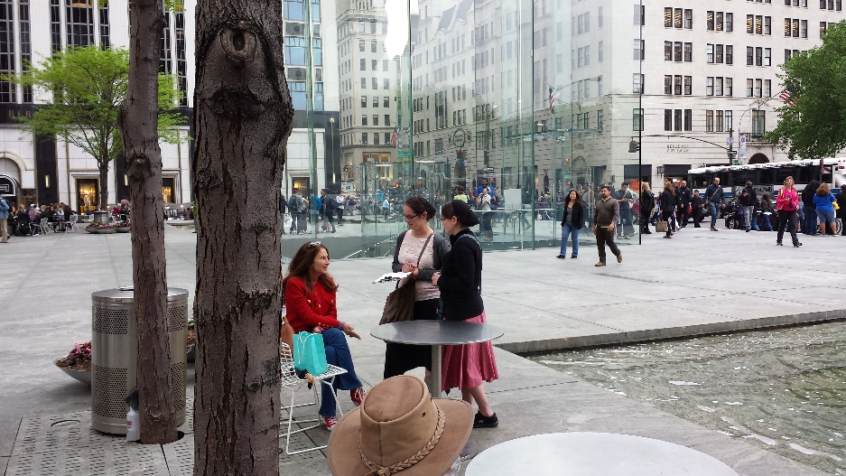
Short-Term Missions Trips
Sharing the Gospel on the streets of New York City
Training Missionaries in Street Evangelism

Slide 7
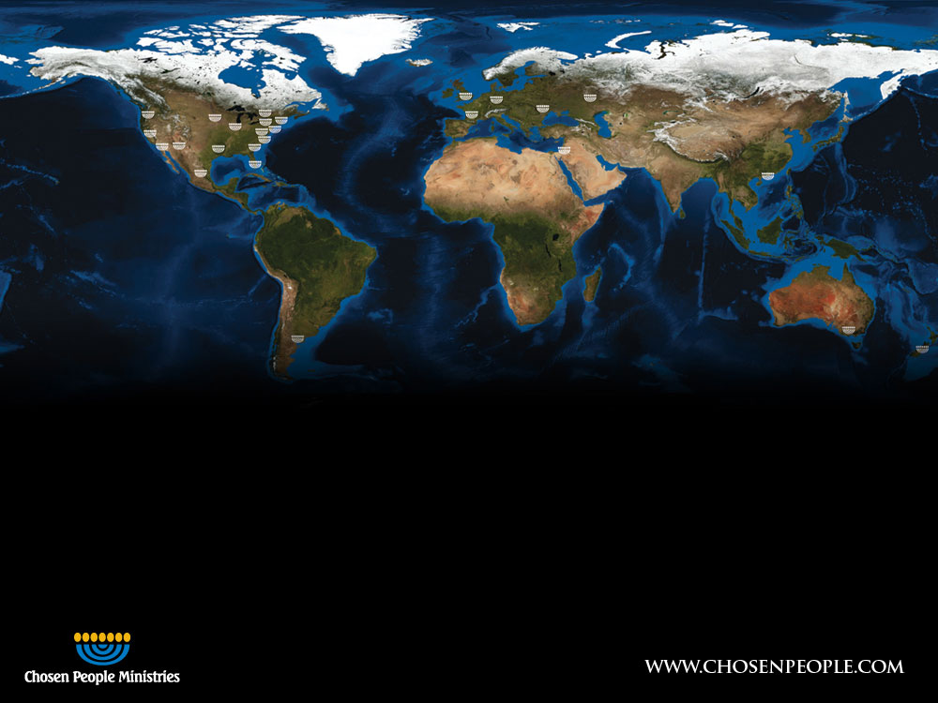
Today, Chosen People Ministries has outreach in 17 countries across the globe.

Slide 8
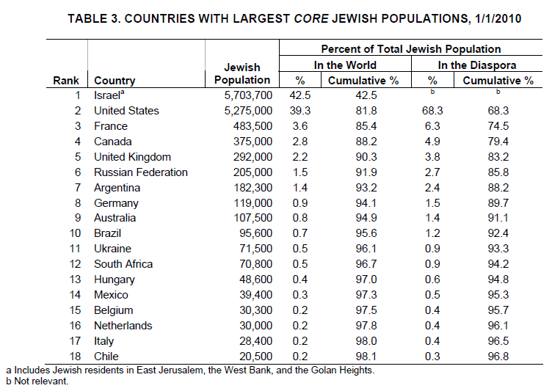

Slide 9
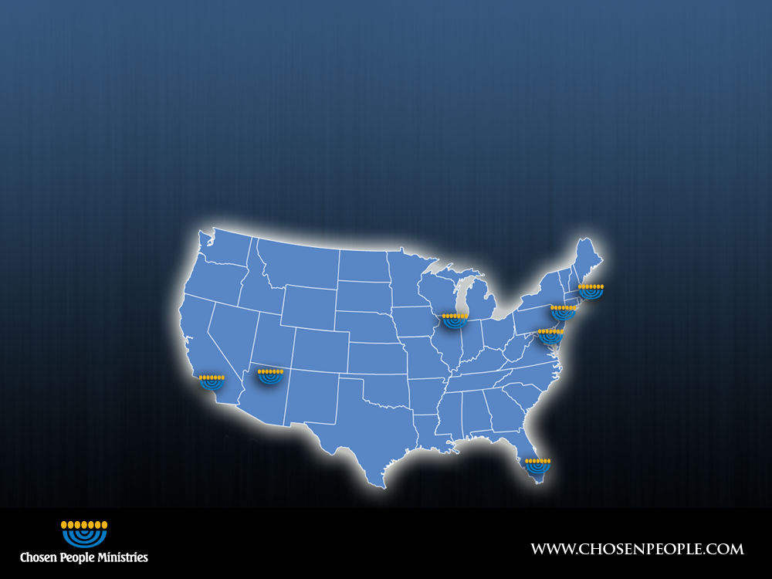
United States
Chosen People Ministries has an established presence in major Jewish population centers throughout the United States
Chicago
Boston
Phoenix
New York City - Manhattan - Brooklyn
Southern California - Orange County - LA County
Washington D.C.
South Florida

Slide 10
What do I do
New York Regional Director
Responsible for all our ministries in the greater New York Area, which is our national and international Headquarters
New York City has more Jewish people than Jerusalem
My area is beyond the borders

Slide 11
How you can get involved?
Sign up to get my monthly prayer letter and the Chosen People Ministries newsletter
Commit to pray for me at least monthly
Consider whether God is leading you to invest financially either once or on a monthly basis
What level: $10, $25, $50, $100, or more

Slide 12
Messiah in the Day of Atonement
Dr. Michael Herts
Chosen People Ministries

Slide 13
Genesis 1:5 (ESV)
⁵God called the light Day, and the darkness he called Night. And there was evening and there was morning, the first day.

Slide 14
John 1:3–5 (ESV)
³All things were made through him, and without him was not any thing made that was made.
⁴In him was life, and the life was the light of men.
⁵The light shines in the darkness, and the darkness has not overcome it.

Slide 15
Matthew 6:10 (ESV)
¹⁰Your kingdom come, your will be done, on earth as it is in heaven.

Slide 16
Colossians 2:16–17 (ESV)
¹⁶Therefore let no one pass judgment on you in questions of food and drink, or with regard to a festival or a new moon or a Sabbath.
¹⁷These are a shadow of the things to come, but the substance belongs to Christ.

Slide 17
Leviticus 23:1–2 (ESV)
¹The Lord spoke to Moses, saying,
²“Speak to the people of Israel and say to them, These are the appointed feasts of the Lord that you shall proclaim as holy convocations; they are my appointed feasts.

Slide 18
Leviticus 23:26–32 (ESV)
²⁶And the Lord spoke to Moses, saying,
²⁷“Now on the tenth day of this seventh month is the Day of Atonement. It shall be for you a time of holy convocation, and you shall afflict yourselves and present a food offering to the Lord.
²⁸And you shall not do any work on that very day, for it is a Day of Atonement, to make atonement for you before the Lord your God.
²⁹For whoever is not afflicted on that very day shall be cut off from his people.
³⁰And whoever does any work on that very day, that person I will destroy from among his people.
³¹You shall not do any work. It is a statute forever throughout your generations in all your dwelling places.
³²It shall be to you a Sabbath of solemn rest, and you shall afflict yourselves. On the ninth day of the month beginning at evening, from evening to evening shall you keep your Sabbath.”

Slide 19
Leviticus 16:20–22 (ESV)
²⁰“And when he has made an end of atoning for the Holy Place and the tent of meeting and the altar, he shall present the live goat.
²¹And Aaron shall lay both his hands on the head of the live goat, and confess over it all the iniquities of the people of Israel, and all their transgressions, all their sins. And he shall put them on the head of the goat and send it away into the wilderness by the hand of a man who is in readiness.
²²The goat shall bear all their iniquities on itself to a remote area, and he shall let the goat go free in the wilderness.

Slide 20
Isaiah 1:18 (ESV)
¹⁸“Come now, let us reason together, says the Lord: though your sins are like scarlet, they shall be as white as snow; though they are red like crimson, they shall become like wool.

Slide 21
Babylonian Talmud
II.5 A. Our rabbis have taught on Tannaite authority:
B. Forty years before the destruction of the sanctuary, the lot did not come up in the right hand, and the thread of crimson never turned white, and the westernmost light never shone, and the doors of the courtyard would open by themselves,
Neusner, J. (2011). The Babylonian Talmud: A Translation and Commentary (Vol. 5a, p. 142). Peabody, MA: Hendrickson Publishers.

Slide 22
Babylonian Talmud
D. And when R. Yohanan b. Zakkai fell ill, his disciples came in to pay a call on him. When he saw them, he began to cry. His disciples said to him, “Light of Israel! Pillar at the right hand! Mighty hammer! On what account are you crying?”
E. He said to them, “If I were going to be brought before a mortal king, who is here today and tomorrow gone to the grave, who, should he be angry with me, will not be angry forever, and, if he should imprison me, will not imprison me forever, and if he should put me to death, whose sentence of death is not for eternity, and whom I can appease with the right words or bribe with money, even so, I should weep.
F. “But now that I am being brought before the King of kings of kings, the Holy One, blessed be he, who endures forever and ever, who, should he be angry with me, will be angry forever, and if he should imprison me, will imprison me forever, and if he should put me to death, whose sentence of death is for eternity, and whom I cannot appease with the right words or bribe with money,
G. “and not only so, but before me are two paths, one to the Garden of Eden and the other to Gehenna, and I do not know by which path I shall be brought,
H. “and should I not weep?”
Neusner, J. (2011). The Babylonian Talmud: A Translation and Commentary (Vol. 1, pp. 188–189). Peabody, MA: Hendrickson Publishers.

Slide 23
Zechariah 12:9–10 (ESV)
⁹And on that day I will seek to destroy all the nations that come against Jerusalem.
¹⁰“And I will pour out on the house of David and the inhabitants of Jerusalem a spirit of grace and pleas for mercy, so that, when they look on me, on him whom they have pierced, they shall mourn for him, as one mourns for an only child, and weep bitterly over him, as one weeps over a firstborn.

Slide 24
Romans 11:25–27 (ESV)
²⁵Lest you be wise in your own sight, I do not want you to be unaware of this mystery, brothers: a partial hardening has come upon Israel, until the fullness of the Gentiles has come in.
²⁶And in this way all Israel will be saved, as it is written, “The Deliverer will come from Zion, he will banish ungodliness from Jacob”;
²⁷“and this will be my covenant with them when I take away their sins.”

Slide 25
John 1:12 (ESV)
¹²But to all who did receive him, who believed in his name, he gave the right to become children of God,

Slide 26
Let’s Pray

