Slide 1
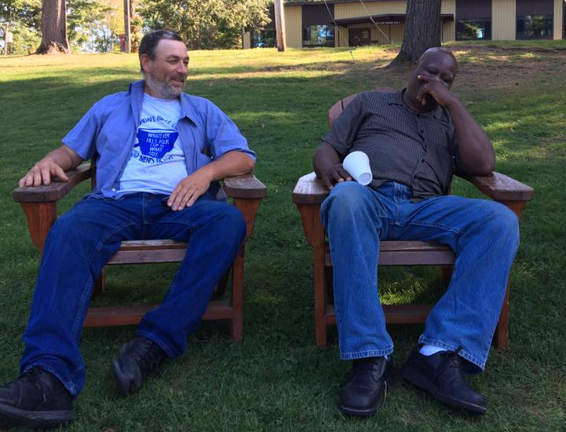
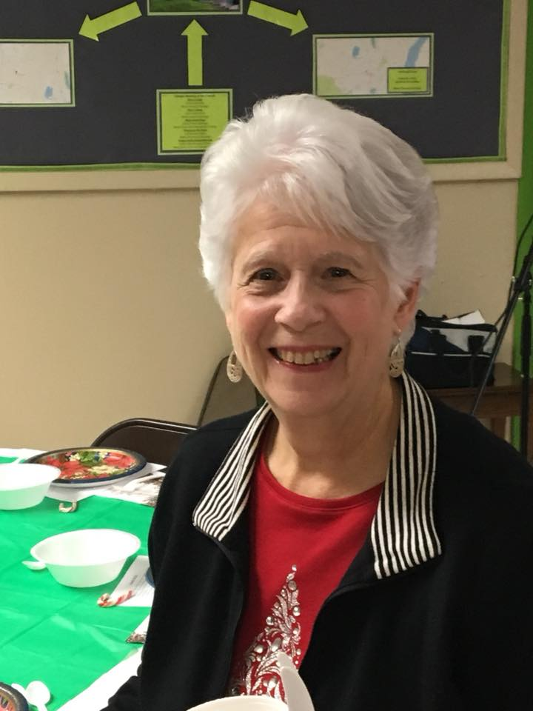
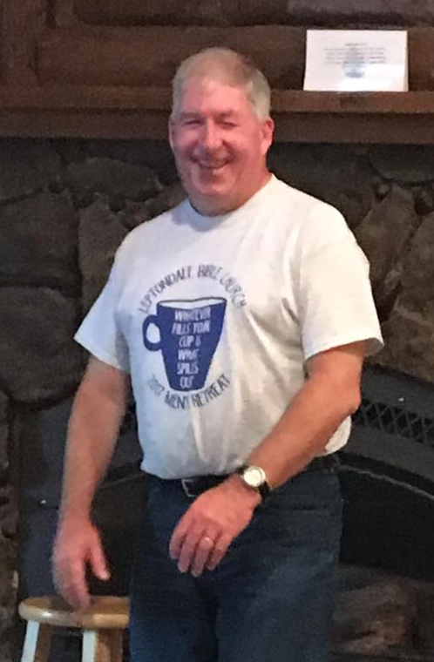
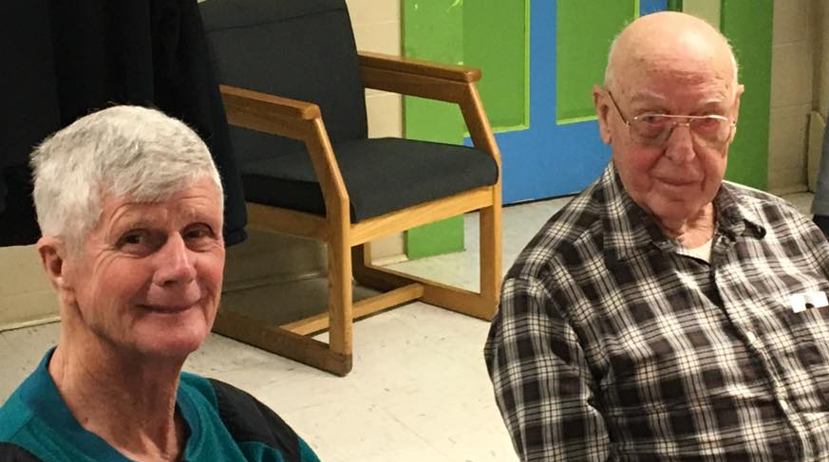
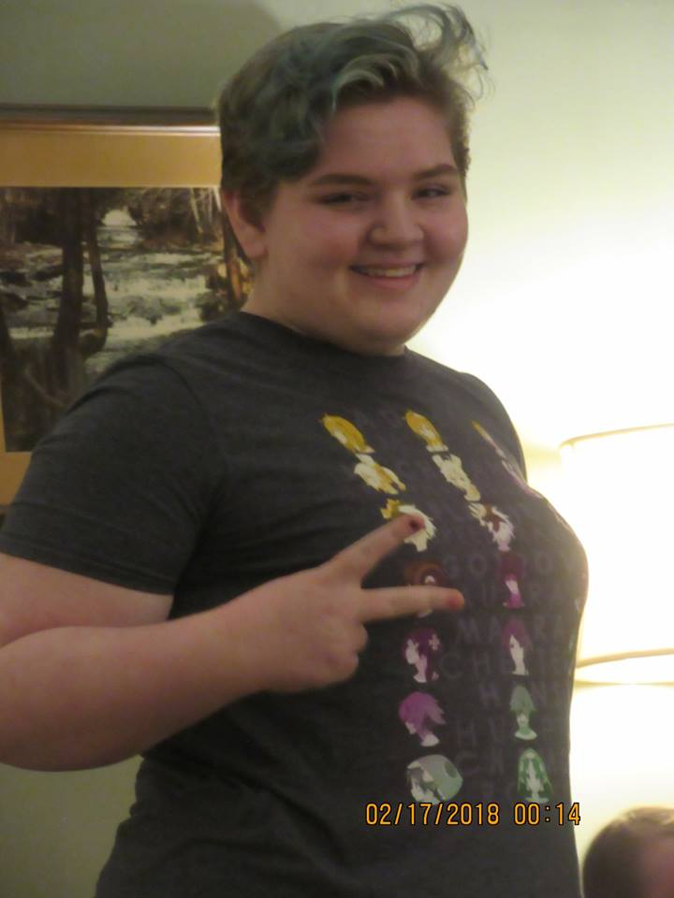
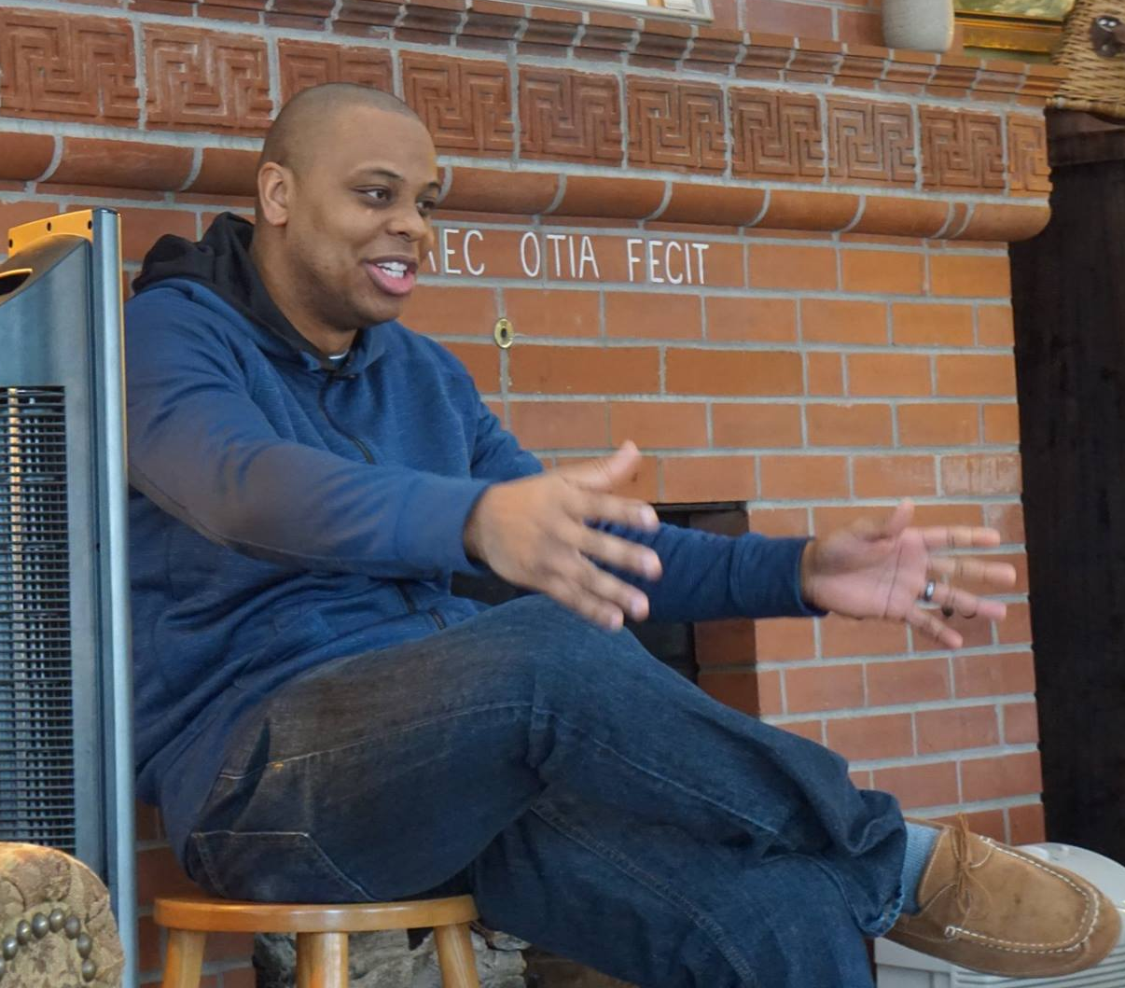
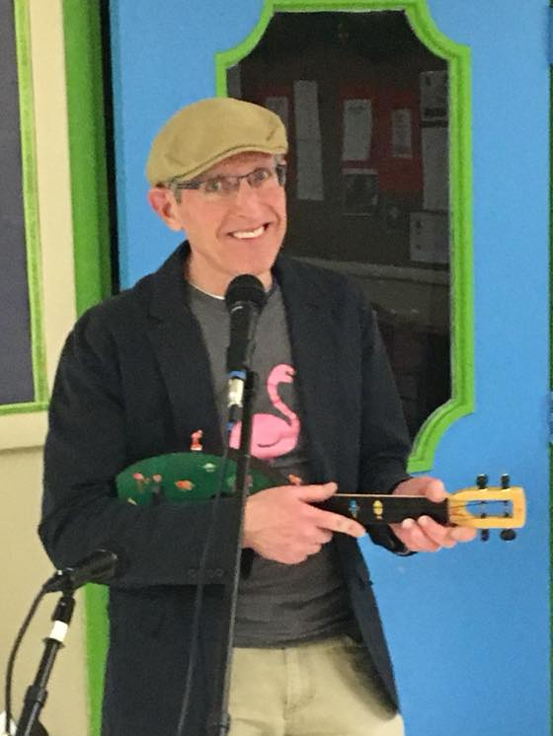
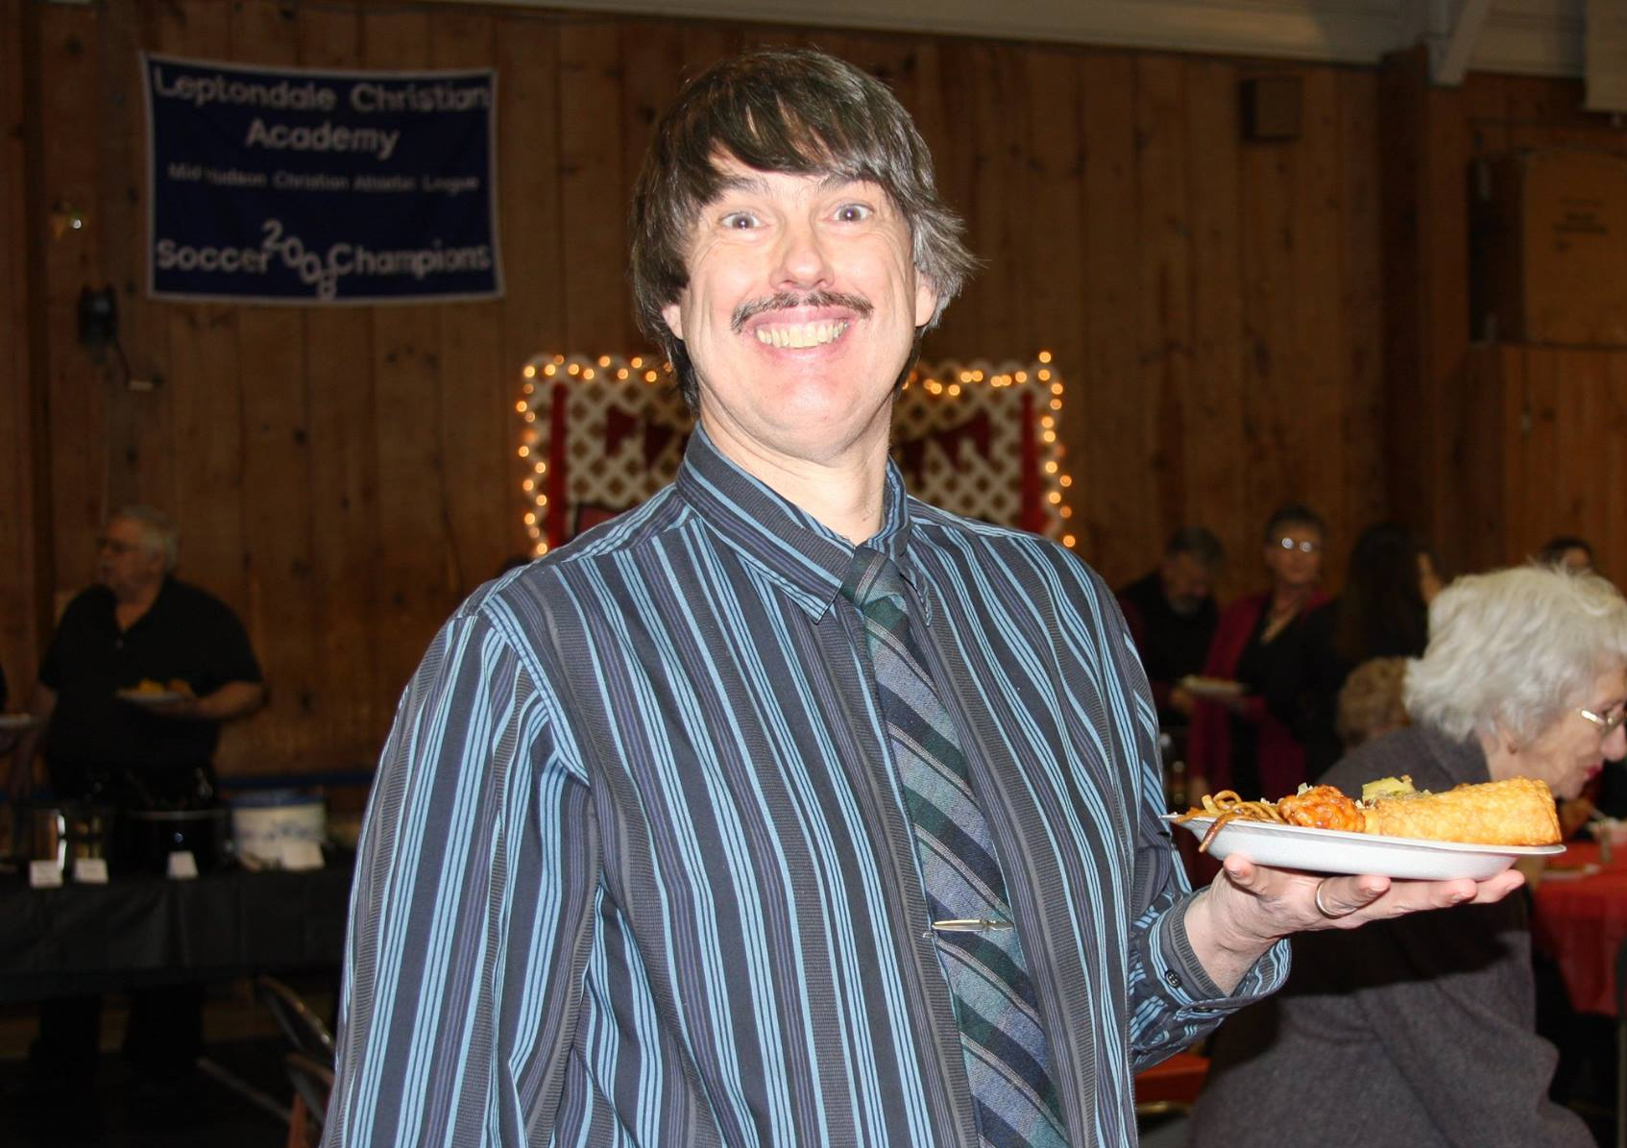
Leptondale on Demand

Slide 2
“If prayer stands as the place where God and human beings meet, then I must learn about prayer. Most of my struggles in the Christian life circle around the same two themes: why God doesn't act the way we want God to, and why I don't act the way God wants me to. Prayer is the precise point where those themes converge. ” Phillip Yancey
“We use prayer as a boatman uses a boat hook: to pull the boat to the shore and not to try to pull the shore to the boat. ” Ralph Sockman, The Higher Happiness

Slide 3
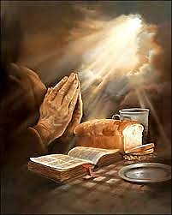
Be transformed through prayer!
Part 2 — Psalm 86

Slide 4
I. Our lord answers Prayer…
Because we are the Lord’s humble and faithful children(verses 1-2)
“‘Because the poor are plundered and the needy groan, I will now arise,’ says the Lord. ‘I will protect them from those who malign them.” Psalm 12:5, NIV

Slide 5
I. Our lord answers Prayer…
Because we are the Lord’s humble and faithful children(verses 1-2)
When we commend our needs to the Lord in prayer (verses 3-7)
Because the Lord abounds “in steadfast love to all who call upon ” Him (verses 5, 13 & 15)
“if we are faithless, he remains faithful—for he cannot deny himself.” 2 Timothy 2:13

Slide 6
II. Our Lord is the only One who is mighty enough to answer prayer
The Lord and the Lord alone is able to answer prayer (verses 8-10)
The Lord answers the greatest of all prayers: to deliver our souls from death (verses 11-13)
“Teach me your way, Lord, that I may rely on your faithfulness; give me an undivided heart, that I may fear your name.” Verse 11, NIV

Slide 7
II. Our Lord is the only One who is mighty enough to answer prayer
The Lord and the Lord alone is able to answer prayer (verses 8-10)
The Lord answers the greatest of all prayers: to deliver our souls from death (verses 11-13)
David’s foremost request is to remain the Lord’s humble & faithful servant, exclusively honoring Him & glorifying Him in every way, and David emphatically pleads with the Lord to preserve him in this faithful state.

Slide 8
III. Through prayer, the Lord sustains us in times of trouble (verses 14-17)
“Arrogant foes are attacking me, O God; ruthless people are trying to kill me—they have no regard for you ” verse 14, NIV
“Show me evidence of your favor! ” verse 17a, NLT

Slide 9
God reveals Himself and His will to us through His word
With God rightly honored in our heart, mind and will, we pray our needs to Him according to His will/promises as revealed through His word

Slide 10
How does David know, with confidence, that he can depend on the Lord’s gracious provision of strength to face those enemies who seek His life?
“He renews my strength. He guides me along right paths, bringing honor to his name. Even when I walk through the darkest valley, I will not be afraid, for you are close beside me. Your rod and your staff protect and comfort me. You prepare a feast for me in the presence of my enemies. You honor me by anointing my head with oil. My cup overflows with blessings.” Psalm 23:3-5, NLT

Slide 11
God makes Himself known to us by uniquely acting according to His word, changing us through the whole encounter
God reveals Himself and His will to us through His word
With God rightly honored in our heart, mind and will, we pray our needs to Him according to His will/promises as revealed through His word

Slide 12
Iv. Be transformed Through prayer!
Our transformation is often the Lord’s aim in how He answers prayer…Luis Palau
… and dan faris
there is no better answer than the answer which clearly shows us the Lord’s hand at work!

