Slide 2
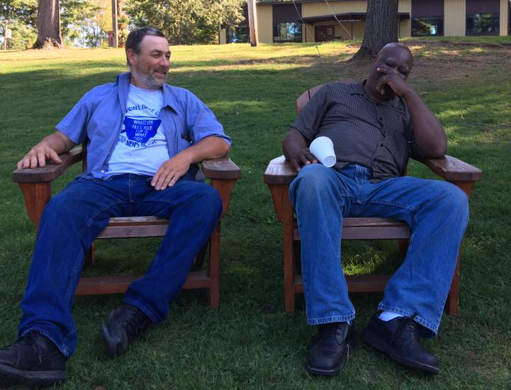
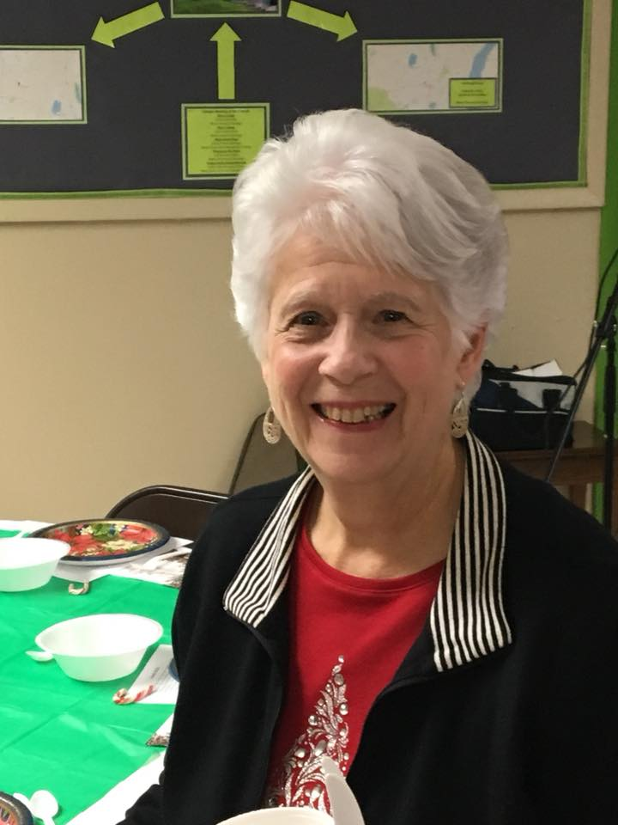
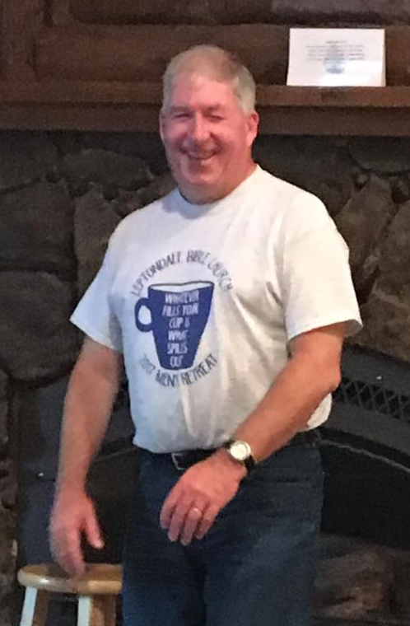
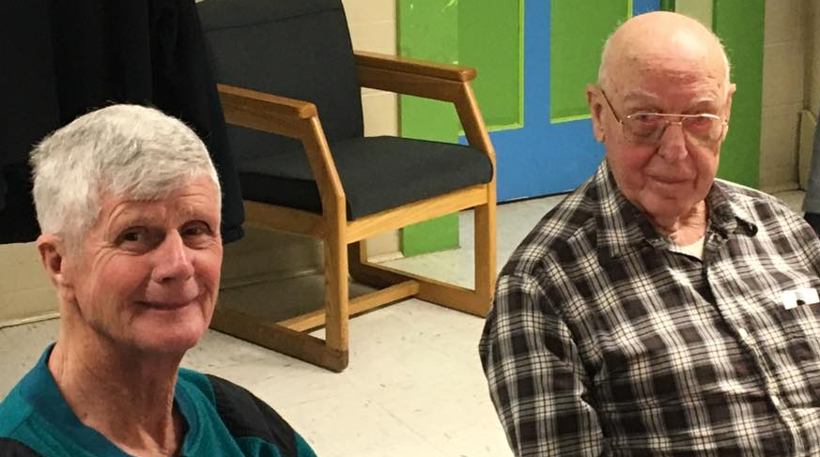
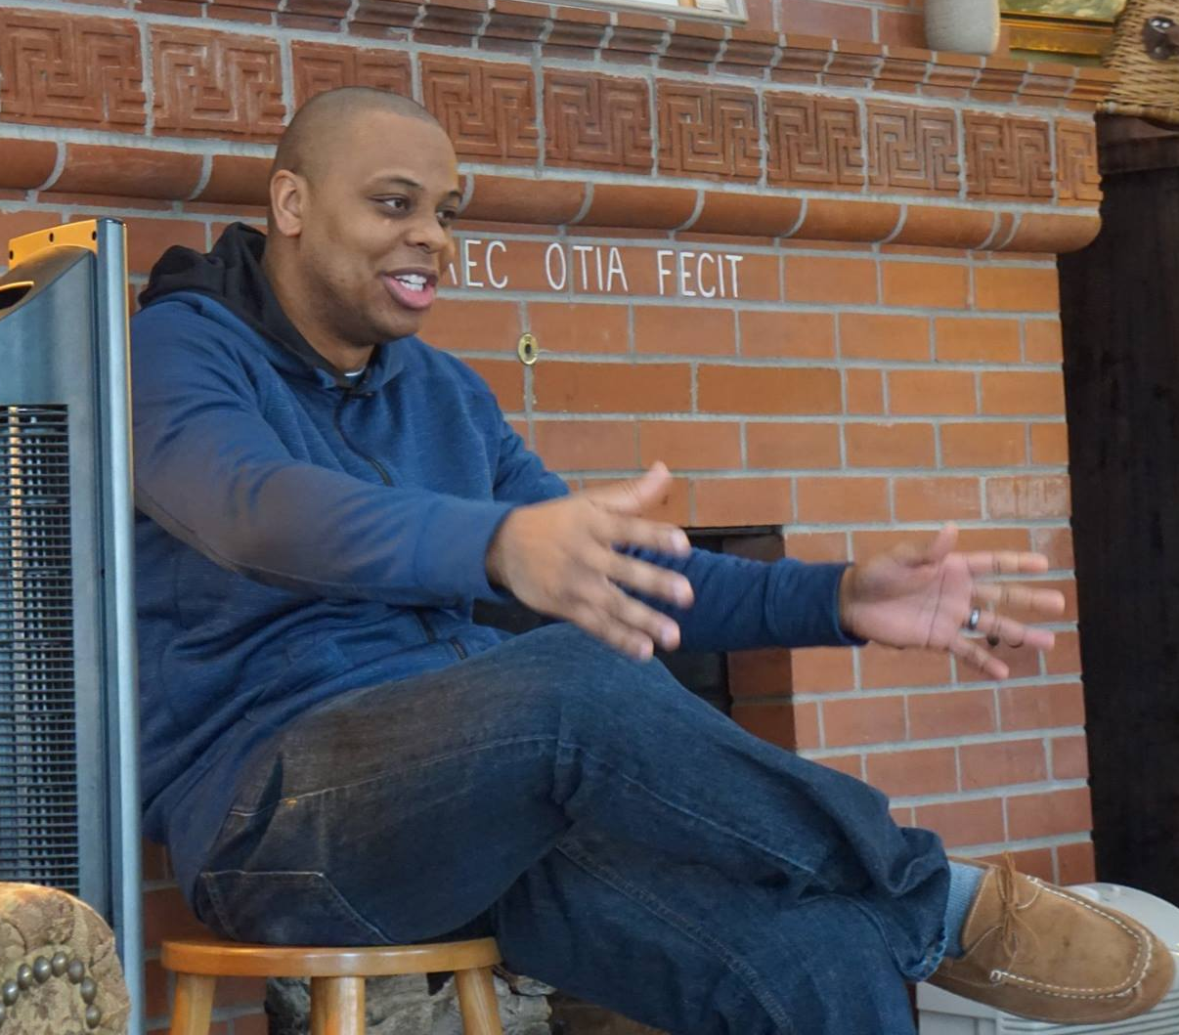
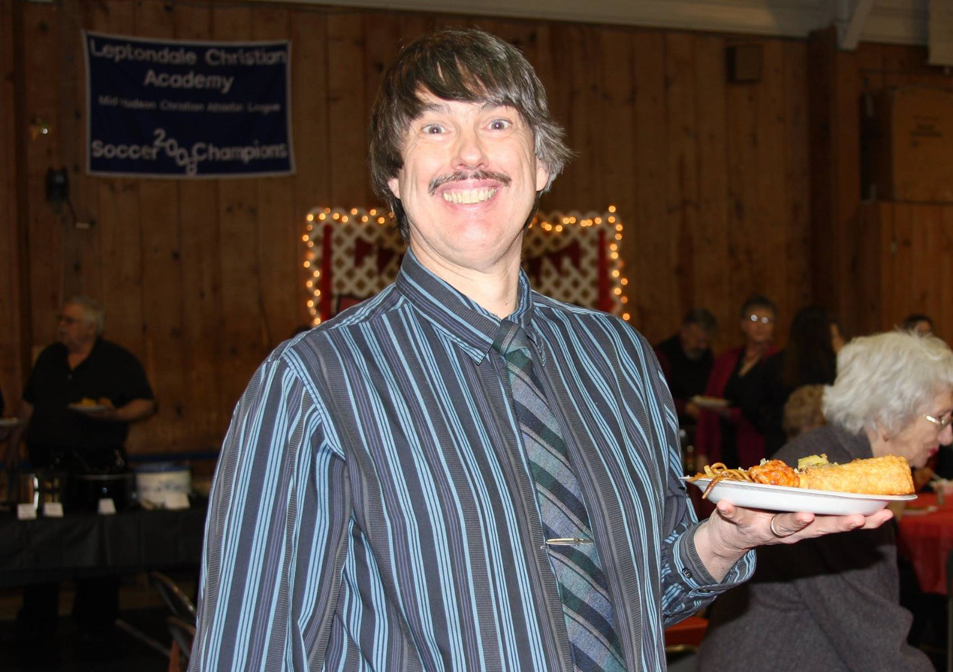
Leptondale on Demand

Slide 3
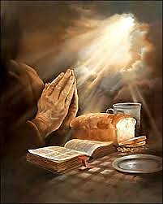
Be transformed through prayer!
Part 1 — Matthew 6:5-15
Effective Prayer
Focused on our Father
Conformed to His will
Our desire is faithful dependence upon Him

Slide 4
I. Prayer that is focused on our Father brings His reward
Prayer is a righteous practice when it is focused on our Father (Matthew 6:1)
Prayer should be genuine conversation with our Father (verses 5-6)
Prayer should be meaningful conversation with our Father (verses 7-8)
“Every good gift and every perfect gift is from above, coming down from the Father of lights.” James 1:17

Slide 5
II. Prayer can (and should) transform our foremost desires to conform to the Father’s will
Our Father calls His children to honor His name as holy (verse 9)
“Therefore, you should pray like this: Our Father in heaven, your name be honored as holy.” Verse 9, Christian Standard Bible

Slide 6
II. Prayer can (and should) transform our foremost desires to conform to the Father’s will
Our Father calls His children to honor His name as holy (verse 9)
Our Father’s will be that His kingdom agenda fully come to pass (verse 10)

Slide 7
“It is therefore impossible to pray this prayer in sincerity without humbly committing oneself to such a course.”
Put another way
“It is therefore impossible to pray this prayer in sincerity without being transformed into being a faithful part of bringing our Father’s will to pass.”

Slide 8
III. Prayer can (and should) express our faith, trust and reliance upon our Father to meet all our needs at all times
Prayer expresses our dependence upon our Father for our daily physical needs (verse 11)
He longs to do His will in our lives and longs for us to long for Him to do His will in our lives so that the routine of our lives becomes a routine of faith, trust and reliance upon Him
“No good thing does he withhold from those who walk uprightly.” Psalm 84:11

Slide 9
III. Prayer can (and should) express our faith, trust and reliance upon our Father to meet all our needs at all times
Prayer expresses our dependence upon our Father for our daily physical needs (verse 11)
Prayer expresses our dependence upon our Father to sustain our fellowship with Him (verses 12-15)
“He has delivered us from the domain of darkness and transferred us to the kingdom of his beloved Son, in whom we have redemption, the forgiveness of sins.” Colossians 1:13-14

Slide 10
What Jesus is teaching us about forgiveness in verses 12, 14 & 15
recognize that our relationship with our Father is rooted in His gracious and merciful forgiveness of our sins
our love for Him in doing so is most sincerely expressed when we mirror His will & ways by forgiving others
Right fellowship with Him will be broken until we do
failing to forgive others is sin because it opposes His will & as latent sin in our lives, breaks our Prayer connection to Him
“If I had cherished iniquity in my heart, the Lord would not have listened.” Psalm 66:18

Slide 11
III. Prayer can (and should) express our faith, trust and reliance upon our Father to meet all our needs at all times
Prayer expresses our dependence upon our Father for our daily physical needs (verse 11)
Prayer expresses our dependence upon our Father to sustain our fellowship with Him (verses 12-15)
“And don’t let us yield to temptation…” Verse 13, NLT
“God is faithful, and he will not let you be tempted beyond your ability, but with the temptation he will also provide the way of escape, that you may be able to endure it.” 1 Corinthians 10:13

Slide 12
IV. Be Transformed through Prayer!
God makes Himself known to us by uniquely acting according to His word, changing us through the whole encounter
God reveals Himself and His will to us through His word
With God rightly honored in our heart, mind and will, we pray our needs to Him according to His will/promises as revealed through His word

