Slide 1
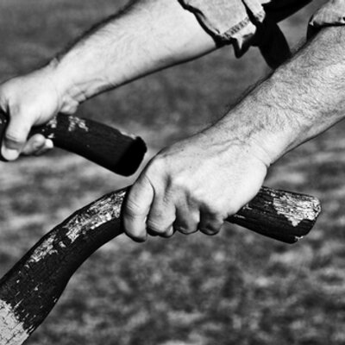
Living the Life

Slide 2
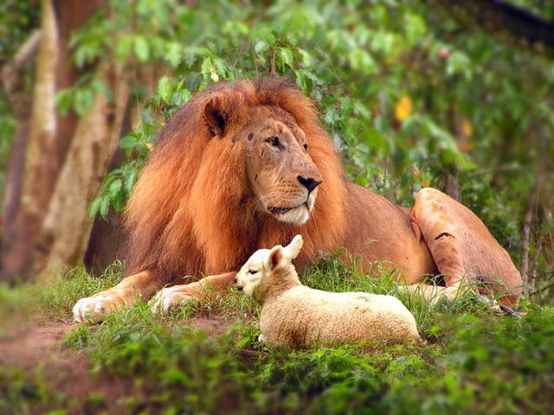
Live the Way of Life that is Best of All!
1 Corinthians 13
“But now let me show you a way of life that is best of all.”’ 1 Corinthians 12:31 (NLT)

Slide 3
Live the Way of Life that is Best of All!
1 Corinthians 13
“I give thanks to my God always for you because of the grace of God that was given you in Christ Jesus, that in every way you were enriched in him in all speech and all knowledge.” 1 Corinthians 1:4-5

Slide 4
I. Ministry - Love = Nothing (verses 1-3)
The Corinthians had pride issues
The Corinthians also struggled with a tendency to be self-glorifying
“So with yourselves, since you are eager for manifestations of the Spirit, strive to excel in building up the church.” 1 Corinthians 14:12

Slide 5
I. Ministry - Love = Nothing (verses 1-3)
The Corinthians had pride issues
The Corinthians also struggled with a tendency to be self-glorifying
Even the greatest of gifts, service and activities are nothing when done without love (verses 1-3)

Slide 6
II. True love … (verses 4-7)
…is patient and kind (verse 4)
“Be kind to one another, tenderhearted, forgiving one another, as God in Christ forgave you.” Ephesians 4:32

Slide 7
II. True love … (verses 4-7)
…is patient and kind (verse 4)
…does not envy or boast, is not arrogant or rude, does not insist on its own way and is not irritable or resentful (verses 4-5)
Love “is not self-seeking, it is not easily angered, it keeps no record of wrongs.” (verse 5, NIV)

Slide 8
II. True love … (verses 4-7)
…is patient and kind (verse 4)
…does not envy or boast, is not arrogant or rude, does not insist on its own way and is not irritable or resentful (verses 4-5)
…does not rejoice at wrongdoing, but rejoices in the truth (verse 6)
“if anyone is caught in any transgression, you who are spiritual should restore him in a spirit of gentleness.” Galatians 6:1

Slide 9
II. True love … (verses 4-7)
…is patient and kind (verse 4)
…does not envy or boast, is not arrogant or rude, does not insist on its own way and is not irritable or resentful (verses 4-5)
…does not rejoice at wrongdoing, but rejoices in the truth (verse 6)
Summary thus far: Love forsakes the self-interest that leads us to see and respond to others as adversaries, but rather, seeks to surrender our self-interest in any way that does not tarnish the truth in order to reach the lost and build up the saved for their well-being and to God’s glory.

Slide 10
II. True love … (verses 4-7)
…is patient and kind (verse 4)
…does not envy or boast, is not arrogant or rude, does not insist on its own way and is not irritable or resentful (verses 4-5)
…does not rejoice at wrongdoing, but rejoices in the truth (verse 6)
…bears, believes, hopes and endures all things (verse 7)
“Those who accept my commandments and obey them are the ones who love me. And because they love me, my Father will love them. And I will love them and reveal myself to each of them.” John 14:21, NLT

Slide 11
III. Love is the most excellent way… (verses 8-13)
…because love is as endless as our God who is love (verses 8a, & 13b)
“Beloved, let us love one another, for love is from God, and whoever loves has been born of God and knows God.” 1 John 4:7

Slide 12
III. Love is the most excellent way… (verses 8-13)
…because love is as endless as our God who is love (verses 8a, & 13b)
…because love is already perfect (verses 8b-13)
“You therefore must be perfect, as your heavenly Father is perfect.” Matthew 5:48

Slide 13
IV. Live the Way of Life that is Best of All!
“we exult in hope of the glory of God.” Romans 5:2, NASB
“and hope does not disappoint…
…because the love of God has been poured out within our hearts through the Holy Spirit who was given to us.” Romans 5:5, NASB

Slide 14
IV. Live the Way of Life that is Best of All!
This is love…
That acts to meet the physical and spiritual needs of our brothers and sisters in Christ along with our neighbors in the world
That acts with the patient and kind heart of Christ
That acts free from the self-interested motives that inevitably turns us from brothers and sisters into adversaries
That longs for the truth to prevail as a result of our loving actions
That bears, believes, hopes and endures all things because our God will not disappoint in leading us to glory where we will worship Him and enjoy Him and love Him and one another as we do now…because love never ends!

Slide 15
Living the Life
“No one who puts his hand to the plow and looks back is fit for the kingdom of God.” Luke 9:62

