Slide 1
“…we are ambassadors for Christ” 2 Corinthians 5:20
“A diplomatic agent of the highest rank accredited to a foreign government or sovereign as the resident representative of his or her own government or sovereign” Webster’s definition of an ambassador

Slide 2
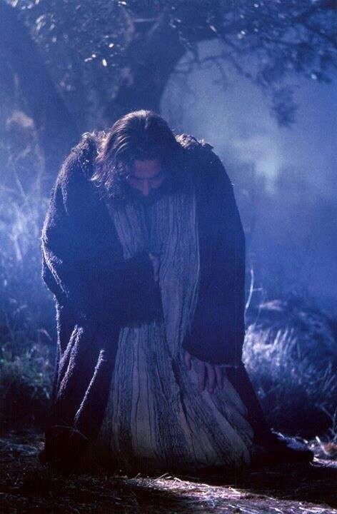
God Sends Himself! John 3:16-18 & 14:15-23

Slide 3
I. God sends Himself to meet our greatest needs
“For while we were still helpless, at the right time Christ died for the ungodly” Romans 5:6

Slide 4
I. God sends Himself to meet our greatest needs
To save us from eternal ruin and condemnation (John 3:16-18)
To change us into His obedient sons and daughters (John 14:15-17)

Slide 5
IB. To change us into His obedient sons and daughters (John 14:15-17)
“Jesus knew very well that the requirement of love and keeping his commands would necessitate a resource of divine proportions and accordingly he prayed that his followers would have ‘another’ resource…Jesus had been leading them, advising them, teaching them, empowering them, and critiquing them. But his time with them would thereafter be limited, and his followers needed a new companion who could function in all those ways”

Slide 6
I. God sends Himself to meet our greatest needs
To save us from eternal ruin and condemnation (John 3:16-18)
To change us into His obedient sons and daughters (John 14:15-17)
To comfort us with the assurance of His promised salvation (14:18-20)
To give us the joy of experiencing intimate relationship with Him (14:21-23)

Slide 7
II. Embrace the God who loves you and sends Himself to save you
The “bad news” of the gospel
“All we like sheep have gone astray; we have turned—every one—to his own way” (Isaiah 53:6)
…But God describes Himself this way: “For as the heavens are higher than the earth, so are my ways higher than your ways and my thoughts than your thoughts” (Isaiah 55:9)
…and so, the Bible says we are “by nature children of wrath” (Ephesians 2:3)

Slide 8
II. Embrace the God who loves you and sends Himself to save you
The “bad news” of the gospel
The good news of the gospel becomes reality for the person who places their faith and trust solely in Jesus Christ, the Son of God, to save them from this eternal ruin and condemnation
“Truly, truly, I say to you, whoever hears my word and believes him who sent me has eternal life. He does not come into judgment, but has passed from death to life” (John 5:24)
“For if we have been united with him in a death like his, we shall certainly be united with him in a resurrection like his” (Romans 6:5)

