Slide 1
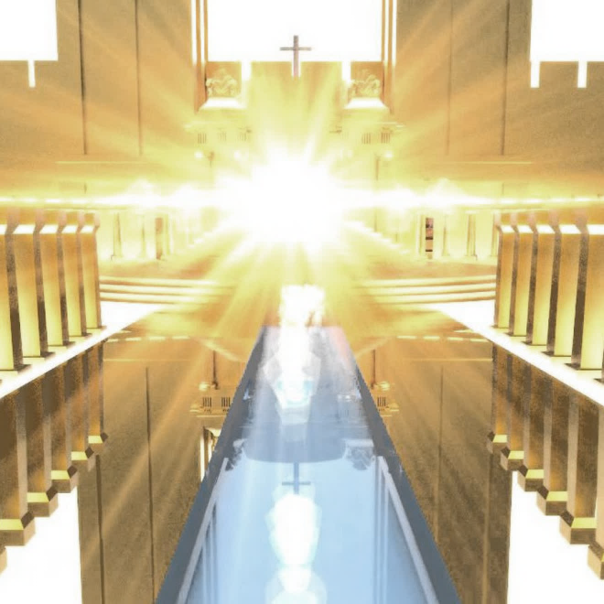
Revelation
21:22 - 22:5
The City of Eternal Glory and Life!

Slide 2
I. The New Jerusalem will be a city of eternal glory!
The New Jerusalem will embody the glory of God’s salvation (Verses 9-21)

Slide 3
The Holy of Holies in the Jewish Temple
“only the high priest goes, and he but once a year, and not without taking blood, which he offers for himself and for the unintentional sins of the people” Hebrews 9:7
But…
Christ “entered once for all into the holy places, not by means of the blood of goats and calves but by means of his own blood, thus securing an eternal redemption…so that those who are called may receive the promised eternal inheritance…” Hebrews 9:12 & 15

Slide 4
Not a “cube” but the New Jerusalem!
The city will be “as wide as it was long. In fact, its length and width and height were each 1,400 miles.” Revelation 21:16, New Living Translation

Slide 5
I. The New Jerusalem will be a city of eternal glory!
The New Jerusalem will embody the glory of God’s salvation (Verses 9-21)
The New Jerusalem will be filled by the glory of God’s salvation (Verses 22-27)

Slide 6
II. The New Jerusalem will be a city of eternal life

Slide 7
Eternal life – “a better resurrection”
“Then the Lord God said, ‘Behold, the man has become like one of us in knowing good and evil. Now, lest he reach out his hand and take also of the tree of life and eat, and live forever—’ therefore the Lord God sent him out from the garden of Eden to work the ground from which he was taken. He drove out the man, and at the east of the garden of Eden he placed the cherubim and a flaming sword that turned every way to guard the way to the tree of life.” Genesis 3:22-24
But…
God promised to deliver us from this life of death and to save those who trusted Him to do so by faith “so that they might obtain a better resurrection” (Hebrews 11:35, NASB)

Slide 8
II. The New Jerusalem will be a city of eternal life
The New Jerusalem will be a city of life restored (verses 1-3a)
The New Jerusalem will be a city where salvation is fully realized (verses 3b-5)

Slide 9
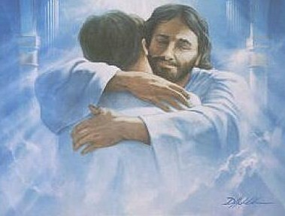
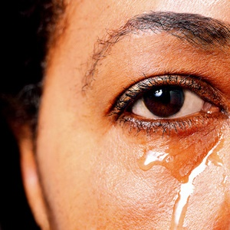
III. Hope in God’s promise of life restored

