Slide 1
DECEPETION
The game for the whole World
Notes:
Title card

Slide 2
Revelation 13:11
Then I saw another beast rising out of the earth. It had two horns like a lamb and spoke like a dragon.

Slide 3
Revelation 16:13 & 19:20
Then I saw 3 evil spirits that looked like frogs; they came out of the mouth of the dragon, out of the mouth of the beast and out of the mouth of the false prophet. (16:13)
But the beast was captured, and with him the false prophet who had performed the signs on his behalf . With these signs he had deluded those who had received the mark of the beast and worshipped his image. (19:20)

Slide 4
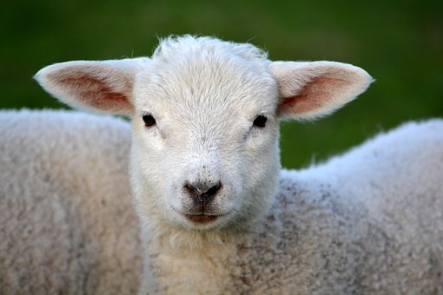

Slide 5
Revelation 5:6
Then I saw a Lamb, looking as if it had been slain, standing in the center before the throne, encircled by the four living creatures and the elders. The Lamb had seven horns and seven eyes, which are the seven spirits of God sent out to all the earth.

Slide 6
Revelation 14:1
Then I looked, and there before me was the Lamb, standing on Mount Zion, and with him 144,000 who had his name and his Father’s name written on their foreheads.

Slide 7
Matthew 7:15
“Watch out for false prophets. They come to you in sheep’s clothing, but inwardly they are ferocious wolves.

Slide 8
2 Thessalonians 2:3
Don’t let anyone deceive you in any way, for that day will not come until the rebellion occurs and the man of lawlessness is revealed.

Slide 9
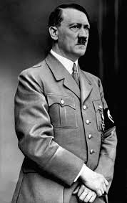

Slide 10
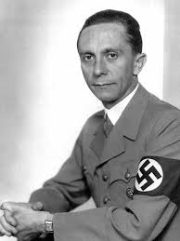
Joseph Goebbels

Slide 11
Revelation 13:12
It exercises all the authority of the first beast in its presence, and makes the earth and its inhabitants worship the first beast, whose mortal wound was healed.

Slide 12
Revelation 11:4
They are “the two olive trees” and the two lampstands and “they stand before the Lord of the earth.”

Slide 13
Revelation 13:13
It performs great signs, even making fire come down from heaven to earth in front of people,

Slide 14
Deuteronomy 13: 1-3
If a prophet, or one who foretells by dreams, appears among you and announces to you a sign or wonder, and if the sign or wonder spoken of takes place and the prophet says, “Let us follow other gods” (gods you have not known) “and let us worship them,” you must not listen to the words of that prophet or dreamer. The Lord your God is testing you to find out whether you love him with all your heart and with all your soul.

Slide 15
Mark 13:22
For false messiahs and false prophets will appear and perform signs and wonders to deceive, if possible, even the elect.

Slide 16
1 John 4:1-3
Dear friends, do not believe every spirit, but test the spirits to see whether they are from God, because many false prophets have gone out into the world. This is how you can recognize the Spirit of God: Every spirit that acknowledges that Jesus Christ has come in the flesh is from God, but every spirit that does not acknowledge Jesus is not from God. This is the spirit of the antichrist, which you have heard is coming and even now is already in the world.

Slide 17
1 Kings 18: 38-39
Then the fire of the Lord fell and burned up the sacrifice, the wood, the stones, and the soil, and also licked up the water in the trench. When all the people saw this they fell prostrate and cried, “The Lord-he is God! The Lord-he is God!

Slide 18
Revelation 11:5
If anyone tries to harm them, fire comes from their mouths and devours their enemies. This is how anyone who wants to harm them must die.

Slide 19
Revelation 13:14
and by the signs that it is allowed to work in the presence of the beast deceives those who dwell on earth telling them to make an image for the beast that was wounded by the sword and yet lived.

Slide 20
Revelation 13:15
And it was allowed to give breath to the image of the beast, so that the image of the beast might even speak and might cause those who would not worship the image of the beast to be slain.

Slide 21
Revelation 11:11
But after three and a half days the breath of life from God entered them, and they stood on their feet and terror struck those who saw them.

Slide 22
Revelation 13:16
Also it causes all, both small and great, both rich and poor, both free and slave, to be marked on the right hand or the forehead

Slide 23
Ezekliel 9:4-6a
And said to him , Go throughout the city of Jerusalem and put a mark on the foreheads of those who grieve and lament over all the detestable things that are done in it. As I listened, he said to the others, “Follow him through the city and kill, without showing pity or compassion. Slaughter the old men, the young men and women, the mothers and children, but do not touch anyone who has the mark.

Slide 24
Revelation 7: 3-4
“Do not harm the land or the sea or the trees until we put a seal on the foreheads of the servants of our God.”

Slide 25
Revelation 13:17
so that they could not buy or sell unless they had the mark, which is the name of the beast or the number of its name.

Slide 26
Revelation 13:18
This calls for wisdom: let the one who has understanding calculate the number of the beast, for it is the number of a man, and his number is 666.

Slide 27
Revelation 17:11
The beast who once was, and now is not, is an eighth king. He belongs to the seven and is going to his destruction.

Slide 28
Revelation 15:2
And I saw what looked like a sea of glass glowing with fire and, standing beside the sea, those who had been victorious over the beast and his image and the number of his name.

Slide 29
Matthew 7:16-20
By their fruit you will recognize them. Do people pick grapes from thorn bushes, or figs from thistles? Likewise, every good tree bears good fruit, but a bad tree bears bad fruit, and a bad tree cannot bear good fruit. Every tree that does not bear good fruit is cut down and thrown into the fire. Thus, by their fruit you will recognize them.

